Slide 1
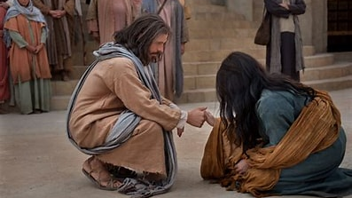
Reaching the Lost
God’s Plan
Matthew 4:12-25

Slide 2
Mark 16:15-16
Mark 16:15-16 (NASB)
¹⁵ And He said to them, “Go into all the world and preach the gospel to all creation. ¹⁶ The one who has believed and has been baptized will be saved; but the one who has not believed will be condemned.

Slide 3

Reaching the Lost

Slide 4
Invite Them In
John 4:28-29 (NASB)
²⁸ So the woman left her waterpot and went into the city, and *said to the people, ²⁹ “Come, see a Man who told me all the things that I have done; this is not the Christ, is He?”

Slide 5
Preach the Word
Hebrews 4:12 (NASB)
¹² For the word of God is living and active, and sharper than any two-edged sword, even penetrating as far as the division of soul and spirit, of both joints and marrow, and able to judge the thoughts and intentions of the heart.

Slide 6
Replace Our Predecessors
Matthew 4:17 (NASB)
¹⁷ From that time Jesus began to preach and say, “Repent, for the kingdom of heaven has come near.”

Slide 7
Train Others for the Task
Proverbs 22:6 (NASB)
⁶ Train up a child in the way he should go,
Even when he grows older, he will not abandon it.

Slide 8
Focus on Jesus’ Preaching
Matthew 28:20 (NASB)
²⁰ teaching them to follow all that I commanded you; and behold, I am with you always, to the end of the age.”

Slide 9
Denounce False Teaching
Revelation 2:2-3 (NASB)
² ‘I know your deeds and your labor and perseverance, and that you cannot tolerate evil people, and you have put those who call themselves apostles to the test, and they are not, and you found them to be false; ³ and you have perseverance and have endured on account of My name and have not become weary.

Slide 10

Be A Soul Winner for Jesus

