Slide 1

Our Eternal Soul

Slide 2
John 11:25-26
²⁵ Jesus said to her, “I am the resurrection and the life; the one who believes in Me will live, even if he dies, ²⁶ and everyone who lives and believes in Me will never die. Do you believe this?”

Slide 3

1 John 2:17
¹⁷ The world is passing away and also its lusts; but the one who does the will of God continues to live forever.

Slide 4
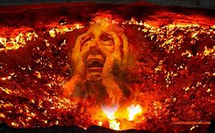
Luke 16:24
²⁴ …for I am tormented in this flame.’

Slide 5
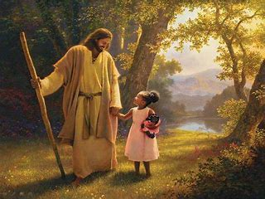

Luke 23:43
⁴³ And He said to him, “Truly I say to you, today you will be with Me in Paradise.”

Slide 6
Awareness of the Soul
Luke 16:23-24 (NKJV)
²³ And being in torments in Hades, he lifted up his eyes and saw Abraham afar off, and Lazarus in his bosom. ²⁴ “Then he cried and said, ‘Father Abraham, have mercy on me, and send Lazarus that he may dip the tip of his finger in water and cool my tongue; for I am tormented in this flame.’

Slide 7
Awareness of the Soul
Luke 16:25, 27-28 (NKJV)
²⁵ But Abraham said, ‘Son, remember that in your lifetime you received your good things, and likewise Lazarus evil things; but now he is comforted and you are tormented.
²⁷ “Then he said, ‘I beg you therefore, father, that you would send him to my father’s house, ²⁸ for I have five brothers, that he may testify to them, lest they also come to this place of torment.’

Slide 8
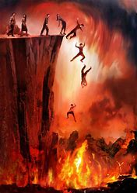
Final Destination
Revelation 20:14-15
¹⁴ Then Death and Hades were cast into the lake of fire. This is the second death. ¹⁵ And anyone not found written in the Book of Life was cast into the lake of fire.

Slide 9

Final Destination
Matthew 25:21
²¹ His lord said to him, ‘Well done, good and faithful servant; you were faithful over a few things, I will make you ruler over many things. Enter into the joy of your lord.’

Slide 10
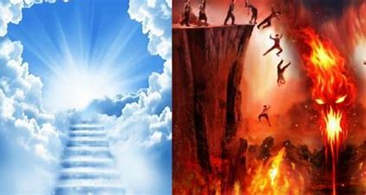
Where Will You Spend Eternity?

