Slide 1
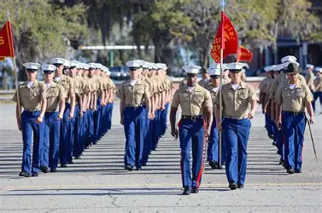
Looking for a Few Good Men
And Women

Slide 2
Matthew 9:37-38
³⁷ Then He *said to His disciples, “The harvest is plentiful, but the workers are few. ³⁸ Therefore, plead with the Lord of the harvest to send out workers into His harvest.”

Slide 3
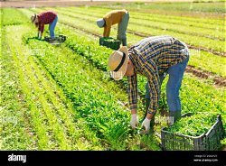
Traits of a Good Worker

Slide 4
Unselfish in All Things
Philippians 2:7-8 (NASB)
⁷ but emptied Himself by taking the form of a bond-servant and being born in the likeness of men. ⁸ And being found in appearance as a man, He humbled Himself by becoming obedient to the point of death: death on a cross.

Slide 5
Seeks the Good of Others
1 Corinthians 10:24 (NASB)
²⁴ No one is to seek his own advantage, but rather that of his neighbor.

Slide 6
Cares for the Needy
Matthew 10:42 (NASB)
⁴² And whoever gives one of these little ones just a cup of cold water to drink in the name of a disciple, truly I say to you, he shall by no means lose his reward.”

Slide 7
Concerned for the Welfare of Others
Philippians 2:19-20 (NASB)
¹⁹ But I hope, in the Lord Jesus, to send Timothy to you shortly, so that I also may be encouraged when I learn of your condition. ²⁰ For I have no one else of kindred spirit who will genuinely be concerned for your welfare.

Slide 8
Proven Character
Philippians 2:22 (NASB)
²² But you know of his proven character, that he served with me in the furtherance of the gospel like a child serving his father.

Slide 9
Give Honor to These
Philippians 2:29-30 (NASB)
²⁹ Receive him then in the Lord with all joy, and hold people like him in high regard, ³⁰ because he came close to death for the work of Christ, risking his life to compensate for your absence in your service to me.

Slide 10
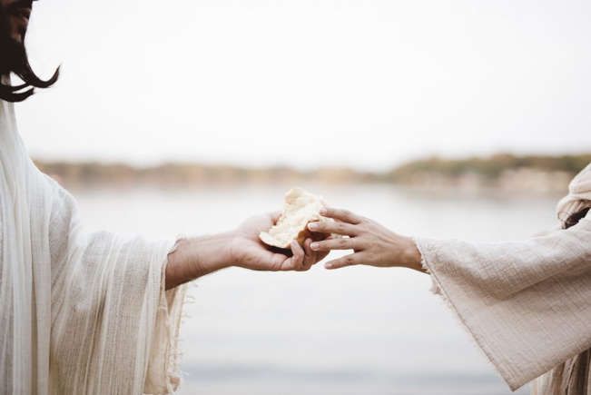
Colossians 3:23
²³ Whatever you do, do your work heartily, as for the Lord and not for people,

