Slide 1

Job Requirements
To Be a Disciple of Christ

Slide 2
Matthew 28:19-20
¹⁹ Go, therefore, and make disciples of all the nations, baptizing them in the name of the Father and the Son and the Holy Spirit, ²⁰ teaching them to follow all that I commanded you; and behold, I am with you always, to the end of the age.”

Slide 3
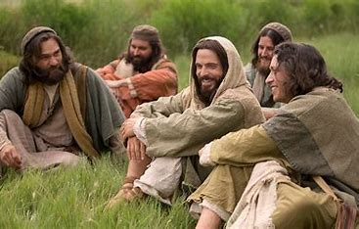
To Be a Disciple of Christ

Slide 4
Get Your House in Order
Philippians 2:12 (NASB)
¹² So then, my beloved, just as you have always obeyed, not as in my presence only, but now much more in my absence, work out your own salvation with fear and trembling;

Slide 5
Work With Confidence
Philippians 2:13 (NASB)
¹³ for it is God who is at work in you, both to desire and to work for His good pleasure.

Slide 6
Work Willingly
Philippians 2:14 (NASB)
¹⁴ Do all things without complaining or arguments;

Slide 7
Work Blamelessly
Philippians 2:15 (NASB)
¹⁵ so that you will prove yourselves to be blameless and innocent, children of God above reproach in the midst of a crooked and perverse generation, among whom you appear as lights in the world,

Slide 8
Strong in the Word
Philippians 2:16 (NASB)
¹⁶ holding firmly the word of life, so that on the day of Christ I can take pride because I did not run in vain nor labor in vain.

Slide 9
Be Happy in Your Work
Philippians 2:17-18 (NASB)
¹⁷ But even if I am being poured out as a drink offering upon the sacrifice and service of your faith, I rejoice and share my joy with you all. ¹⁸ You too, I urge you, rejoice in the same way and share your joy with me.

Slide 10

Be a Disciple of Christ
Know the Joy that Comes from Serving God

