Slide 1
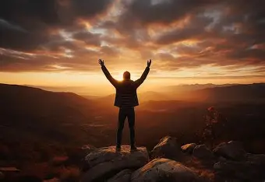
Encourage One Another
Philippians 2:9-11

Slide 2
1 Thessalonians 5:9-11
⁹ For God has not destined us for wrath, but for obtaining salvation through our Lord Jesus Christ, ¹⁰ who died for us, so that whether we are awake or asleep, we will live together with Him. ¹¹ Therefore, encourage one another and build one another up, just as you also are doing.

Slide 3
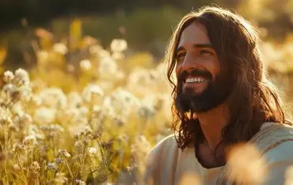
Encourage One Another

Slide 4
We Will Have Trials
John 16:33 (NASB)
³³ These things I have spoken to you so that in Me you may have peace. In the world you have tribulation but take courage; I have overcome the world.”

Slide 5
Help Those Who Need
Isaiah 25:4 (NASB)
⁴ For You have been a stronghold for the helpless, A stronghold for the poor in his distress, A refuge from the storm, a shade from the heat; For the breath of the ruthless Is like a rainstorm against a wall.

Slide 6
Spirit Helps Us
John 14:17 (NASB)
¹⁷ the Helper is the Spirit of truth, whom the world cannot receive, because it does not see Him or know Him; but you know Him because He remains with you and will be in you.

Slide 7
Christ is With Us
Matthew 28:20 (NASB)
²⁰ teaching them to follow all that I commanded you; and behold, I am with you always, to the end of the age.”

Slide 8
Those Who Overcome
Revelation 2:7 (NASB)
⁷ The one who has an ear, let him hear what the Spirit says to the churches. To the one who overcomes, I will grant to eat from the tree of life, which is in the Paradise of God.’

Slide 9
Heaven Our Reward
Matthew 5:12 (NASB)
¹² Rejoice and be glad, for your reward in heaven is great; for in this same way they persecuted the prophets who were before you.

Slide 10


