Slide 1
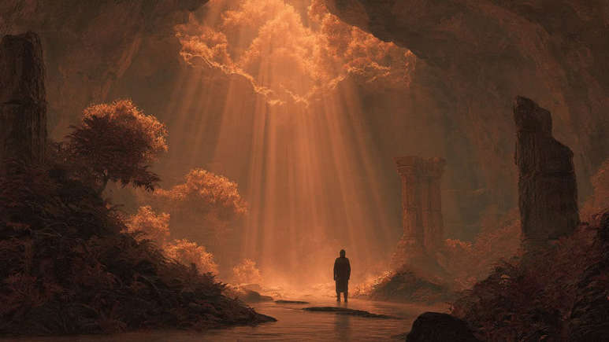
Making Our Way Back Home

Slide 2
1 John 1:8-9
⁸ If we say that we have no sin, we are deceiving ourselves and the truth is not in us. ⁹ If we confess our sins, He is faithful and righteous, so that He will forgive us our sins and cleanse us from all unrighteousness.

Slide 3
How Do We Come Back?

Slide 4
First Step
Luke 15:16-17 (NASB)
¹⁶ And he longed to have his fill of the carob pods that the pigs were eating, and no one was giving him anything. ¹⁷ But when he came to his senses, he said, ‘How many of my father’s hired laborers have more than enough bread, but I am dying here from hunger!

Slide 5
Second, Seek God
Luke 15:18 (NASB)
¹⁸ I will set out and go to my father, and will say to him, “Father, I have sinned against heaven, and in your sight;

Slide 6
Third, Humble Yourself
Luke 15:19 (NASB)
¹⁹ I am no longer worthy to be called your son; treat me as one of your hired laborers.”’

Slide 7
Fourth, Seek Forgiveness
1 John 1:9 (NASB)
⁹ If we confess our sins, He is faithful and righteous, so that He will forgive us our sins and cleanse us from all unrighteousness.

Slide 8
Re-Baptism/Baptism?
For What Were You Baptized?
Acts 2:38 (NASB) - ³⁸ Peter said to them, “Repent, and each of you be baptized in the name of Jesus Christ for the forgiveness of your sins; and you will receive the gift of the Holy Spirit.
Ephesians 4:5 (NASB) - ⁵ one Lord, one faith, one baptism,

Slide 9
Re-Baptism/Baptism?
1 John 4:17 (NASB)
¹⁷ By this, love is perfected with us, so that we may have confidence in the day of judgment; because as He is, we also are in this world.

Slide 10

Revelation 2:4-5
⁴ …that you have left your first love. ⁵ Therefore, remember from where you have fallen, and repent, and do the deeds you did at first;…

