Slide 1
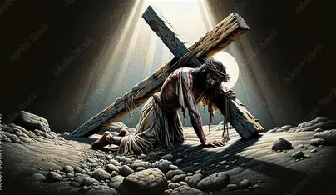
Why is There Suffering

Slide 2
Romans 8:18
¹⁸ For I consider that the sufferings of this present time are not worthy to be compared with the glory that is to be revealed to us.

Slide 3
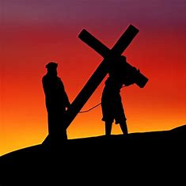
Why is There Suffering in the World Today?

Slide 4
Origin of Suffering
Genesis 3:17-19 (NASB)
¹⁷ Then to Adam He said, “Because you have listened to the voice of your wife, and have eaten from the tree about which I commanded you, saying, ‘You shall not eat from it’; Cursed is the ground …; With hard labor …¹⁸ Both thorns and thistles …¹⁹ By the sweat of your face …shall eat bread,…

Slide 5
Christ Suffered Also
1 Peter 3:18 (NASB)
¹⁸ For Christ also suffered for sins once for all time, the just for the unjust, so that He might bring us to God, having been put to death in the flesh, but made alive in the spirit;

Slide 6
He Weeps in Our Suffering
John 11:33-35 (NASB)
³³ Therefore when Jesus saw her weeping, and the Jews who came with her also weeping, He was deeply moved in spirit and was troubled, ³⁴ and He said, “Where have you laid him?” They *said to Him, “Lord, come and see.” ³⁵ Jesus wept.

Slide 7
We Have Help
1 John 2:1 (NASB)
2 My little children, I am writing these things to you so that you may not sin. And if anyone sins, we have an Advocate with the Father, Jesus Christ the righteous;

Slide 8
We Are Made Perfect
1 Peter 5:10 (NASB)
¹⁰ After you have suffered for a little while, the God of all grace, who called you to His eternal glory in Christ, will Himself perfect, confirm, strengthen, and establish you.

Slide 9
Philippians 4:4-7
⁴ Rejoice in the Lord always; again. I will say, rejoice! ⁵ Let your gentle spirit be known to all people. The Lord is nearby. ⁶ Do not be anxious about anything, …

Slide 10
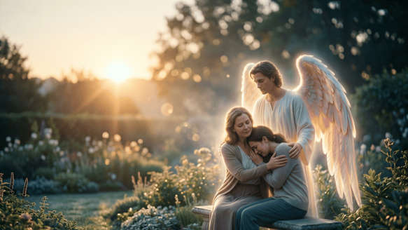
Philippians 4:4-7
⁶ …but in everything by prayer and pleading with thanksgiving let your requests be made known to God. ⁷ And the peace of God, which surpasses all comprehension, will guard your hearts and minds in Christ Jesus.

