Slide 1
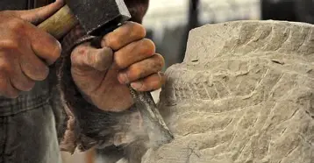
Building Upon the Foundation
1 Corinthians 3:10-15

Slide 2
Matthew 16:18
¹⁸ And I also say to you that you are Peter, and upon this rock I will build My church; and the gates of Hades will not overpower it.

Slide 3
Be Careful How You Build
1 Corinthians 3:10-15

Slide 4
God Has Laid the Foundation
1 Corinthians 3:10 (NASB)
¹⁰ According to the grace of God which was given to me, like a wise master builder I laid a foundation, and another is building on it. But each person must be careful how he builds on it.

Slide 5
We Are to Build Upon It
1 Corinthians 3:10 (NASB)
¹⁰ According to the grace of God which was given to me, like a wise master builder I laid a foundation, and another is building on it. But each person must be careful how he builds on it.

Slide 6
We Must Be Careful
1 Corinthians 3:10 (NASB)
¹⁰ According to the grace of God which was given to me, like a wise master builder I laid a foundation, and another is building on it. But each person must be careful how he builds on it.

Slide 7
Your Work Will Be Reveled
1 Corinthians 3:13 (NASB)
¹³ each one’s work will become evident; for the day will show it because it is to be revealed with fire, and the fire itself will test the quality of each one’s work.

Slide 8
Tested By Fire
1 Corinthians 3:13 (NASB)
¹³ each one’s work will become evident; for the day will show it because it is to be revealed with fire, and the fire itself will test the quality of each one’s work.

Slide 9
Judged By Our Works
Revelation 20:12 (NKJV)
¹² And I saw the dead, small and great, standing before God, and books were opened. And another book was opened, which is the Book of Life. And the dead were judged according to their works, by the things which were written in the books.

Slide 10
Psalm 118:22
²² A stone which the builders rejected
Has become the chief cornerstone.

