Slide 1
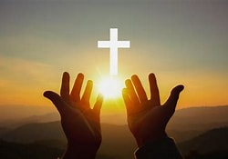
Faith in Action

Slide 2
Matthew 5:16
¹⁶ Your light must shine before people in such a way that they may see your good works and glorify your Father who is in heaven.

Slide 3

The Sign of God in You!

Slide 4
Command to Do
Matthew 7:21 (NASB)
²¹ “Not everyone who says to Me, ‘Lord, Lord,’ will enter the kingdom of heaven, but the one who does the will of My Father who is in heaven will enter.

Slide 5
Command to Do
John 14:15 (NASB)
¹⁵ “If you love Me, you will keep My commandments.

Slide 6
Command to Do
Luke 6:46 (NASB)
⁴⁶ “Now why do you call Me, ‘Lord, Lord,’ and do not do what I say?

Slide 7
Action is Motivated by Faith
James 2:22 (NASB)
²² You see that faith was working with his works, and as a result of the works, faith was perfected;

Slide 8
Identifies Who You Are
Matthew 7:16 (NASB)
¹⁶ You will know them by their fruits. Grapes are not gathered from thorn bushes, nor figs from thistles, are they?

Slide 9
Response to God’s Word
Romans 10:17 (NASB)
¹⁷ So faith comes from hearing, and hearing by the word of Christ.

Slide 10
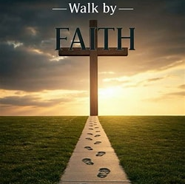
2 Corinthians
5:7-8
⁷ for we walk by faith, not by sight— ⁸ but we are of good courage and prefer rather to be absent from the body and to be at home with the Lord.

