Slide 1
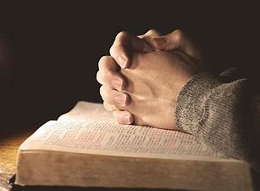

Prayer of
Thanksgiving
For
You!

Slide 2
Colossians 1:1-3
1 Paul, an apostle of Christ Jesus by the will of God, and Timothy our brother,
² To the saints and faithful brothers and sisters in Christ who are at Colossae: Grace to you and peace from God our Father.
³ We give thanks to God, the Father of our Lord Jesus Christ, praying always for you,

Slide 3
Paul’s
Thankfulness
For
Christians

Slide 4
Paul Prayed for Them
Colossians 1:3 (NASB)
³ We give thanks to God, the Father of our Lord Jesus Christ, praying always for you,

Slide 5
Because of Their Faith
Colossians 1:4 (NASB)
⁴ since we heard of your faith in Christ Jesus and the love which you have for all the saints;

Slide 6
Because of Their Love
Colossians 1:4 (NASB)
⁴ since we heard of your faith in Christ Jesus and the love which you have for all the saints;

Slide 7
Because of Their Hope
Colossians 1:5 (NASB)
⁵ because of the hope reserved for you in heaven, of which you previously heard in the word of truth, the gospel

Slide 8
Because of Their Fruit
Colossians 1:6 (NASB)
⁶ which has come to you, just as in all the world also it is bearing fruit and increasing, even as it has been doing in you also since the day you heard it and understood the grace of God in truth;

Slide 9
Jesus’ Prayer for Us
John 17:22-26 (NASB)
²² The glory which You have given Me I also have given to them, so that they may be one, just as We are one; ²³ I in them and You in Me, that they may be perfected in unity, so that the world may know that You sent Me, and You loved them, just as You loved Me.

Slide 10
Jesus’ Prayer for Us
²⁴ Father, I desire that they also, whom You have given Me, be with Me where I am, so that they may see My glory which You have given Me, for You loved Me before the foundation of the world.

Slide 11
Jesus’ Prayer for Us
²⁵ “Righteous Father, although the world has not known You, yet I have known You; and these have known that You sent Me; ²⁶ and I have made Your name known to them, and will make it known, so that the love with which You loved Me may be in them, and I in them.”

Slide 12
I thank God for YOU!

