Slide 1
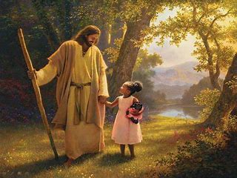

Appropriate and Profitable Living
“Our Goals
in Life”

Slide 2
1 Corinthians 10:23-24
²³ All things are permitted, but not all things are of benefit. All things are permitted, but not all things build people up. ²⁴ No one is to seek his own advantage, but rather that of his neighbor.

Slide 3
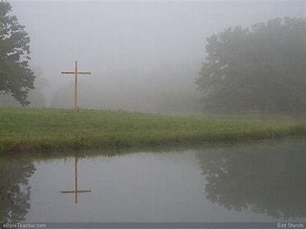
Living a Christ Centered Life

Slide 4
Problem at Corinth
1 Corinthians 10:25 (NASB)
²⁵ Eat anything that is sold in the meat market without asking questions, for the sake of conscience;

Slide 5
Conclusion of Everything
Ecclesiastes 12:13 (NASB)
¹³ The conclusion, when everything has been heard, is: fear God and keep His commandments, because this applies to every person.

Slide 6
Go Preach and Teach
Matthew 28:19 (NASB)
¹⁹ Go, therefore, and make disciples of all the nations, baptizing them in the name of the Father and the Son and the Holy Spirit,

Slide 7
Seek Good for All
1 Corinthians 10:24 (NASB)
²⁴ No one is to seek his own advantage, but rather that of his neighbor.

Slide 8
Give No Offense
2 Corinthians 6:3 (NASB)
³ giving no reason for taking offense in anything, so that the ministry will not be discredited,

Slide 9
Build Each Other Up
1 Corinthians 10:23 (NASB)
²³ All things are permitted, but not all things are of benefit. All things are permitted, but not all things build people up.

Slide 10

Therefore, whether you eat or drink, or whatever you do, do all things for the glory of God.

