Slide 1
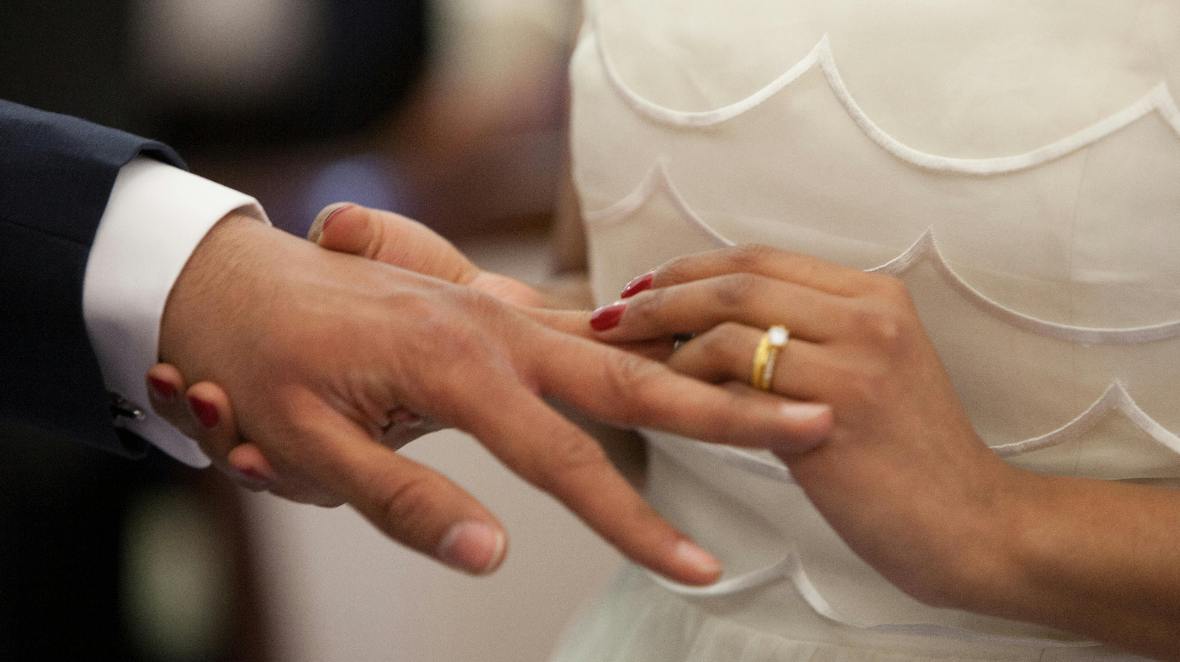
Lifelong Commitment

Slide 2
Genesis 2:23-24
²³ Then the man said, “At last, this is bone of my bones, And flesh of my flesh; She shall be called ‘woman,’ Because she was taken out of man.” ²⁴ For this reason a man shall leave his father and his mother and be joined to his wife; and they shall become one flesh.

Slide 3

How Are We Committed?

Slide 4
Romantic Love
Genesis 24:67 (NASB)
⁶⁷ Then Isaac brought her into his mother Sarah’s tent, and he took Rebekah, and she became his wife, and he loved her; so, Isaac was comforted after his mother’s death.
He First Made the Commitment
Then He Loved Her

Slide 5
Committed to Each Other
Genesis 2:24 (NASB)
²⁴ For this reason a man shall leave his father and his mother and be joined to his wife; and they shall become one flesh.

Slide 6
Committed to Love
Ephesians 5:24-25 (NASB)
²⁴ But as the church is subject to Christ, so also the wives, ought to be to their husbands in everything. ²⁵ Husbands, love your wives, just as Christ also loved the church and gave Himself up for her,

Slide 7
Committed to Children
Proverbs 22:6 (NASB)
⁶ Train up a child in the way he should go, Even when he grows older, he will not abandon it.

Slide 8
Committed to Christ
Ephesians 5:24-25 (NASB)
²⁴ But as the church is subject to Christ, so also the wives, ought to be to their husbands in everything. ²⁵ Husbands, love your wives, just as Christ also loved the church and gave Himself up for her,

Slide 9
Begins With Commitment
Joshua 24:15 (NASB)
¹⁵ But if it is disagreeable in your sight to serve the Lord, choose for yourselves today whom you will serve: whether the gods which your fathers served, which were beyond the Euphrates River, or the gods of the Amorites in whose land you are living; but as for me and my house, we will serve the Lord.”

Slide 10
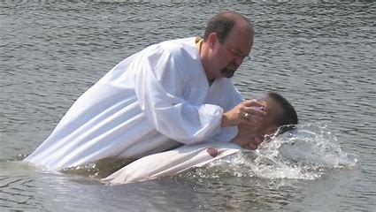
Lifelong Commitment
Follow God; Keep His Commandments

