Slide 1
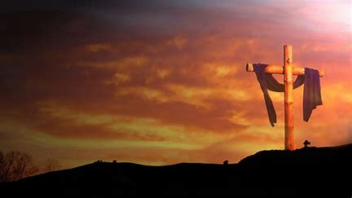
Seeing God Through Trials

Slide 2
James 1:2-4
² Consider it all joy, my brothers and sisters, when you encounter various trials, ³ knowing that the testing of your faith produces endurance. ⁴ And let endurance have its perfect result, so that you may be perfect and complete, lacking in nothing.

Slide 3


Slide 4
God Works Through Us
Isaiah 6:8 (NASB)
⁸ Then I heard the voice of the Lord, saying, “Whom shall I send, and who will go for Us?” Then I said, “Here am I. Send me!”

Slide 5
Your Faith Grows
James 1:2-3 (NASB)
² Consider it all joy, my brothers and sisters, when you encounter various trials, ³ knowing that the testing of your faith produces endurance.

Slide 6
Gospel is Proclaimed
Philippians 1:12 (NASB)
¹² Now I want you to know, brothers and sisters, that my circumstances have turned out for the greater progress of the gospel,

Slide 7
The World is Watching
Philippians 1:13 (NASB)
¹³ so that my imprisonment in the cause of Christ has become well known throughout the praetorian guard and to everyone else,

Slide 8
Encourages Others
Philippians 1:14 (NASB)
¹⁴ and that most of the brothers and sisters, trusting in the Lord because of my imprisonment, have far more courage to speak the word of God without fear.

Slide 9
We Are Perfected
James 1:4 (NASB)
⁴ And let endurance have its perfect result, so that you may be perfect and complete, lacking in nothing.

Slide 10
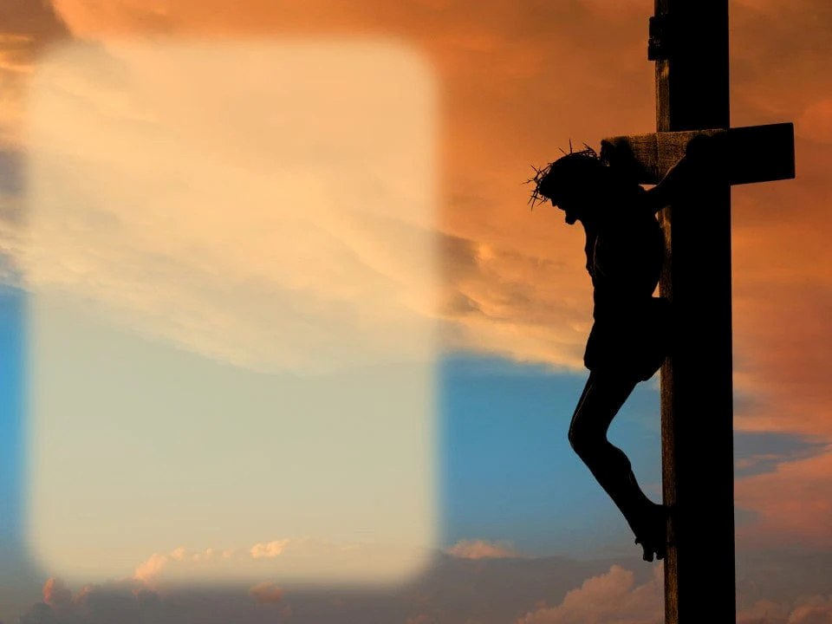
⁵ For just as the sufferings of Christ are ours in abundance, so also our comfort is abundant through Christ.

