Slide 1
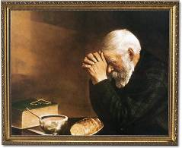
Looking to the Future with Prayer

Slide 2
Philippians 1:9
⁹ And this I pray, that your love may overflow still more and more in real knowledge and all discernment,

Slide 3
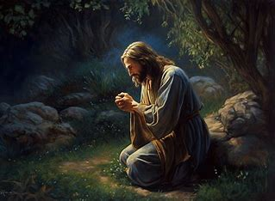
Approaching our Future with Prayer to God

Slide 4
Your Love May Grow
Philippians 1:9 (NASB)
⁹ And this I pray, that your love may overflow still more and more in real knowledge and all discernment,

Slide 5
Your Knowledge will Increase
Philippians 1:9 (NASB)
⁹ And this I pray, that your love may overflow still more and more in real knowledge and all discernment,

Slide 6
Grow in Understanding
Philippians 1:9 (NASB)
⁹ And this I pray, that your love may overflow still more and more in real knowledge and all discernment,

Slide 7
Examine and Test
Philippians 1:10 (NASB)
¹⁰ so that you may discover the things that are excellent, that you may be sincere and blameless for the day of Christ;

Slide 8
Be Sincere and Blameless
Philippians 1:10 (NASB)
¹⁰ so that you may discover the things that are excellent, that you may be sincere and blameless for the day of Christ;

Slide 9
Be Filled with Righteousness
Philippians 1:11 (NASB)
¹¹ having been filled with the fruit of righteousness which comes through Jesus Christ, for the glory and praise of God.

Slide 10

All Things Come Through Jesus Christ

