Slide 1

WELCOME
LET US WORSHIP
TOGETHER!

Slide 2
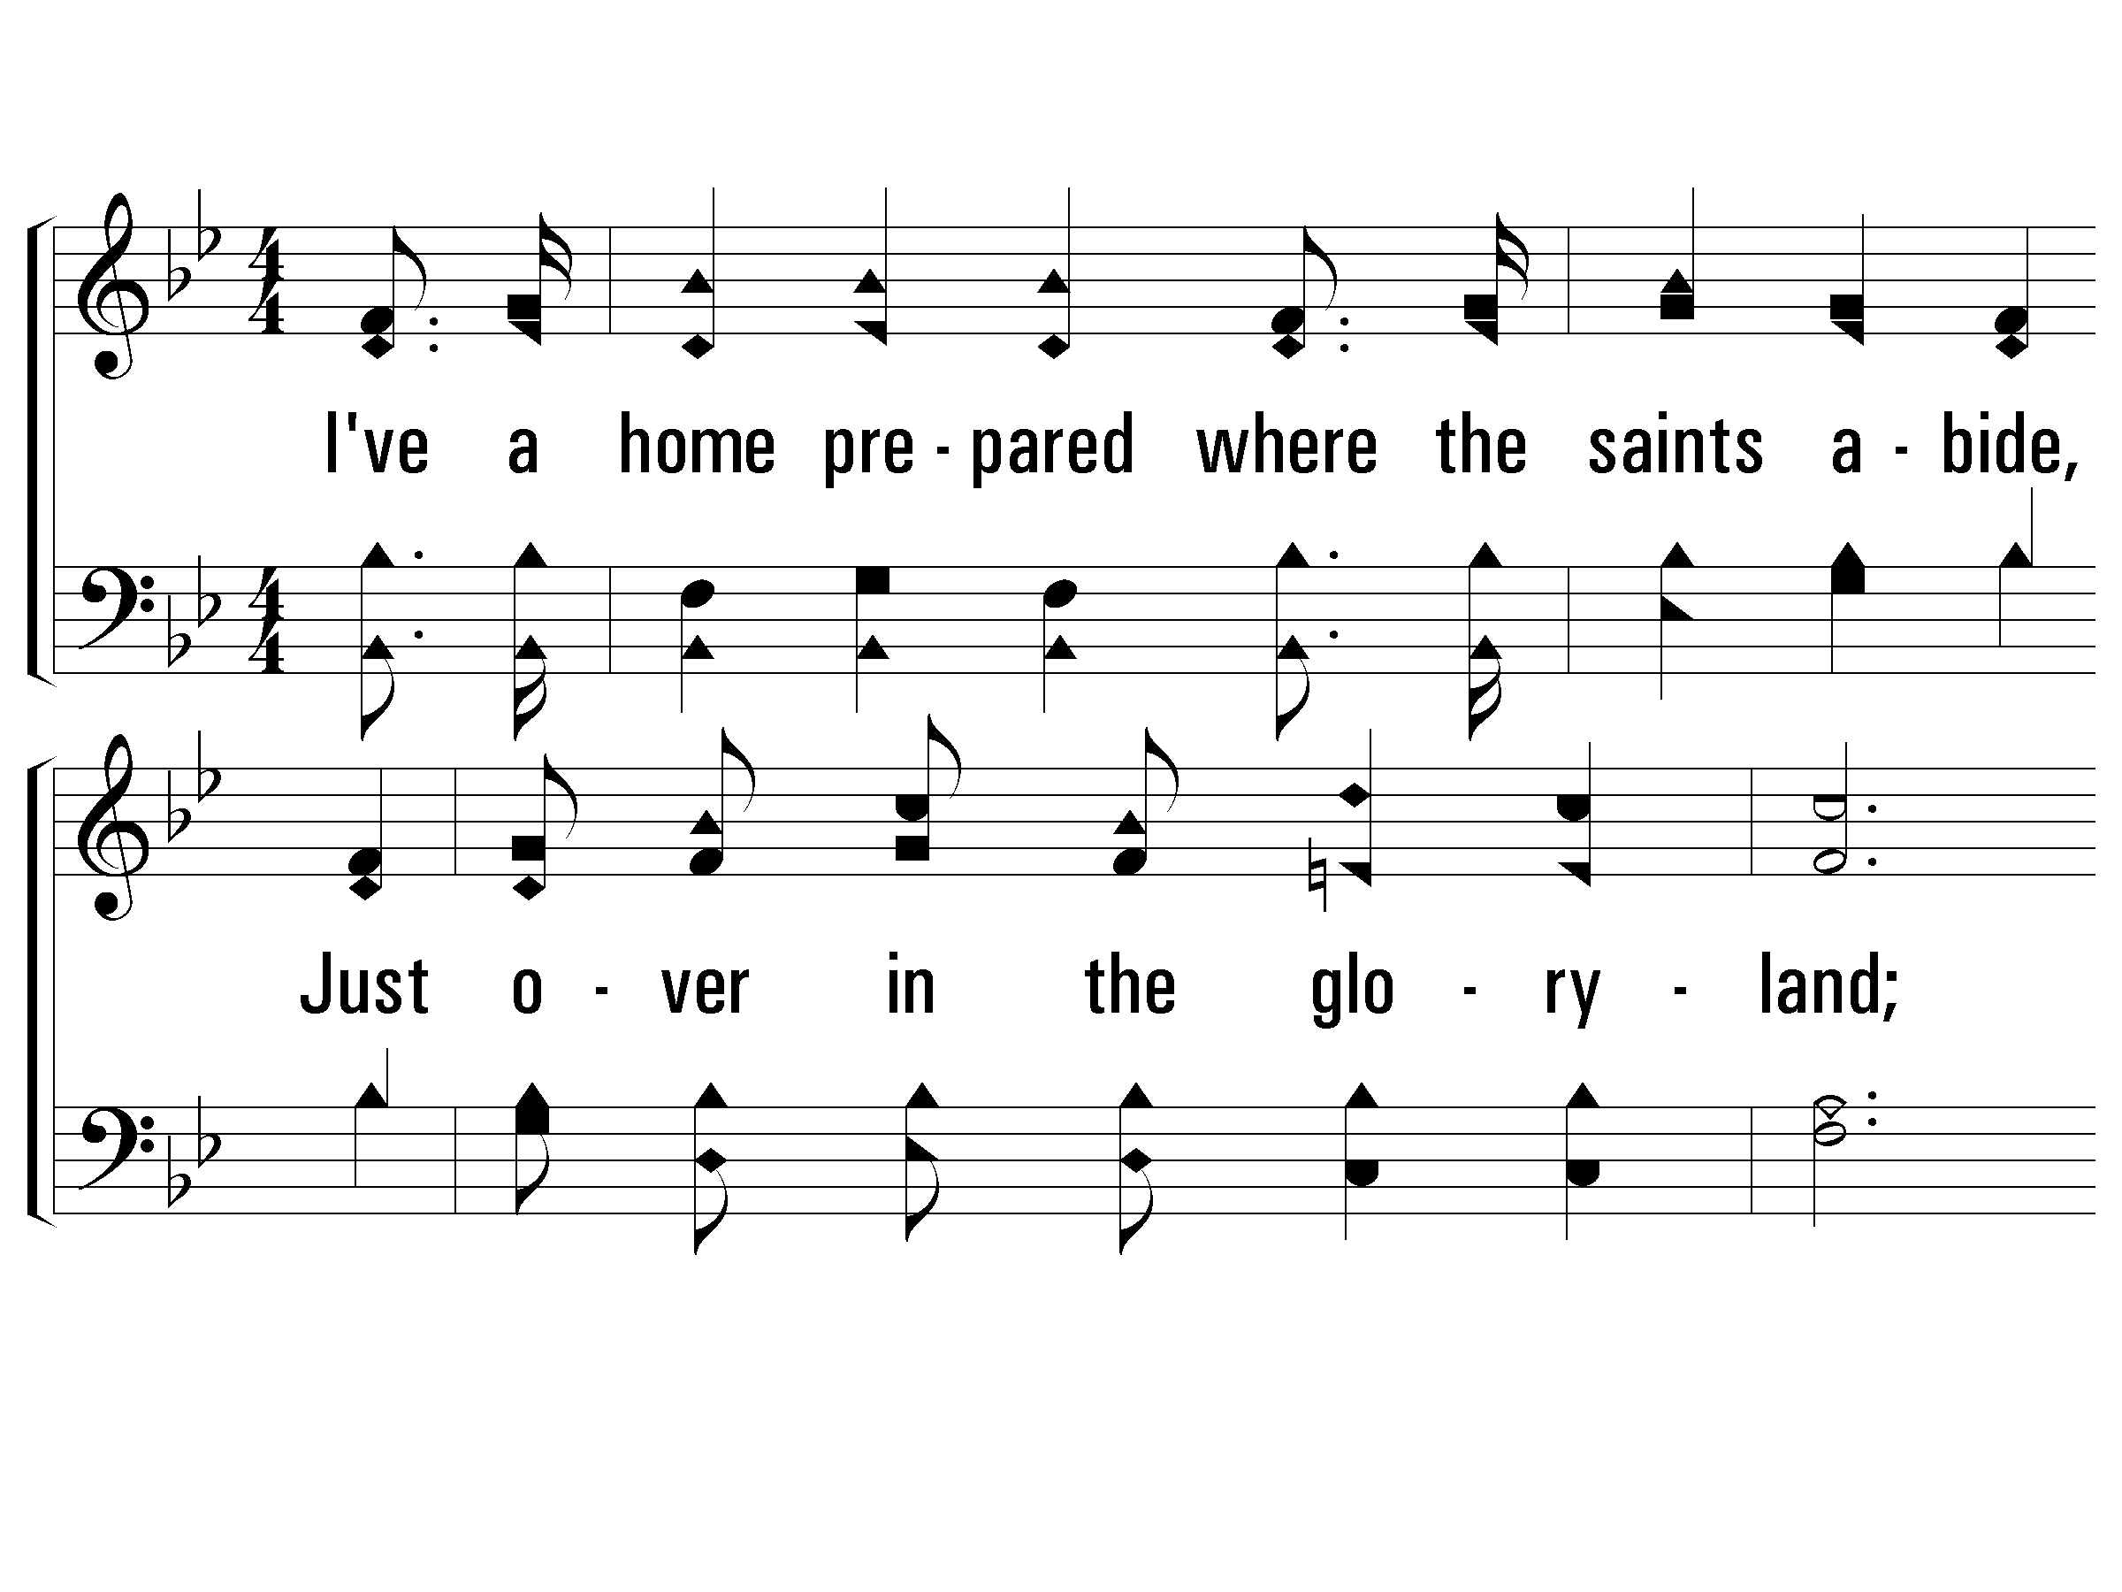
1 – Just Over In the Glory-Land
1.
I've a home prepared where the saints abide,
Just over in the glory-land;
And I long to be by my Savior's side,
Just over in the glory-land.
Words: James W. Acuff
Music: Emmett S. Dean
© 2002 The Paperless Hymnal™

Slide 3
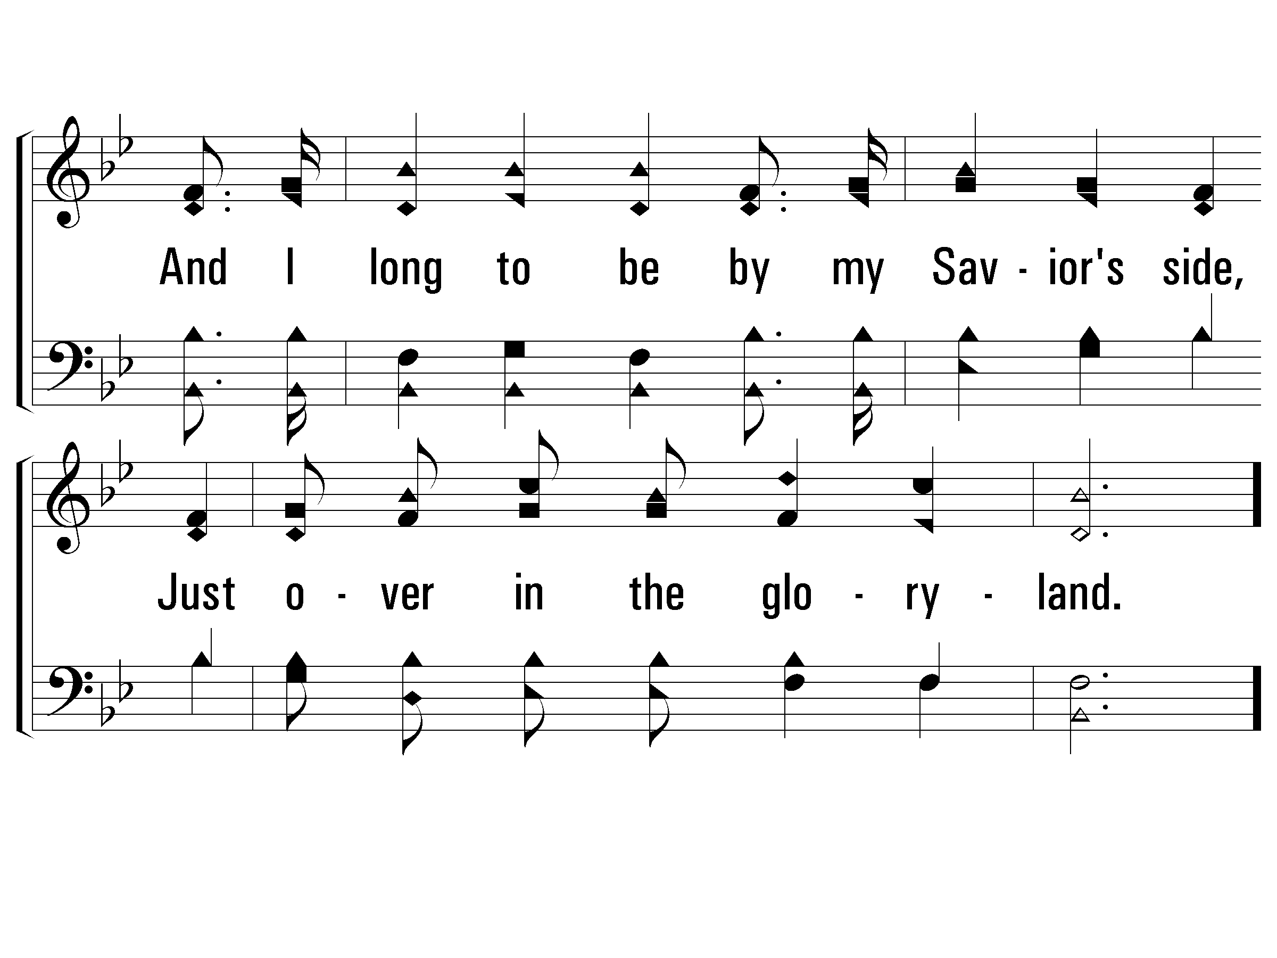
1 – Just Over In the Glory-Land
© 2002 The Paperless Hymnal™

Slide 4
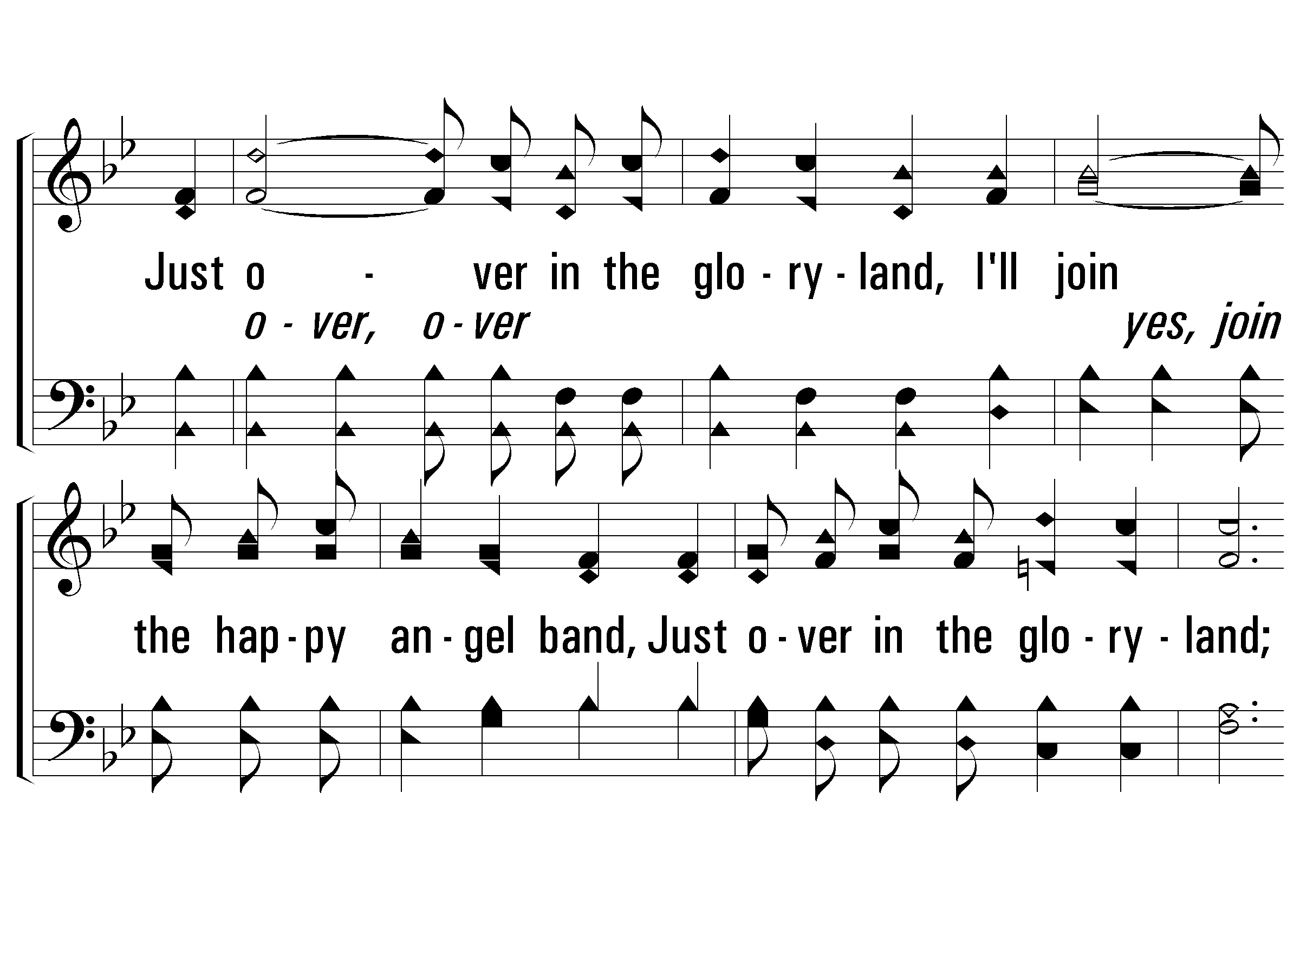
c – Just Over In the Glory-Land
Just over in the glory-land,
I'll join the happy angel band,
Just over in the glory-land;
Just over in the glory-land,
There with the mighty host I'll stand,
just over in the glory-land.
© 2002 The Paperless Hymnal™

Slide 5
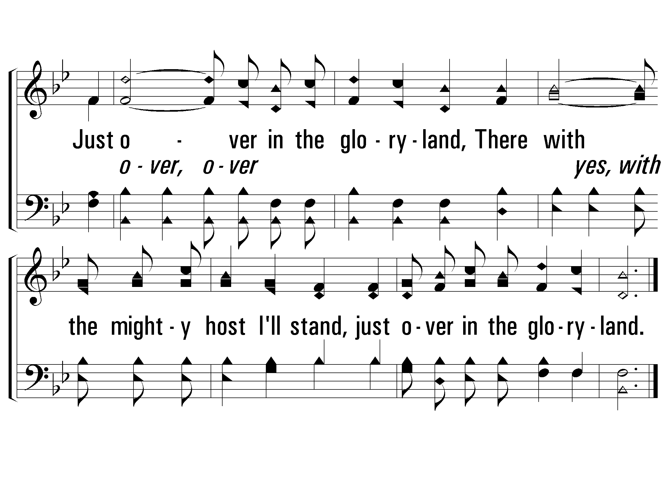
c – Just Over In the Glory-Land
© 2002 The Paperless Hymnal™

Slide 6
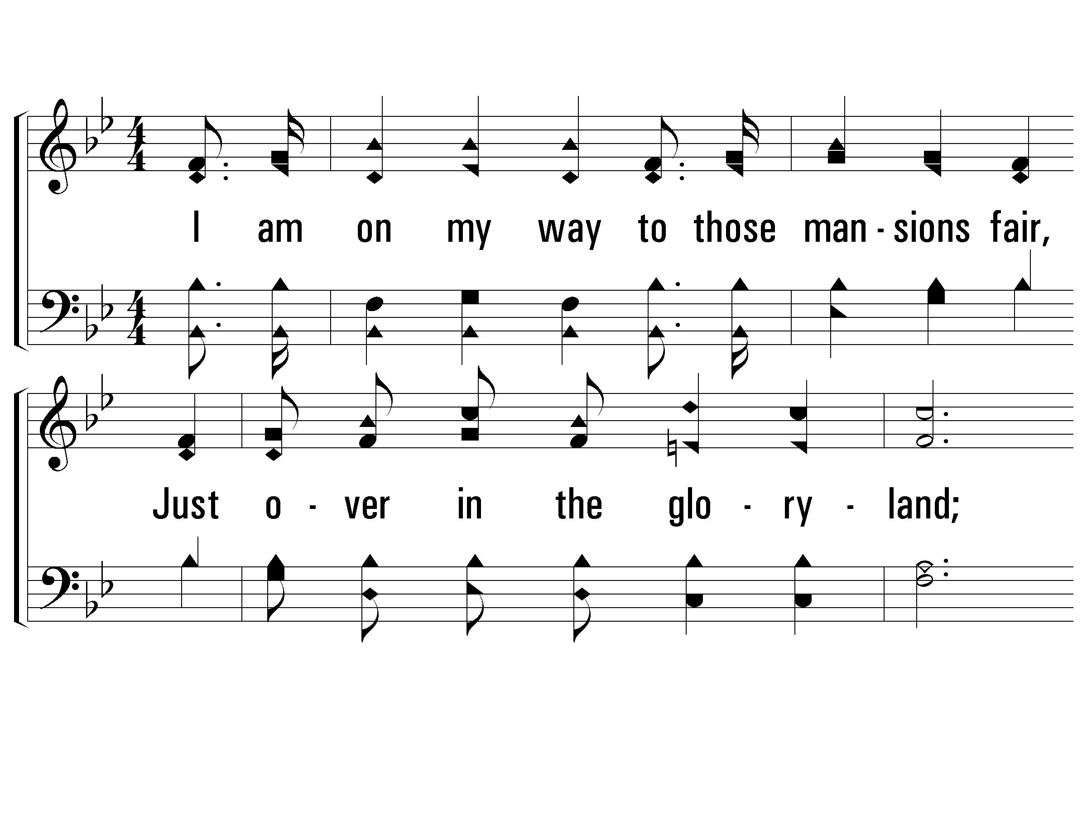
2 – Just Over In the Glory-Land
2.
I am on my way to those mansions fair,
Just over in the glory-land;
There to sing God's praise, and His glory share,
Just over in the glory-land.
Words: James W. Acuff
Music: Emmett S. Dean
© 2002 The Paperless Hymnal™

Slide 7
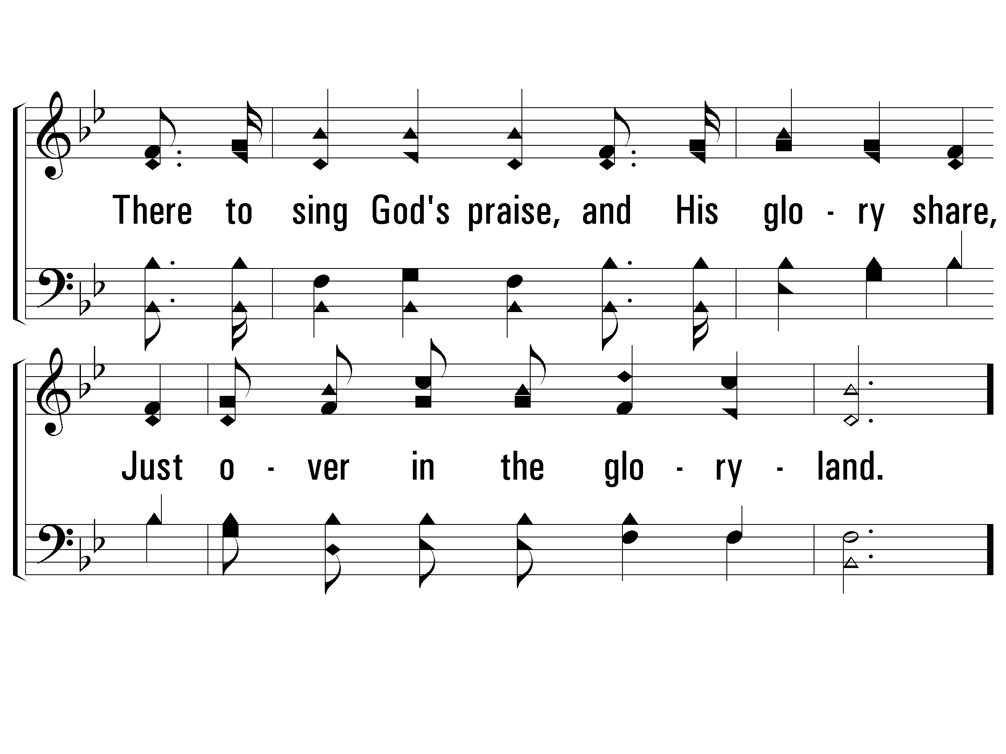
2 – Just Over In the Glory-Land
© 2002 The Paperless Hymnal™

Slide 8
c – Just Over In the Glory-Land
Just over in the glory-land,
I'll join the happy angel band,
Just over in the glory-land;
Just over in the glory-land,
There with the mighty host I'll stand,
just over in the glory-land.
© 2002 The Paperless Hymnal™

Slide 9
c – Just Over In the Glory-Land
© 2002 The Paperless Hymnal™

Slide 10
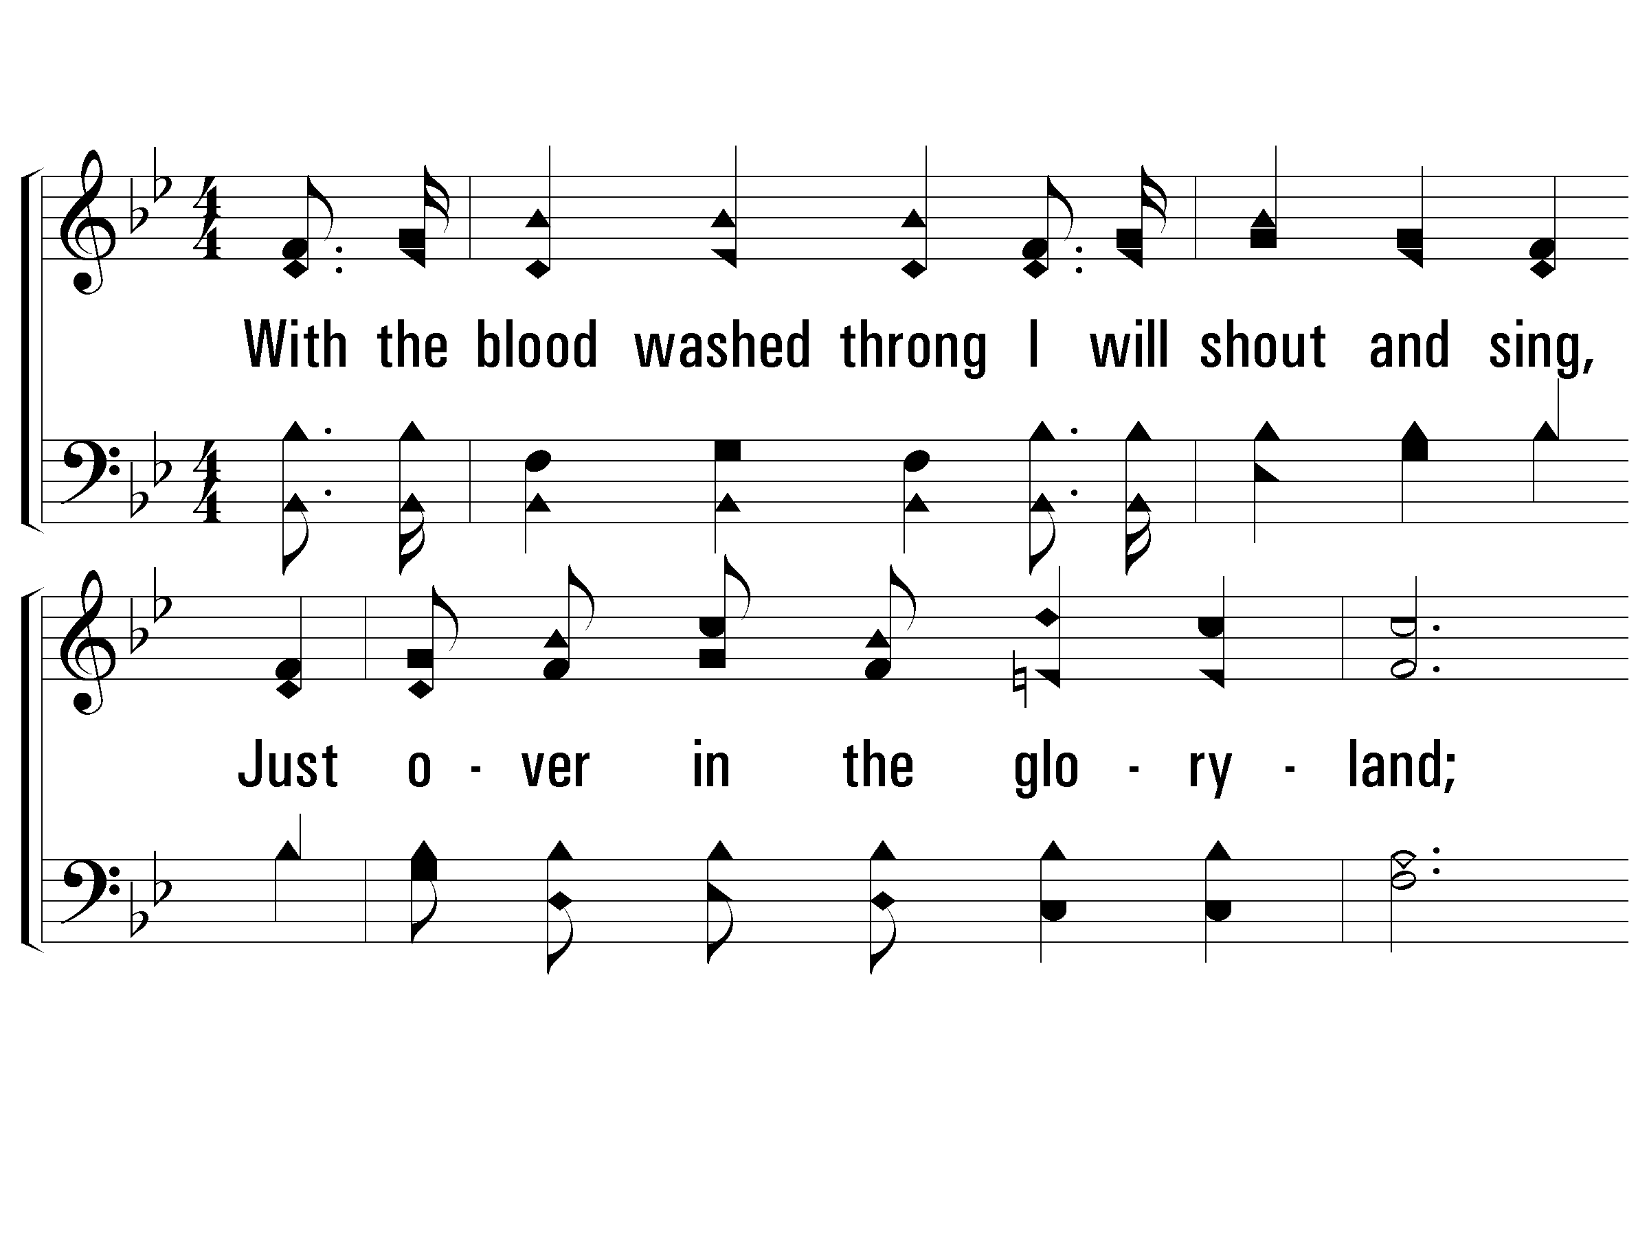
4 – Just Over In the Glory-Land
4.
With the blood washed throng I will shout and sing,
Just over in the glory-land;
Glad hosannas to Christ, the Lord and King,
Just over in the glory-land.
Words: James W. Acuff
Music: Emmett S. Dean
© 2002 The Paperless Hymnal™

Slide 11
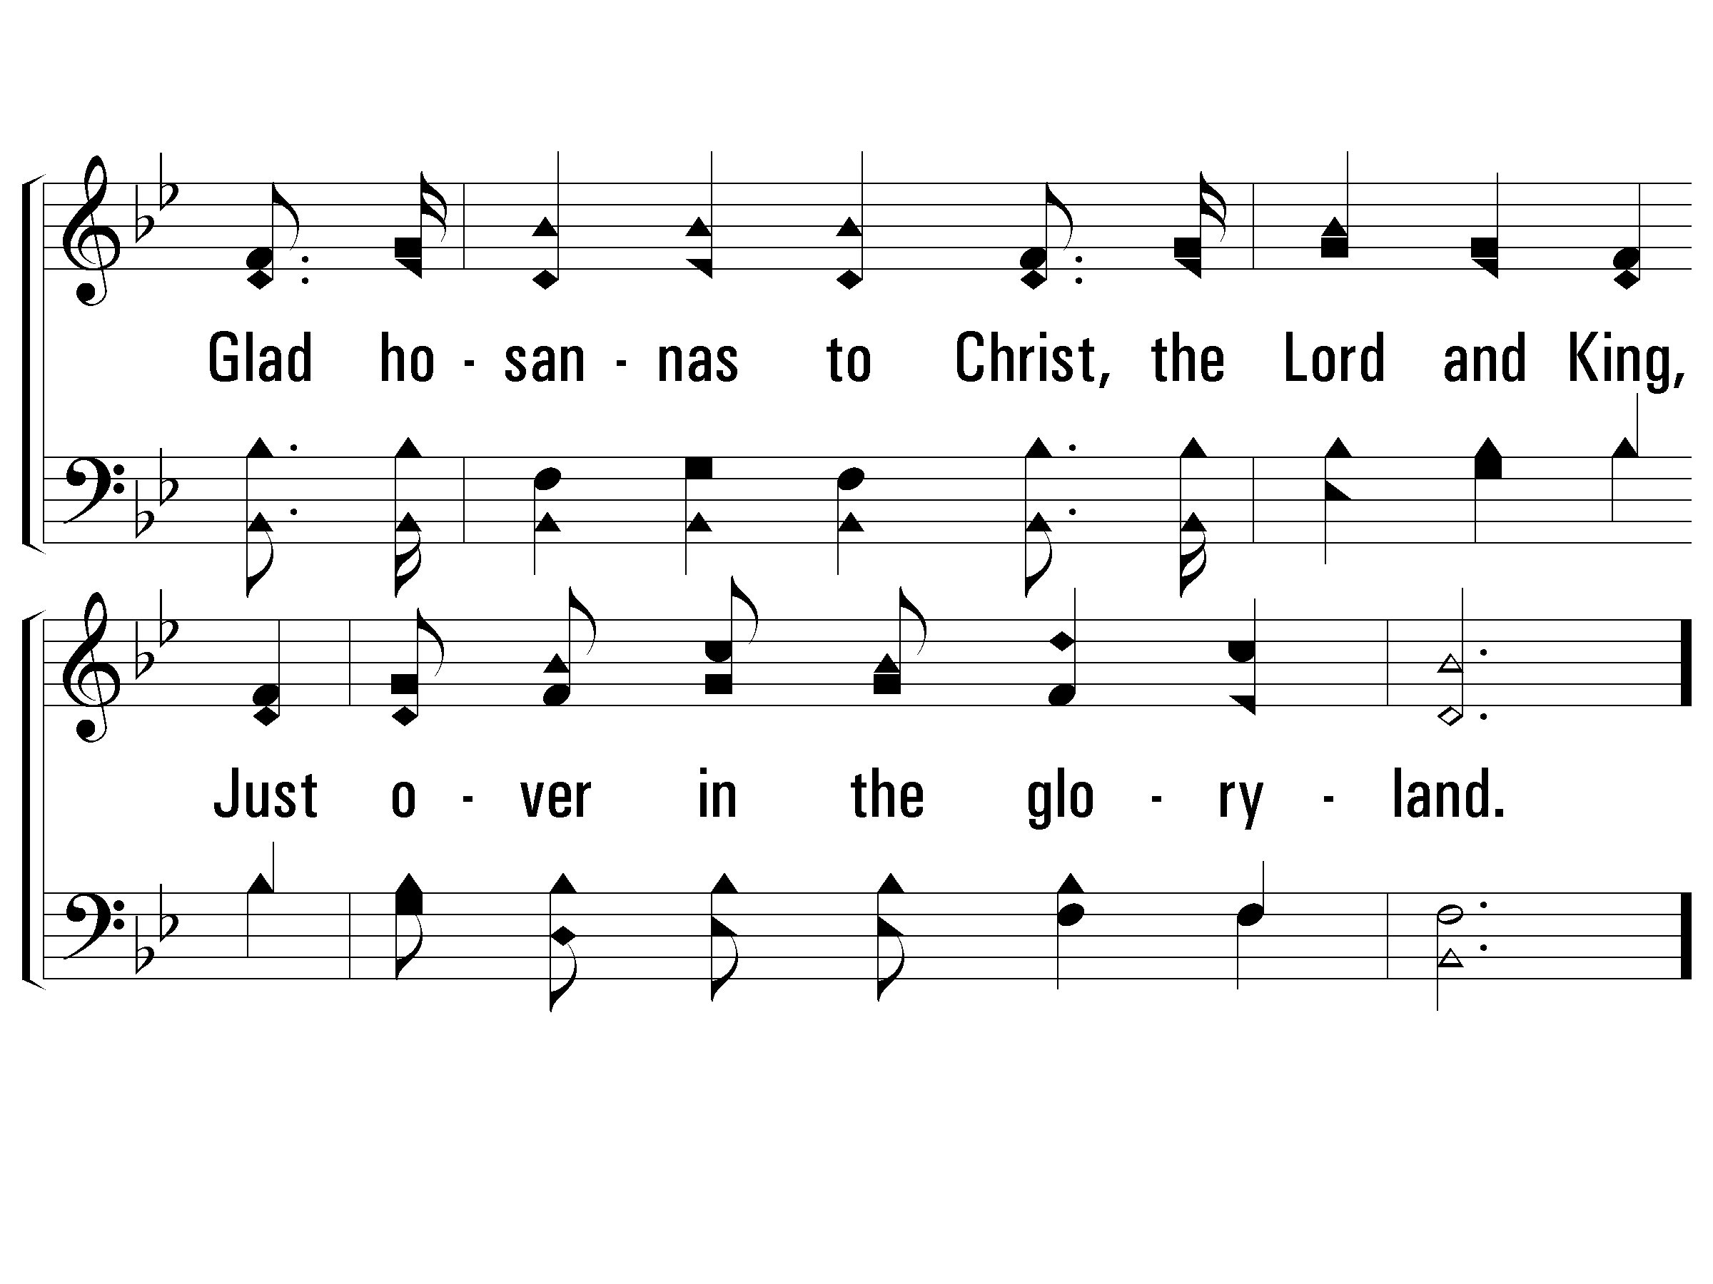
4 – Just Over In the Glory-Land
© 2002 The Paperless Hymnal™

Slide 12
c – Just Over In the Glory-Land
Just over in the glory-land,
I'll join the happy angel band,
Just over in the glory-land;
Just over in the glory-land,
There with the mighty host I'll stand,
just over in the glory-land.
Announcement leader come forward
© 2002 The Paperless Hymnal™

Slide 13
c – Just Over In the Glory-Land
© 2002 The Paperless Hymnal™

Slide 14

-ANNOUCNEMENTS-
FIRST TIME HERE?
We’d Love To Meet You
STAY AFTER SERVICE & GET TO KNOW US

Slide 15
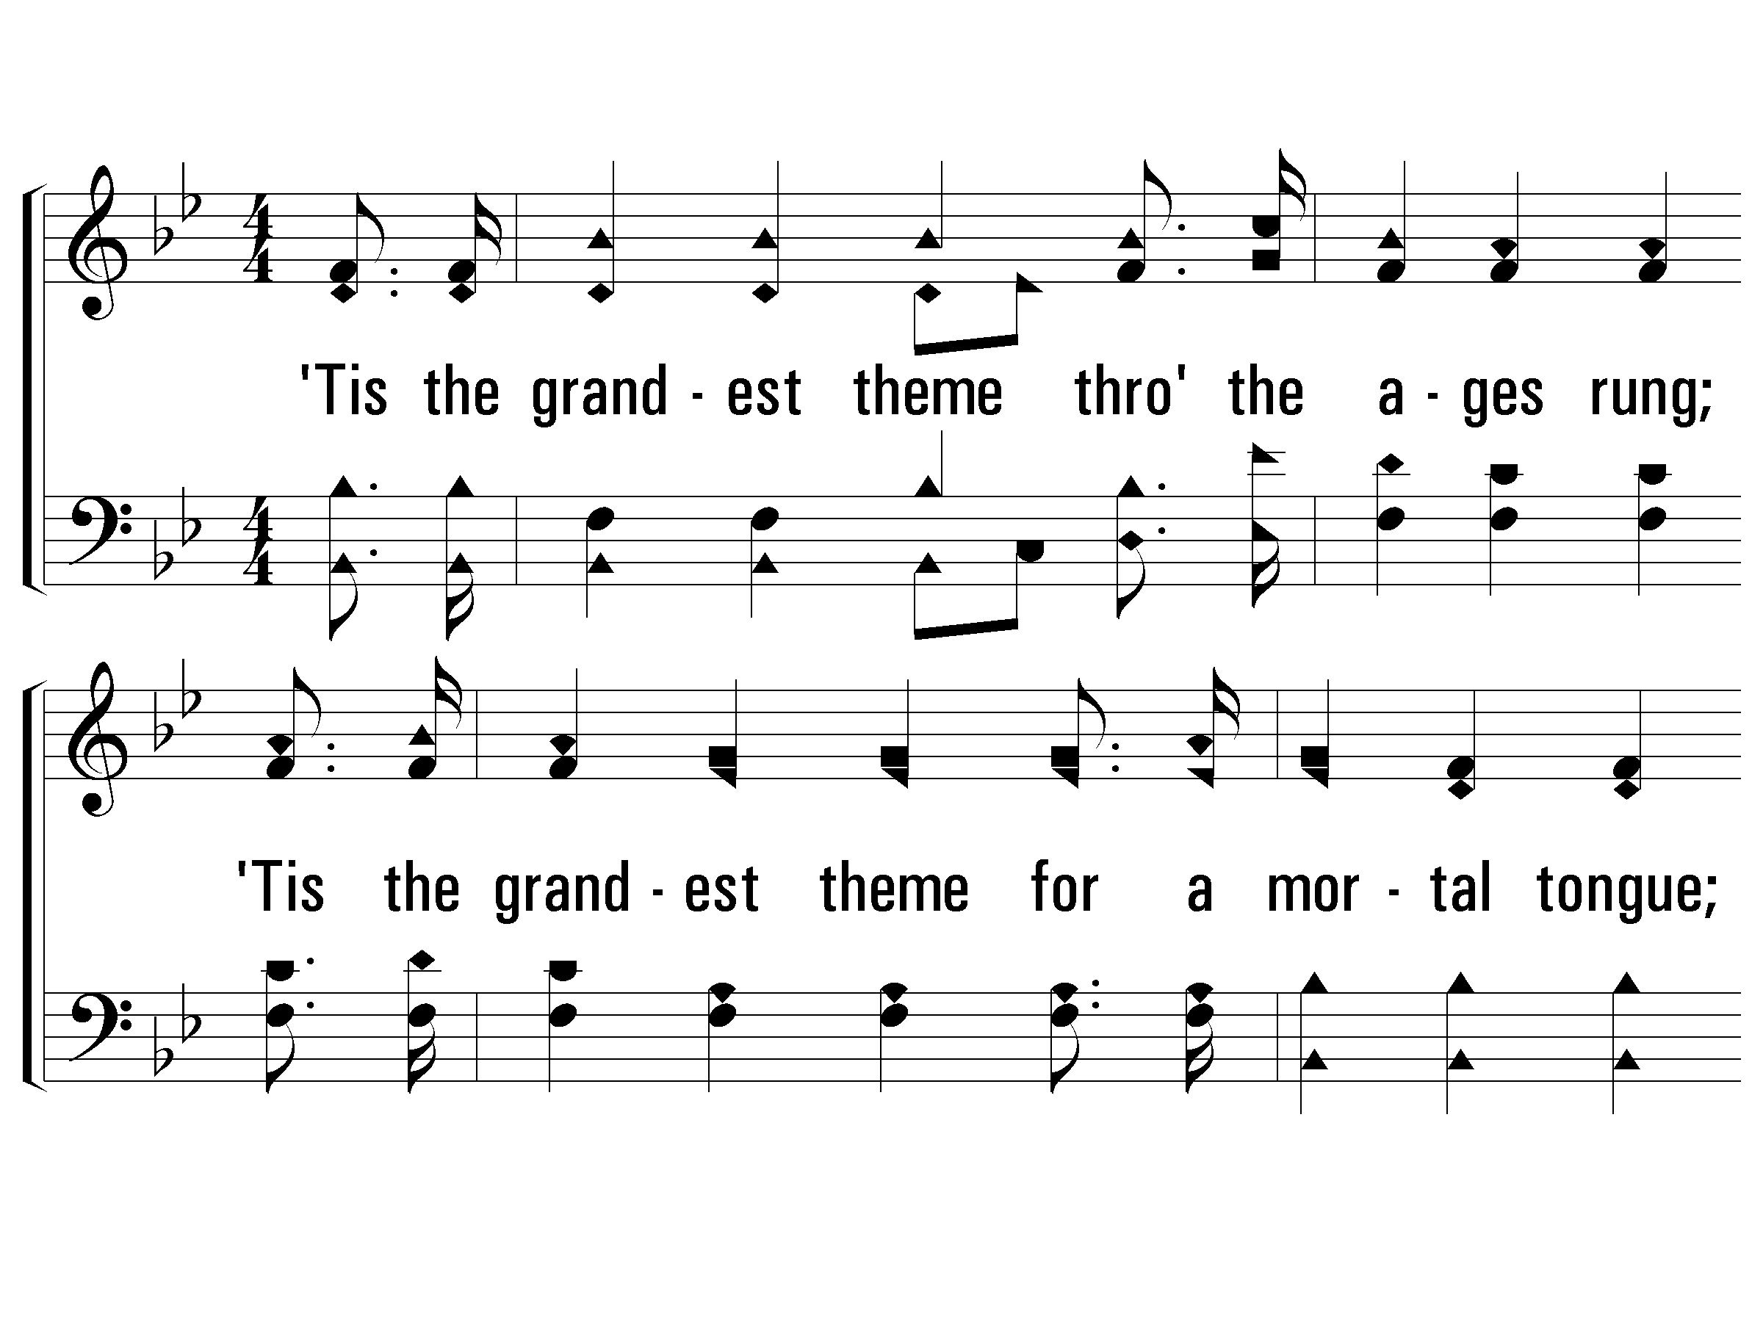
1 - He Is Able to Deliver Thee
1.
'Tis the grandest theme through the ages rung;
'Tis the grandest theme for a mortal tongue;
'Tis the grandest theme that the world ever sung,
"Our God is able to deliver thee."
Words & Music: William A. Ogden
© 2007 The Paperless Hymnal®

Slide 16
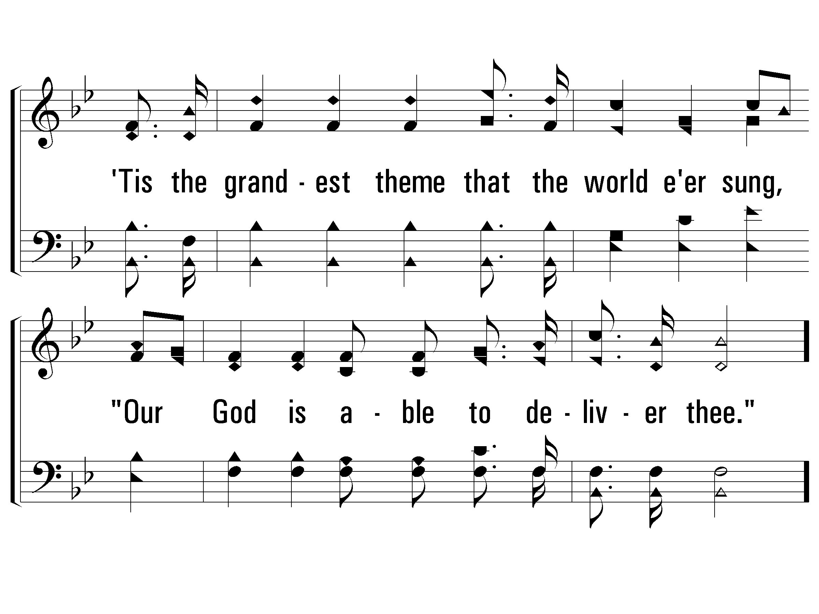
1 - He Is Able to Deliver Thee
© 2007 The Paperless Hymnal®

Slide 17
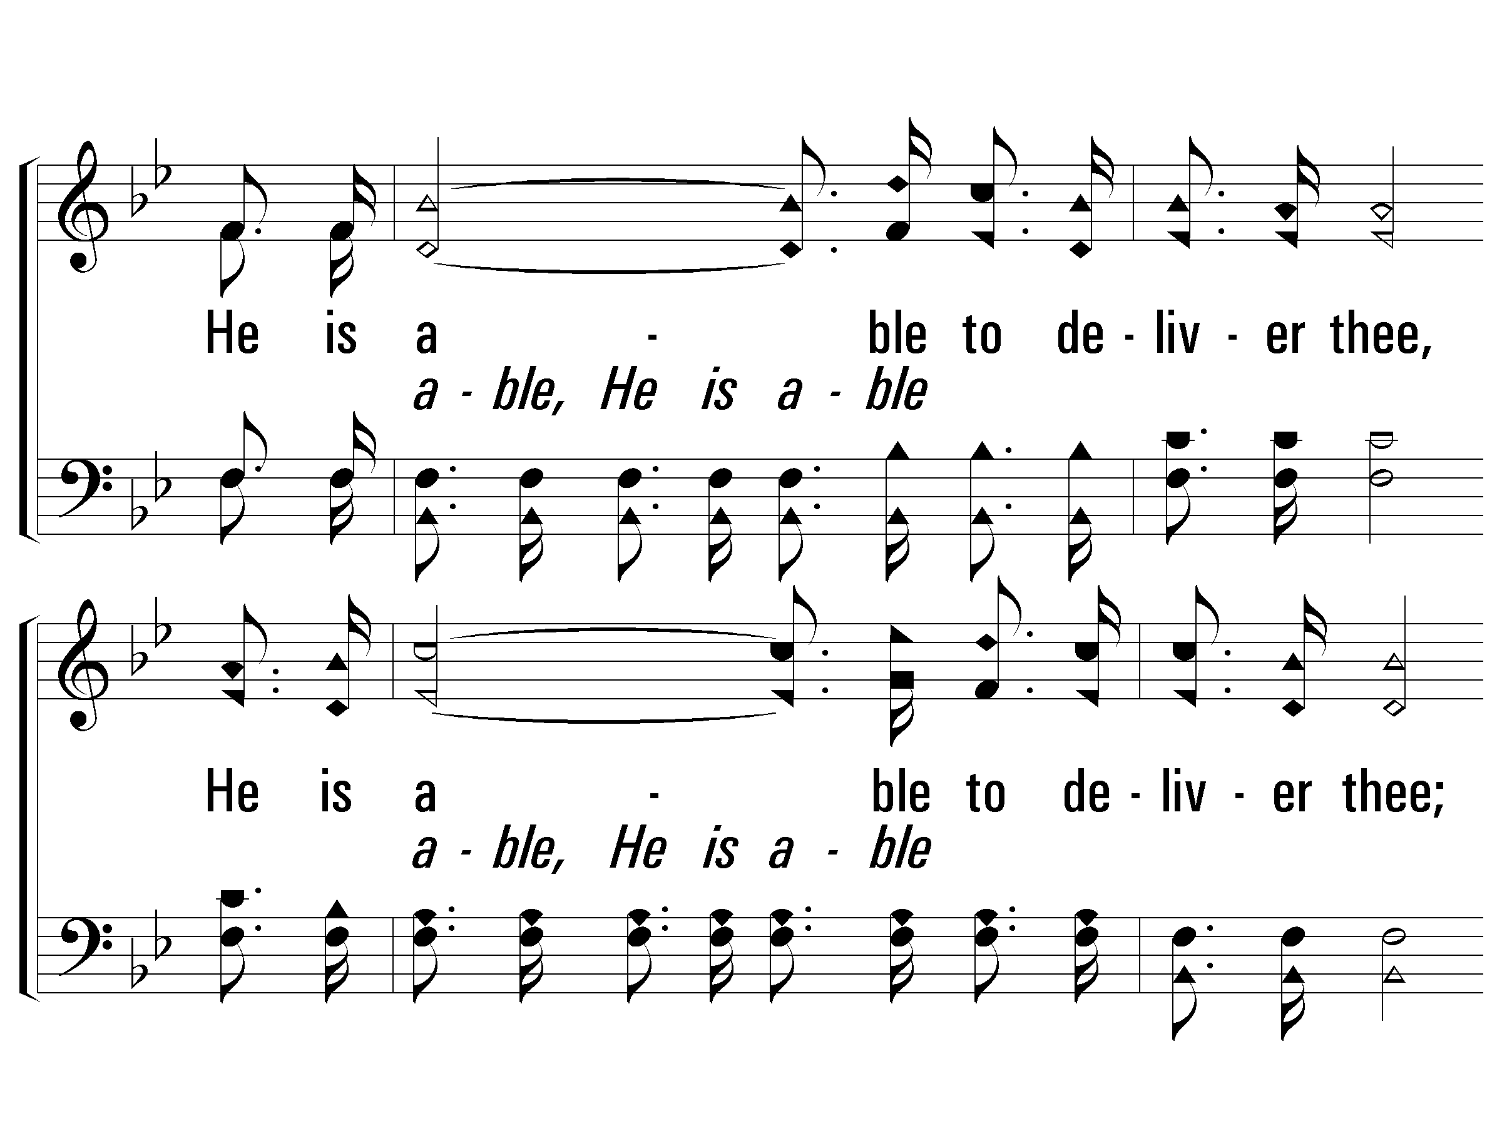
c - He Is Able to Deliver Thee
He is able to deliver thee,
He is able to deliver thee;
Though by sin oppressed, Go to Him for rest;
"Our God is able to de-liver thee."
© 2007 The Paperless Hymnal®

Slide 18
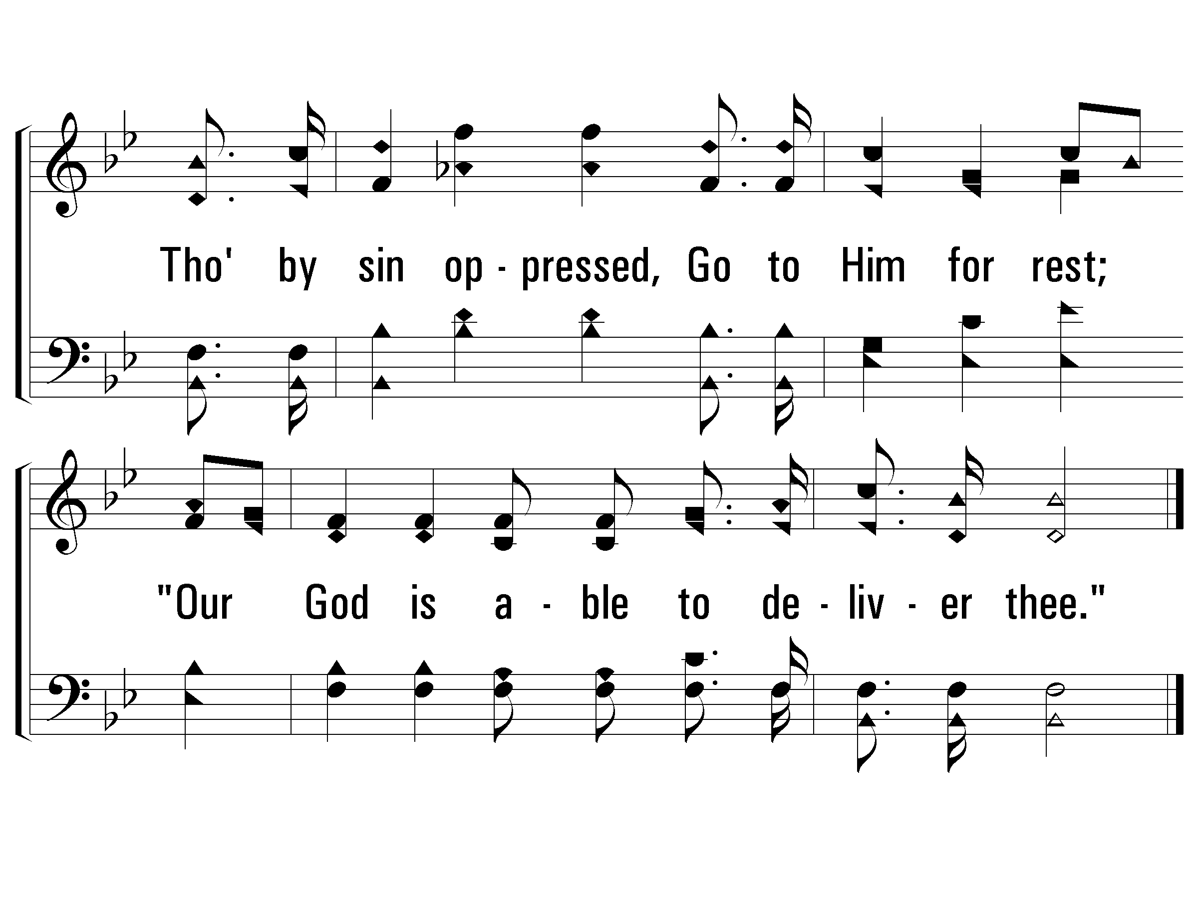
c - He Is Able to Deliver Thee
© 2007 The Paperless Hymnal®

Slide 19
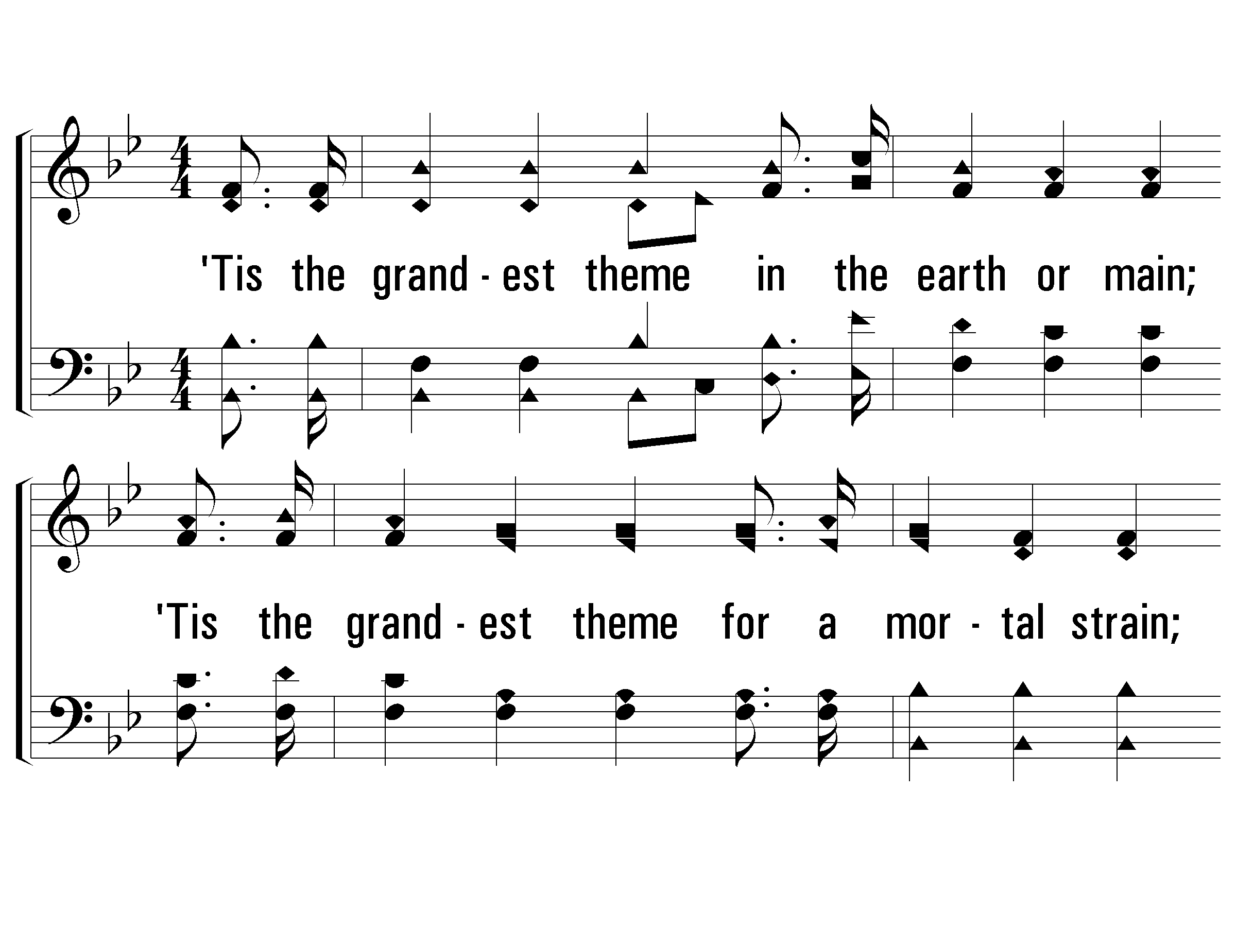
2 - He Is Able to Deliver Thee
2.
'Tis the grandest theme in the earth or main;
'Tis the grandest theme for a mortal strain;
'Tis the grandest theme, tell the world again,
"Our God is able to deliver thee."
Words & Music: William A. Ogden
© 2007 The Paperless Hymnal®

Slide 20
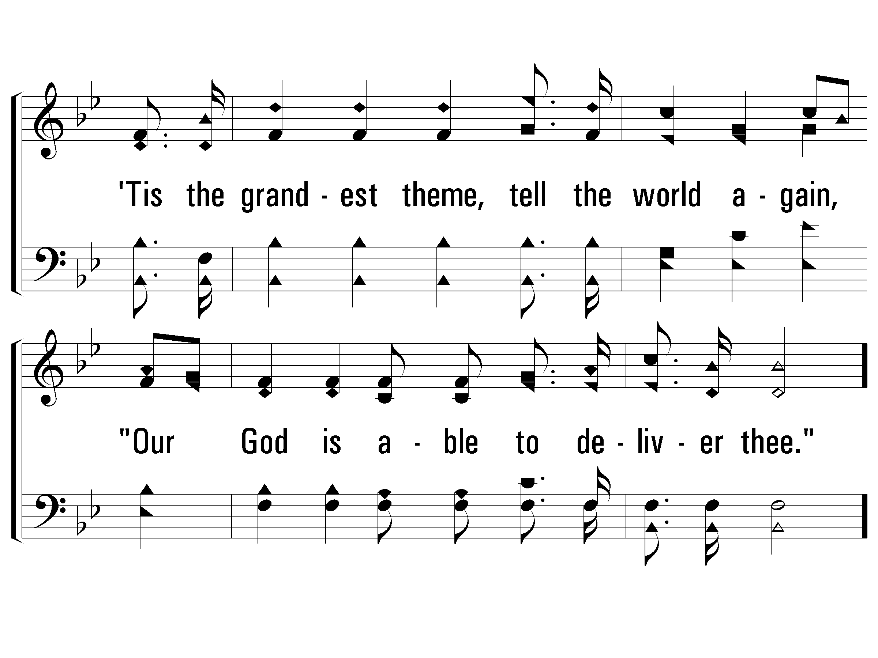
2 - He Is Able to Deliver Thee
© 2007 The Paperless Hymnal®

Slide 21
c - He Is Able to Deliver Thee
He is able to deliver thee,
He is able to deliver thee;
Though by sin oppressed, Go to Him for rest;
"Our God is able to de-liver thee."
© 2007 The Paperless Hymnal®

Slide 22
c - He Is Able to Deliver Thee
© 2007 The Paperless Hymnal®

Slide 23
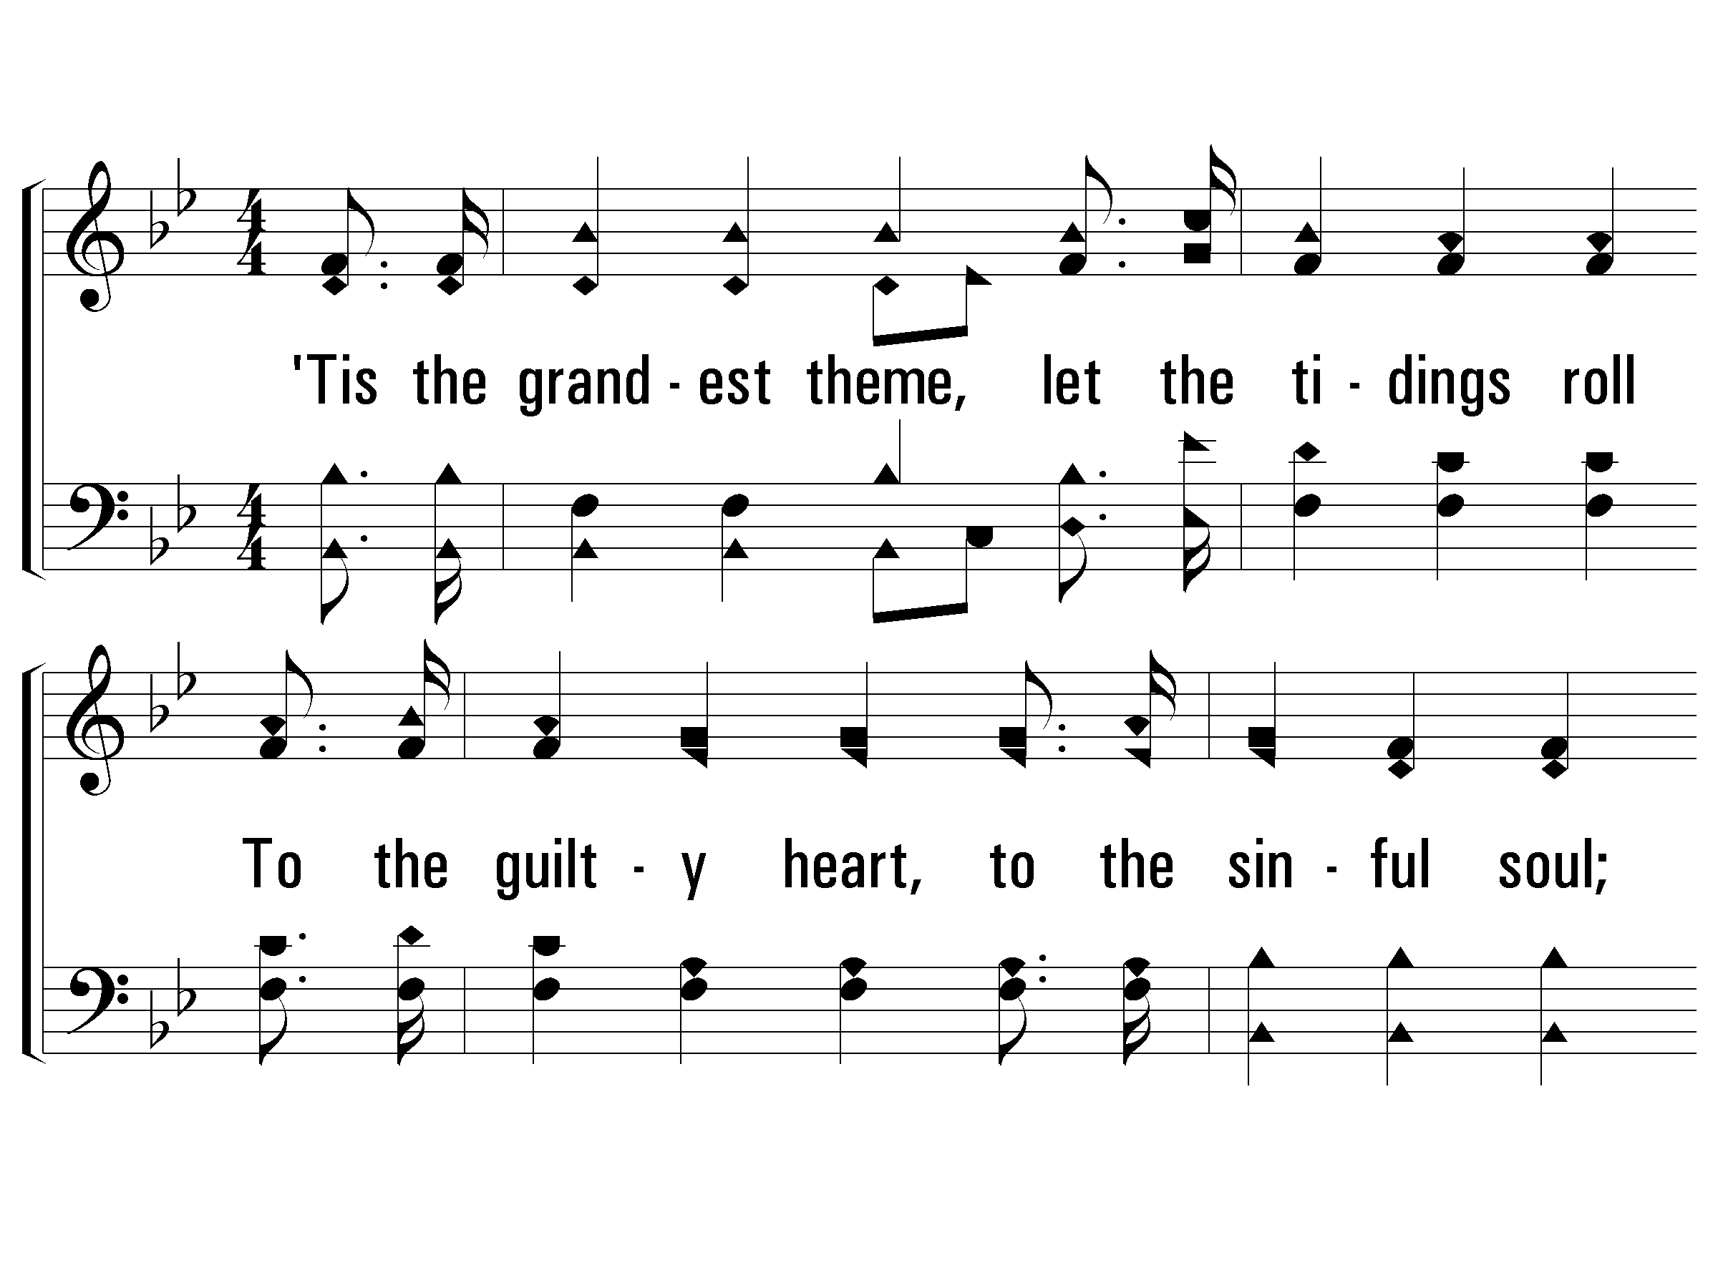
3 - He Is Able to Deliver Thee
3.
'Tis the grandest theme, let the tidings roll
To the guilty heart, to the sinful soul;
Look to God in faith, He will make thee whole;
"Our God is able to deliver thee."
Words & Music: William A. Ogden
© 2007 The Paperless Hymnal®

Slide 24
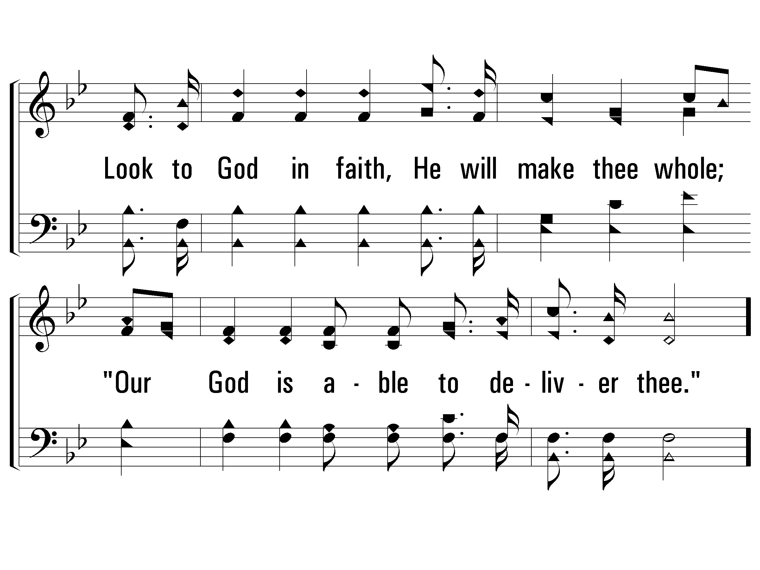
3 - He Is Able to Deliver Thee
© 2007 The Paperless Hymnal®

Slide 25
c - He Is Able to Deliver Thee
He is able to deliver thee,
He is able to deliver thee;
Though by sin oppressed, Go to Him for rest;
"Our God is able to de-liver thee."
Prayer leader come forward
© 2007 The Paperless Hymnal®

Slide 26
c - He Is Able to Deliver Thee
© 2007 The Paperless Hymnal®

Slide 27
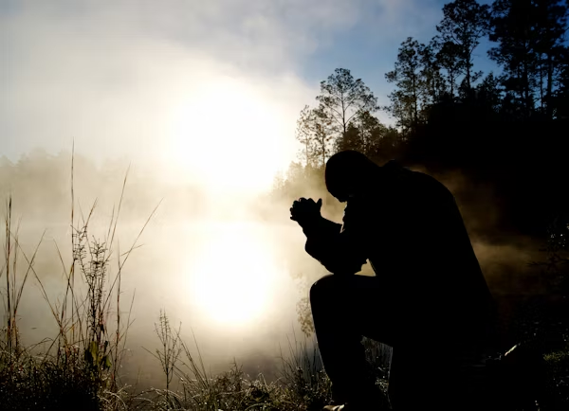
PRAY

Slide 28
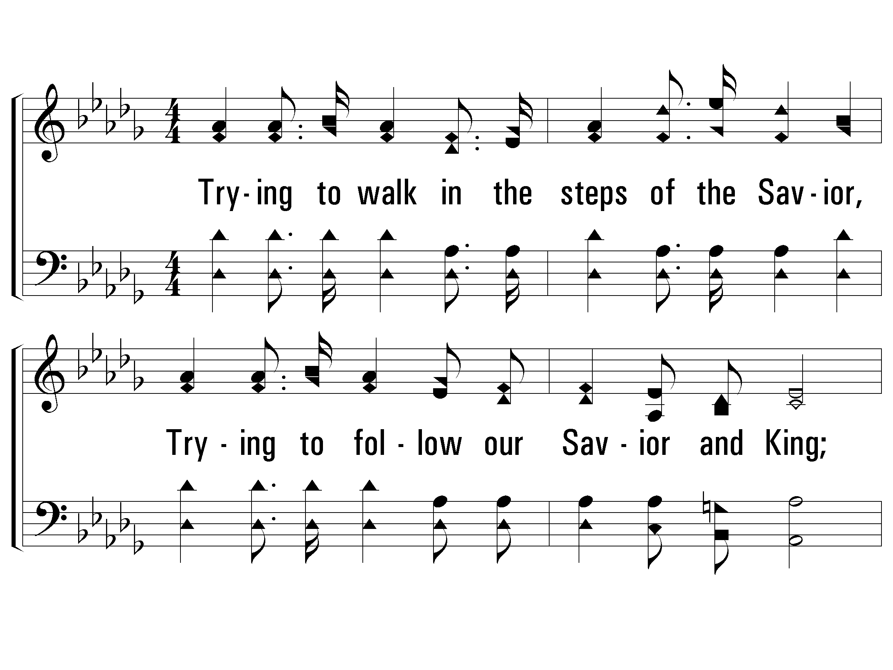
1 – Stepping in the Light
1.
Trying to walk in the steps of the Savior,
Trying to follow our Savior and King;
Shaping our lives by His blessed example,
Happy, how happy, the songs that we bring.
Words: Eliza E. Hewitt
Music: William J. Kirkpatrick
© 2004 The Paperless Hymnal™

Slide 29
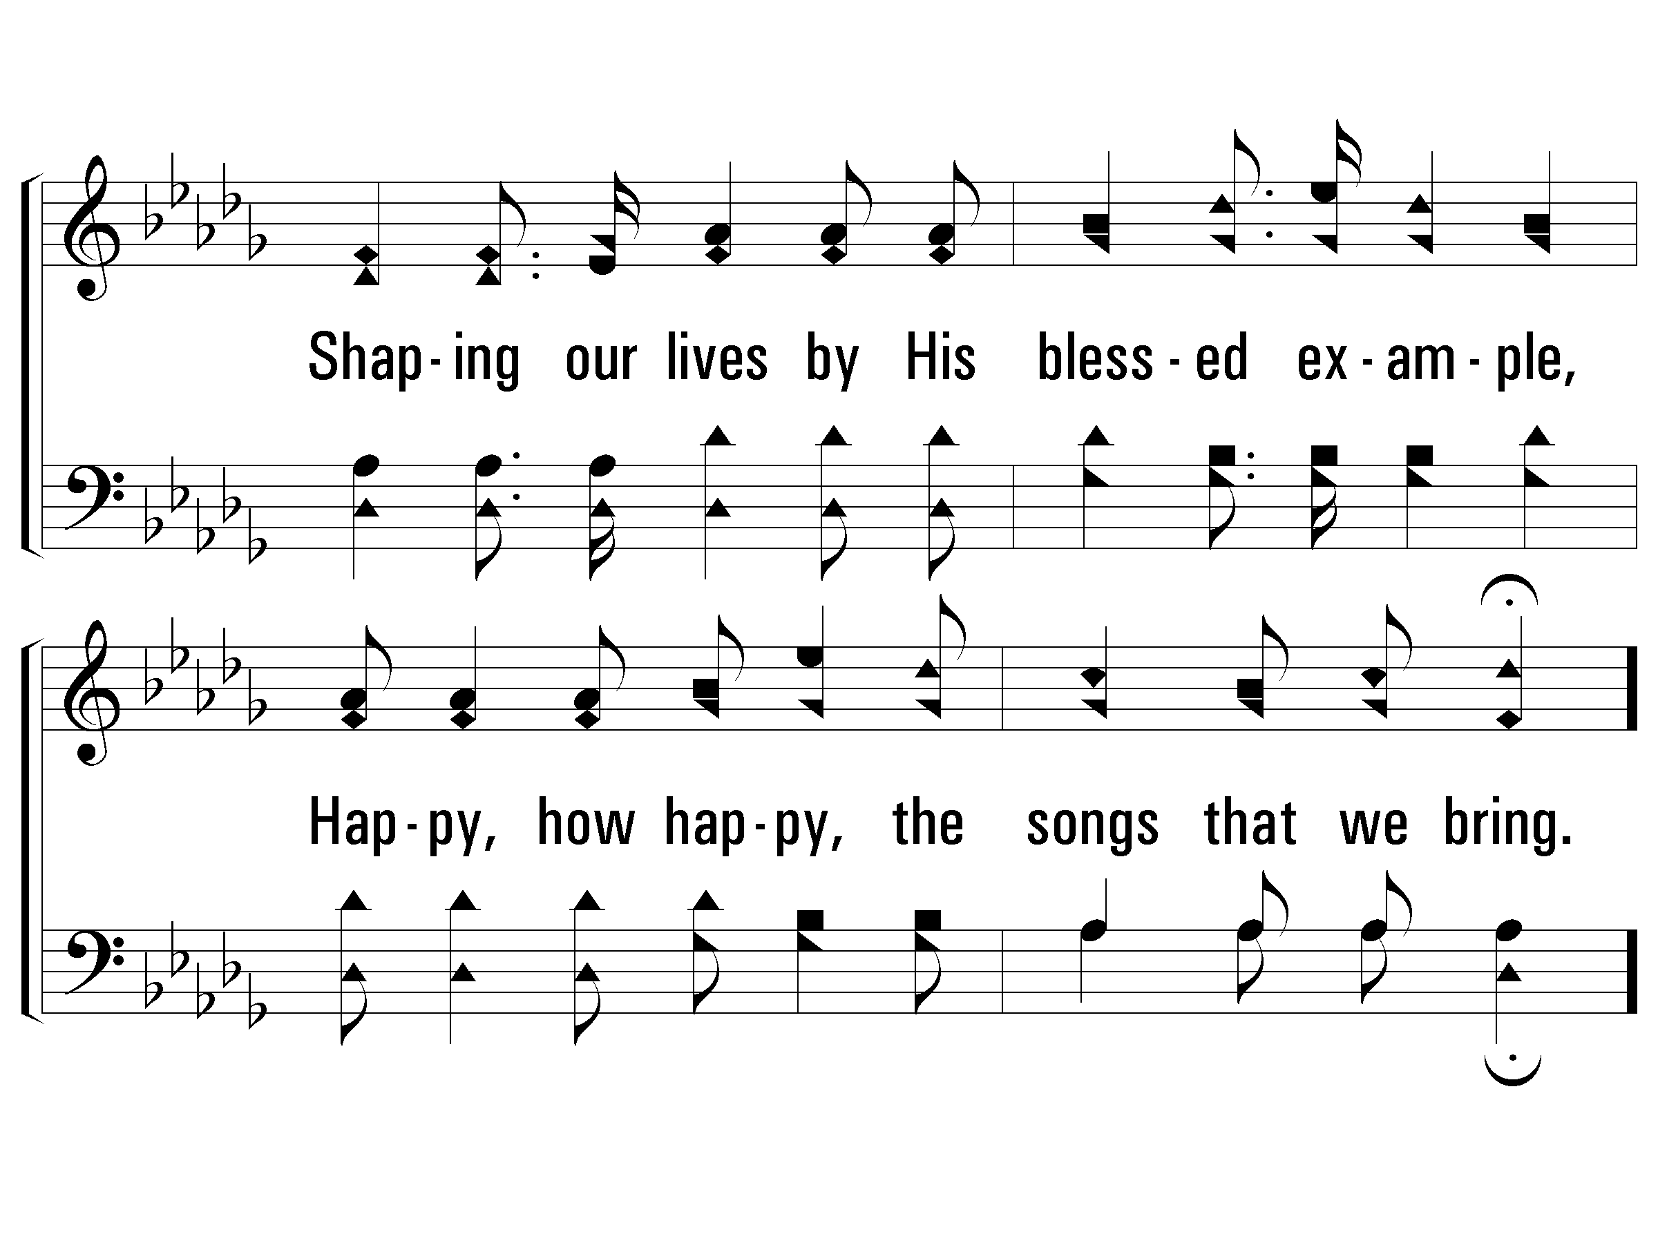
1 – Stepping in the Light
© 2004 The Paperless Hymnal™

Slide 30
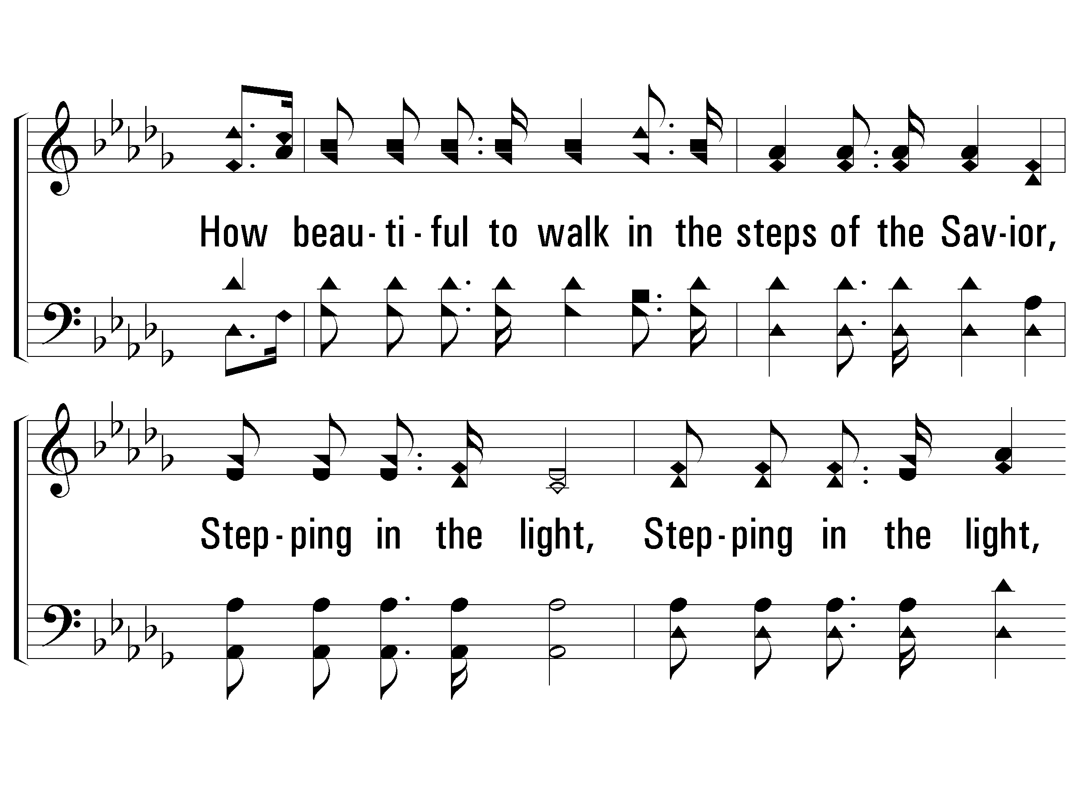
c – Stepping in the Light
How beautiful to walk in the steps of the Savior,
Stepping in the light,
Stepping in the light,
How beautiful to walk in the steps of the Savior,
Led in paths of light!
© 2004 The Paperless Hymnal™

Slide 31
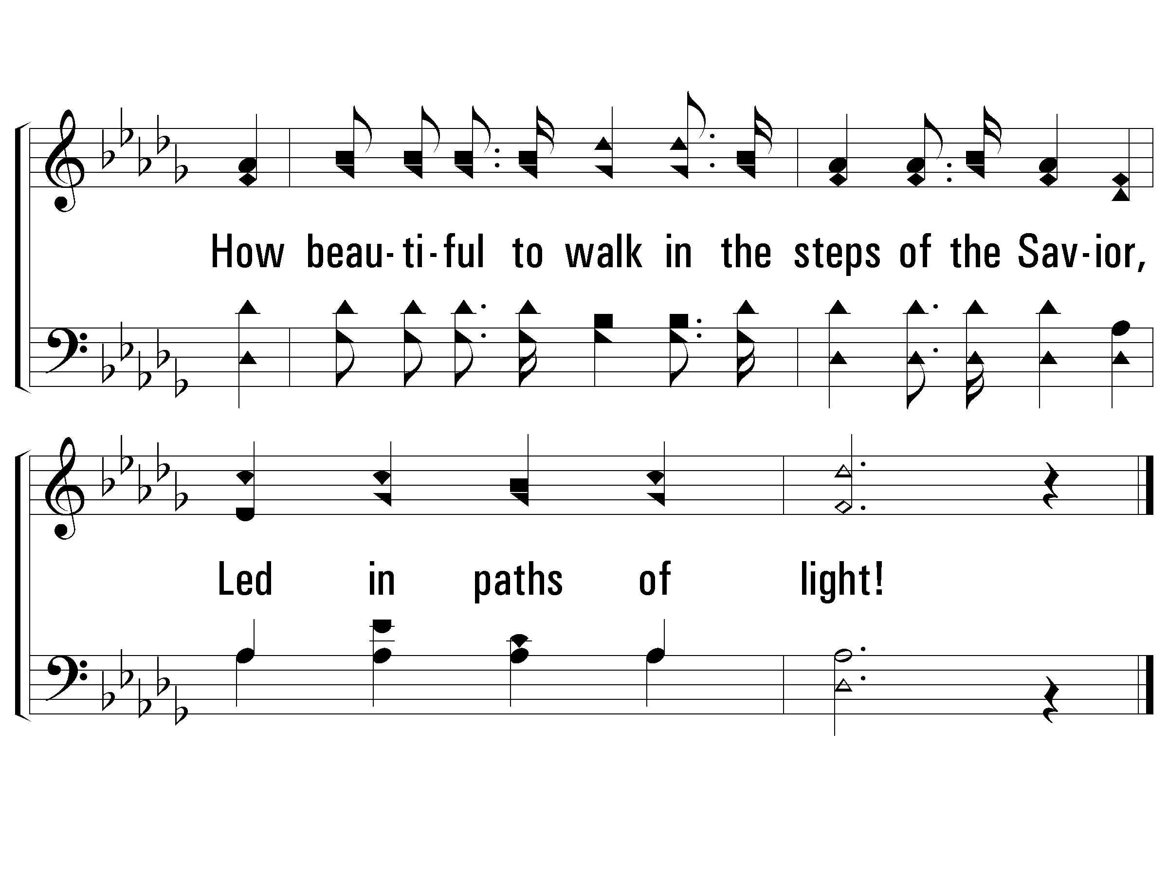
c – Stepping in the Light
© 2004 The Paperless Hymnal™

Slide 32
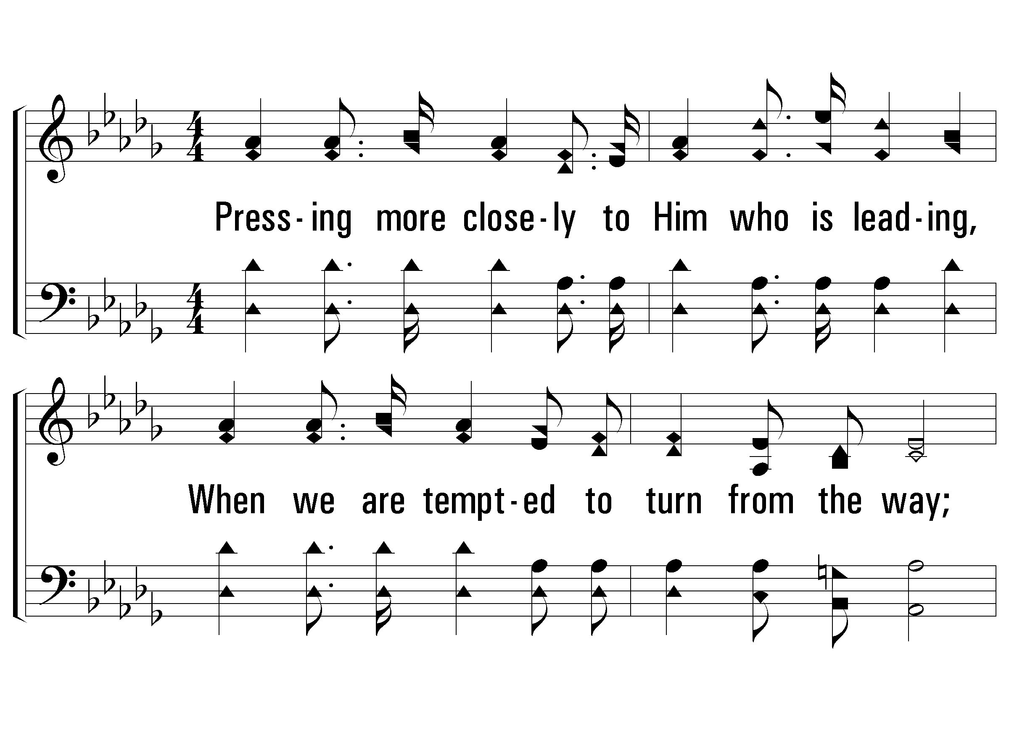
2 – Stepping in the Light
2.
Pressing more closely to Him who is leading,
When we are tempted to turn from the way;
Trusting the arm that is strong to defend us,
Happy, how happy, our praises each day.
Words: Eliza E. Hewitt
Music: William J. Kirkpatrick
© 2004 The Paperless Hymnal™

Slide 33
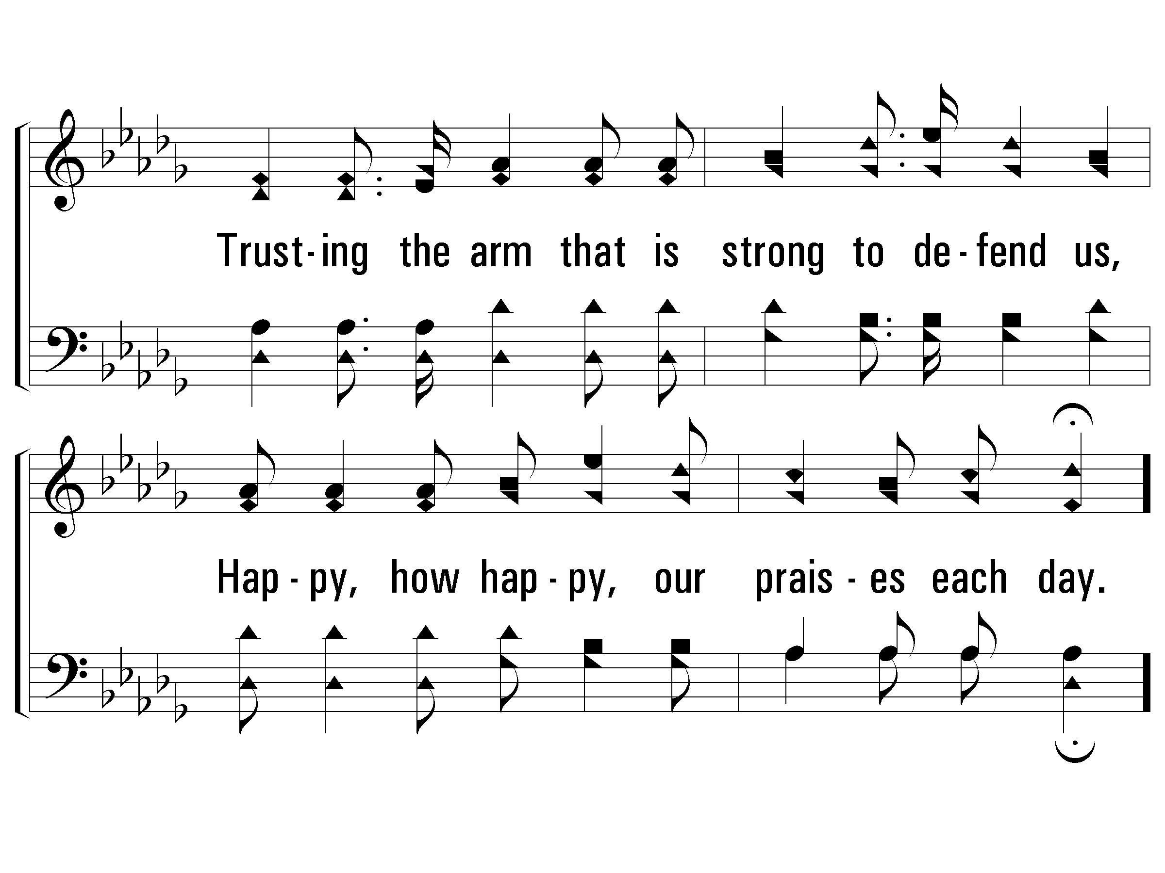
2 – Stepping in the Light
© 2004 The Paperless Hymnal™

Slide 34
c – Stepping in the Light
How beautiful to walk in the steps of the Savior,
Stepping in the light,
Stepping in the light,
How beautiful to walk in the steps of the Savior,
Led in paths of light!
© 2004 The Paperless Hymnal™

Slide 35
c – Stepping in the Light
© 2004 The Paperless Hymnal™

Slide 36

4 – Stepping in the Light
4.
Trying to walk in the steps of the Savior,
Upward, still upward we'll follow our Guide;
When we shall see Him, "the King in His beauty,"
Happy, how happy, our place at His side!
Words: Eliza E. Hewitt
Music: William J. Kirkpatrick
© 2004 The Paperless Hymnal™

Slide 37
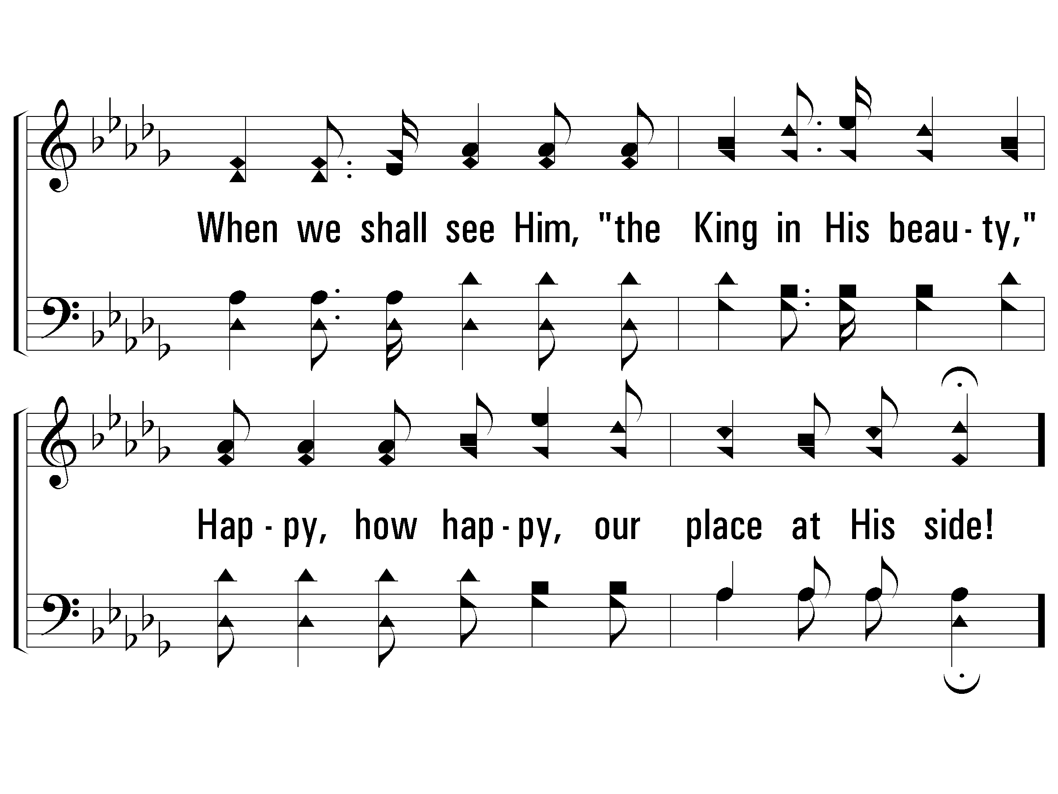
4 – Stepping in the Light
© 2004 The Paperless Hymnal™

Slide 38
c – Stepping in the Light
How beautiful to walk in the steps of the Savior,
Stepping in the light,
Stepping in the light,
How beautiful to walk in the steps of the Savior,
Led in paths of light!
© 2004 The Paperless Hymnal™

Slide 39
c – Stepping in the Light
© 2004 The Paperless Hymnal™

Slide 40
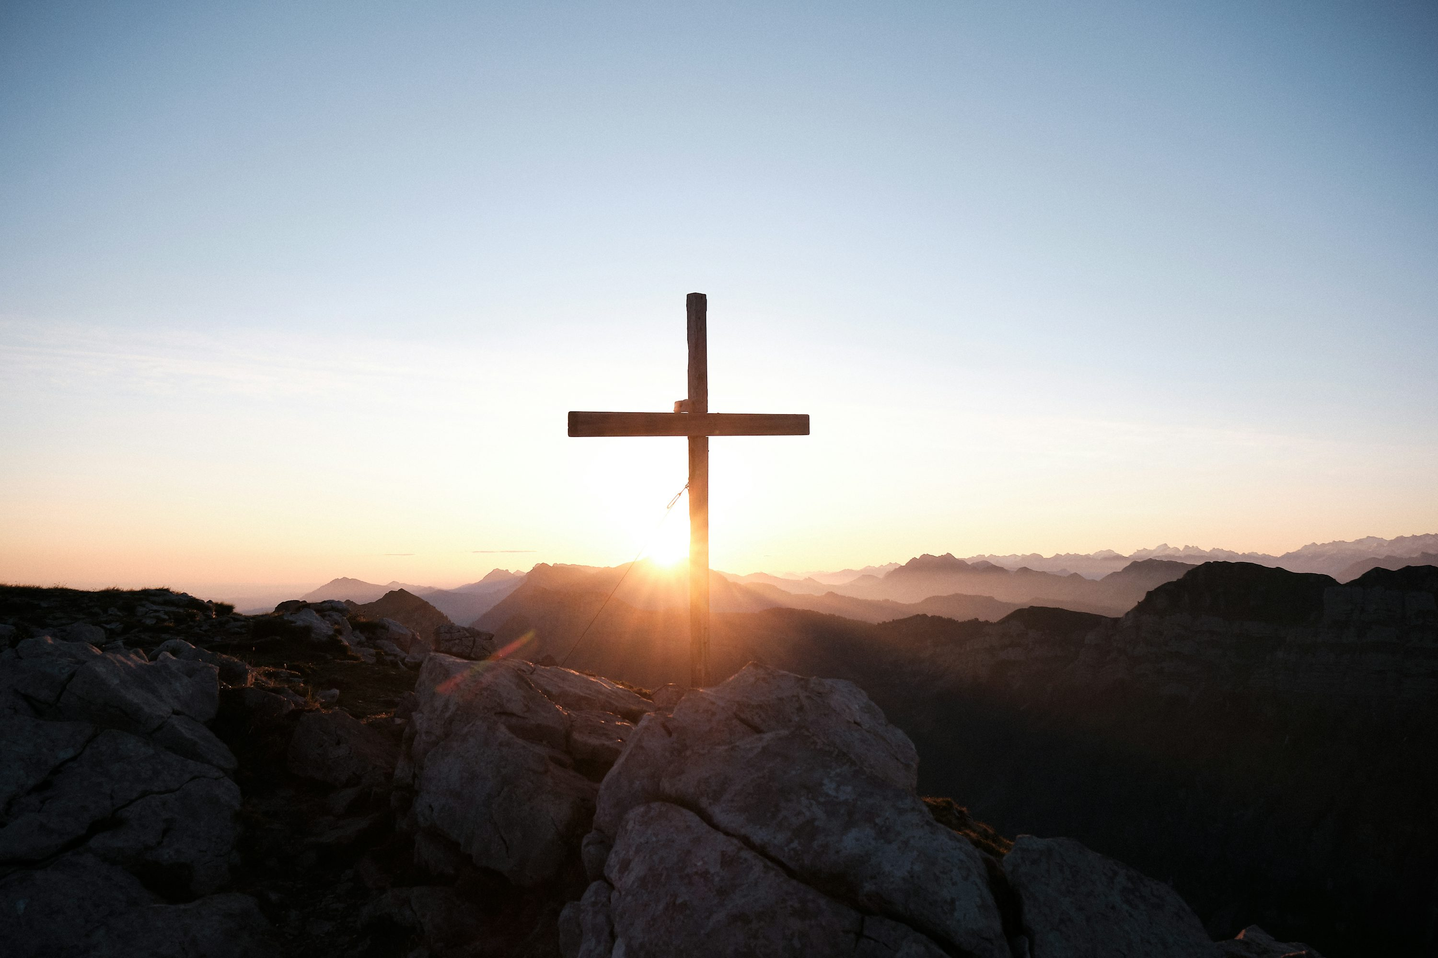
Let Him Have His
Way With Thee

Slide 41
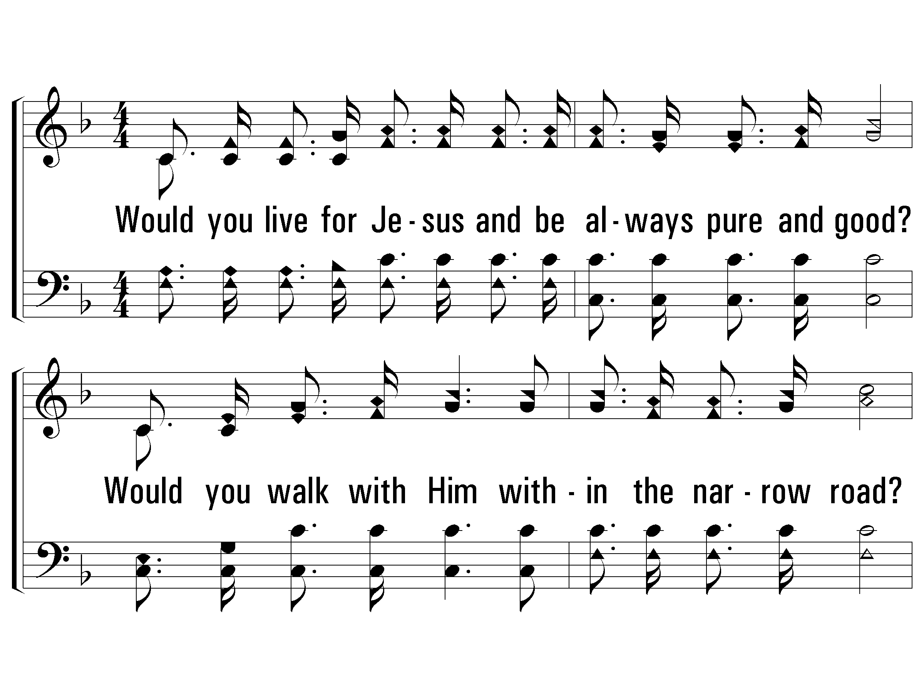
1 - Let Him Have His Way with Thee
1.
Would you live for Jesus and be always pure and good?
Would you walk with Him within the narrow road?
Would you have Him bear your burden, carry all your load?
Let Him have His way with thee.
Words & Music: Cyrus S. Nusbarm
© 2008 The Paperless Hymnal®

Slide 42
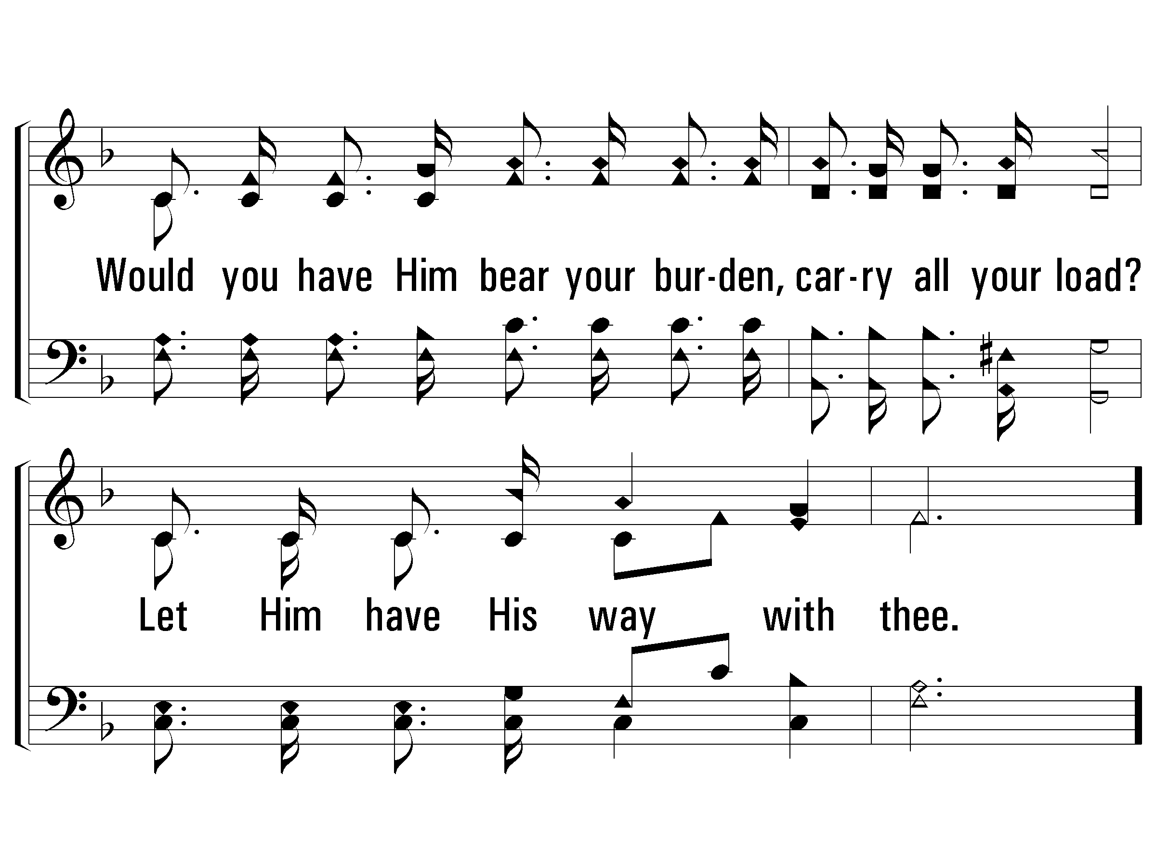
1 - Let Him Have His Way with Thee
© 2008 The Paperless Hymnal®

Slide 43
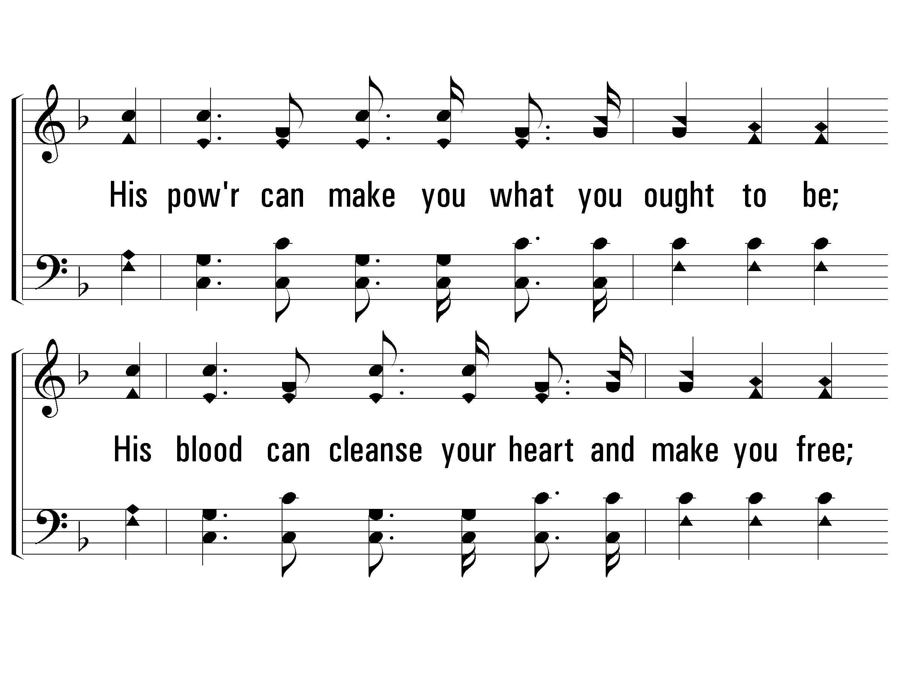
c - Let Him Have His Way with Thee
His power can make you what you ought to be;
His blood can cleanse your heart and make you free;
His love can fill your soul, and you will see
'Twas best for Him to have His way with thee.
© 2008 The Paperless Hymnal®

Slide 44
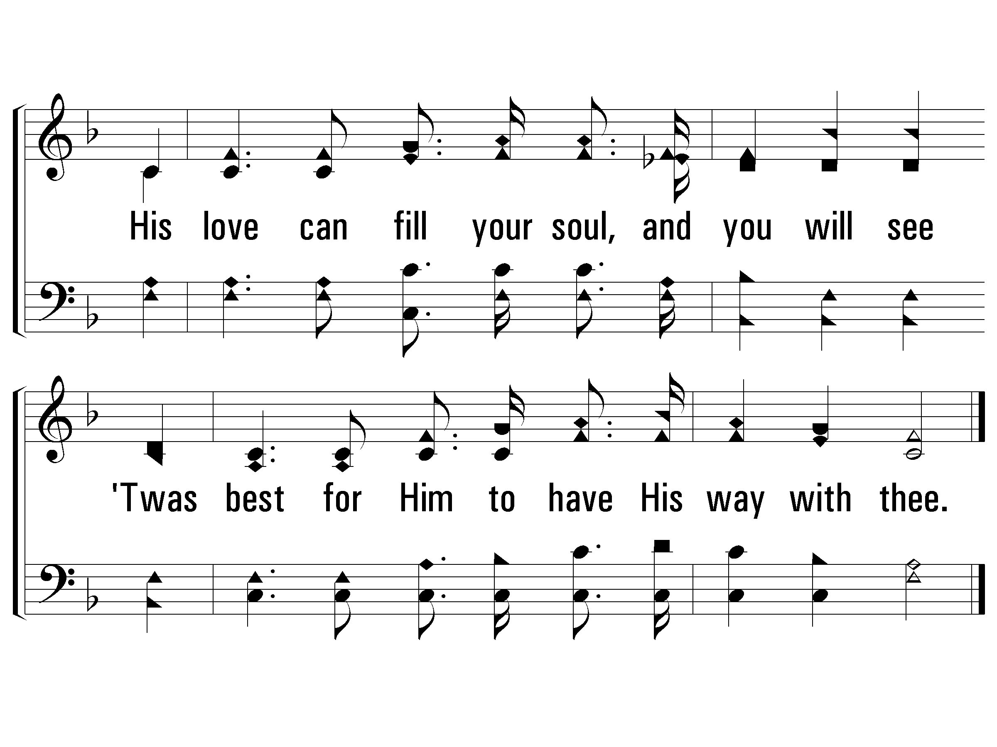
c - Let Him Have His Way with Thee
© 2008 The Paperless Hymnal®

Slide 45
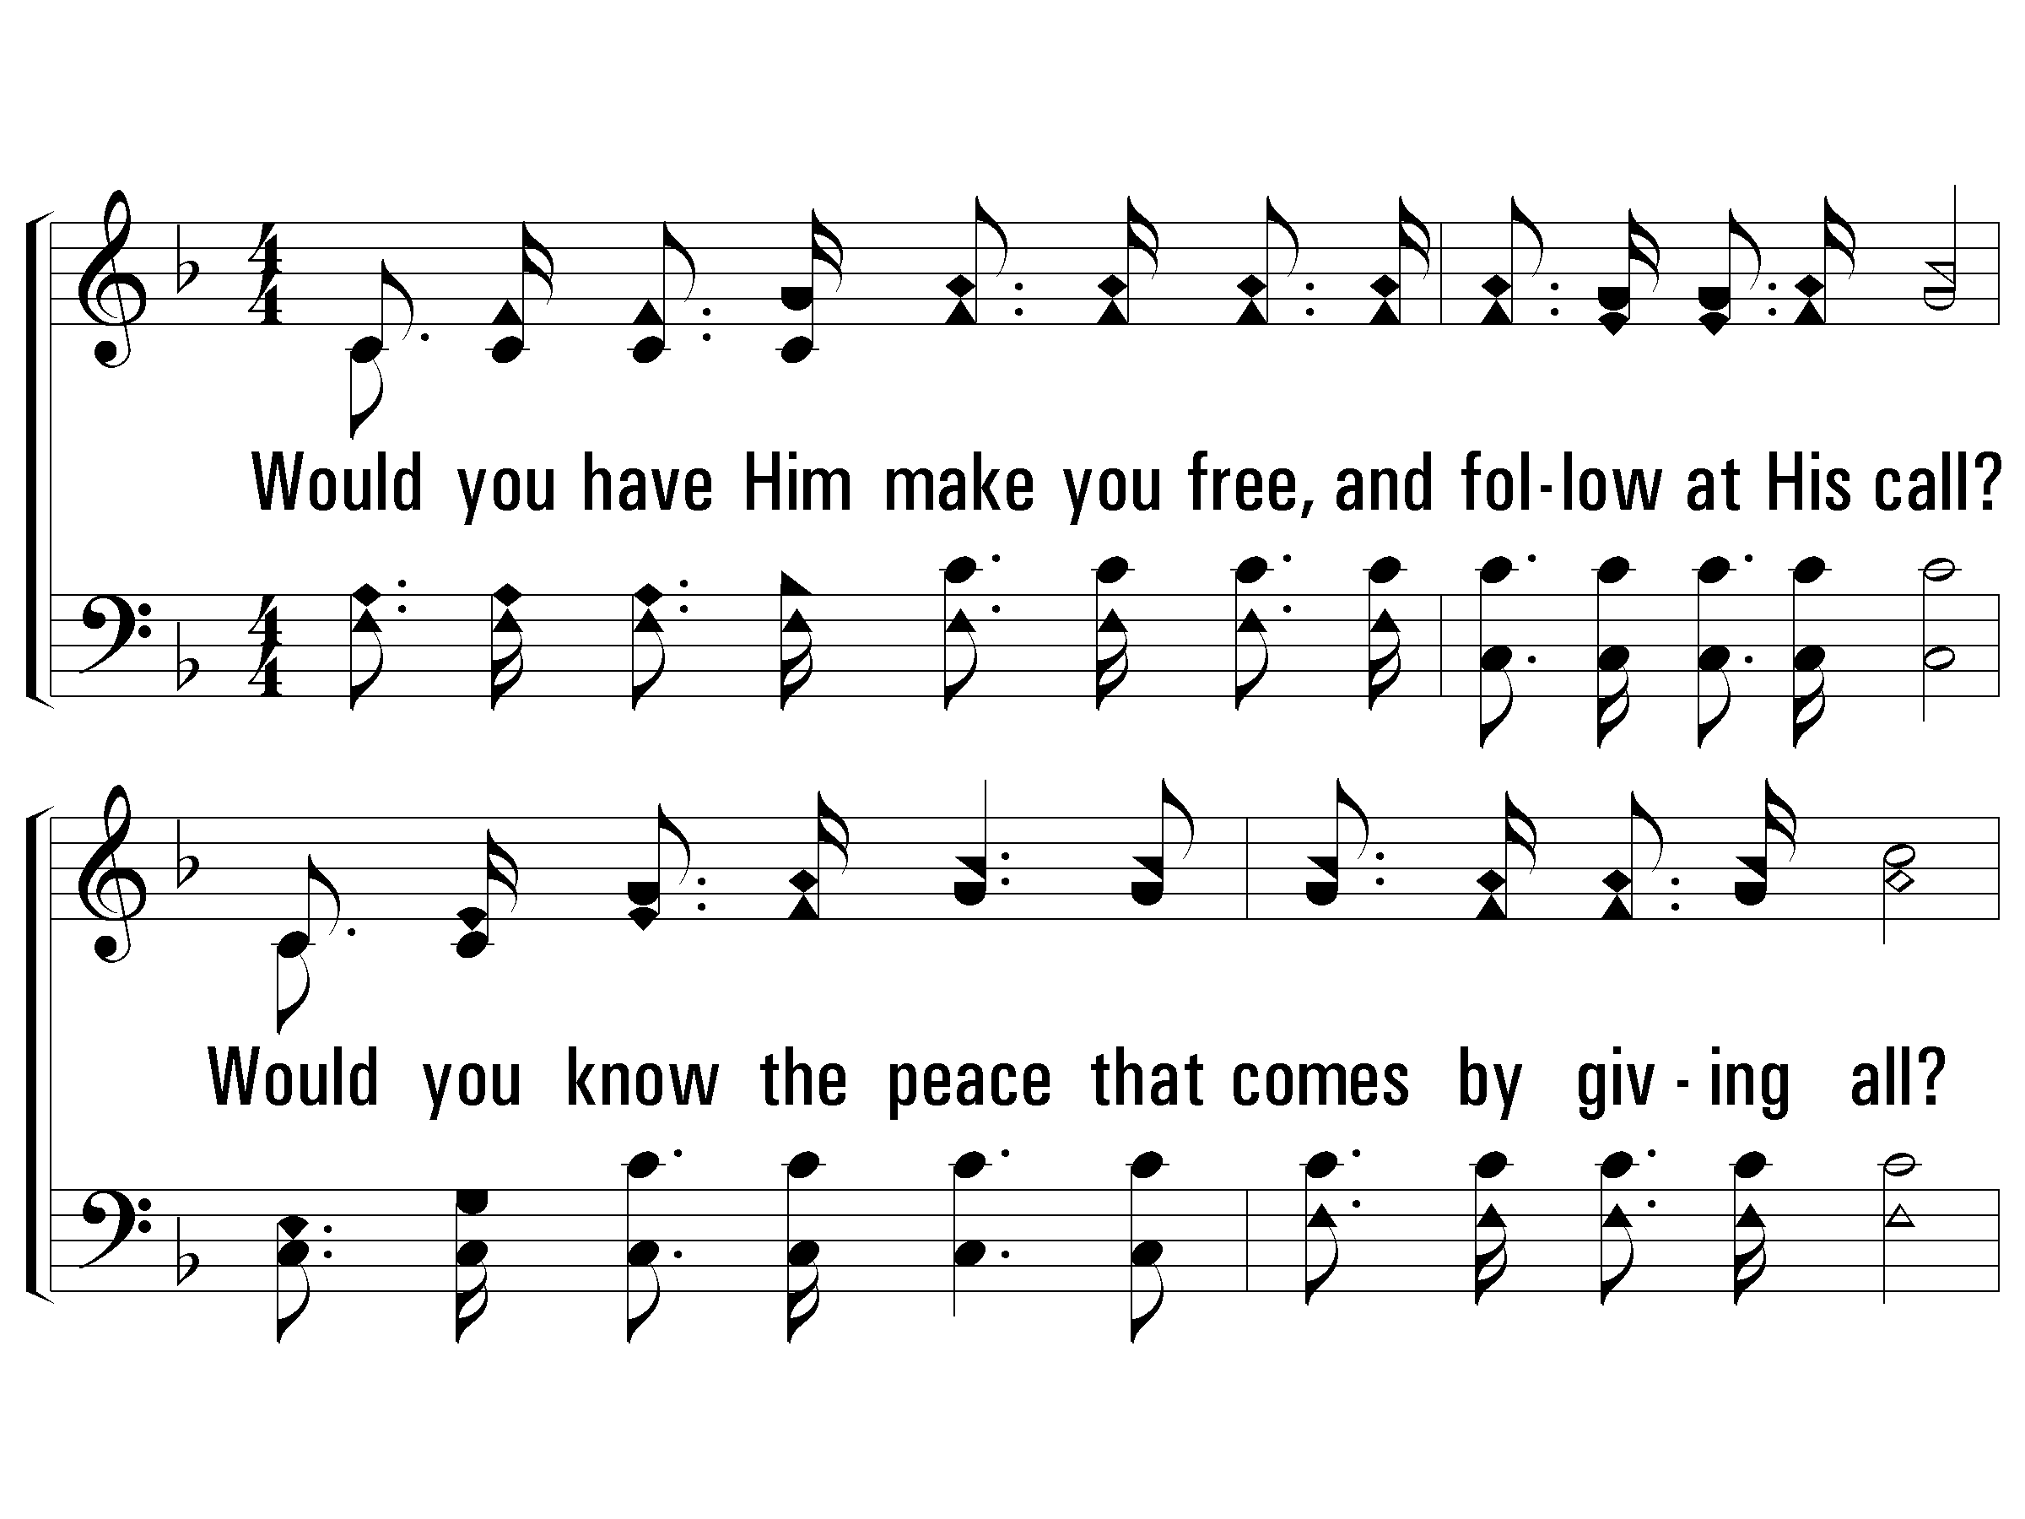
2 - Let Him Have His Way with Thee
2.
Would you have Him make you free, and follow at His call?
Would you know the peace that comes by giving all?
Would you have Him save you, so that you need never fall?
Let Him have His way with thee.
Words & Music: Cyrus S. Nusbarm
© 2008 The Paperless Hymnal®

Slide 46
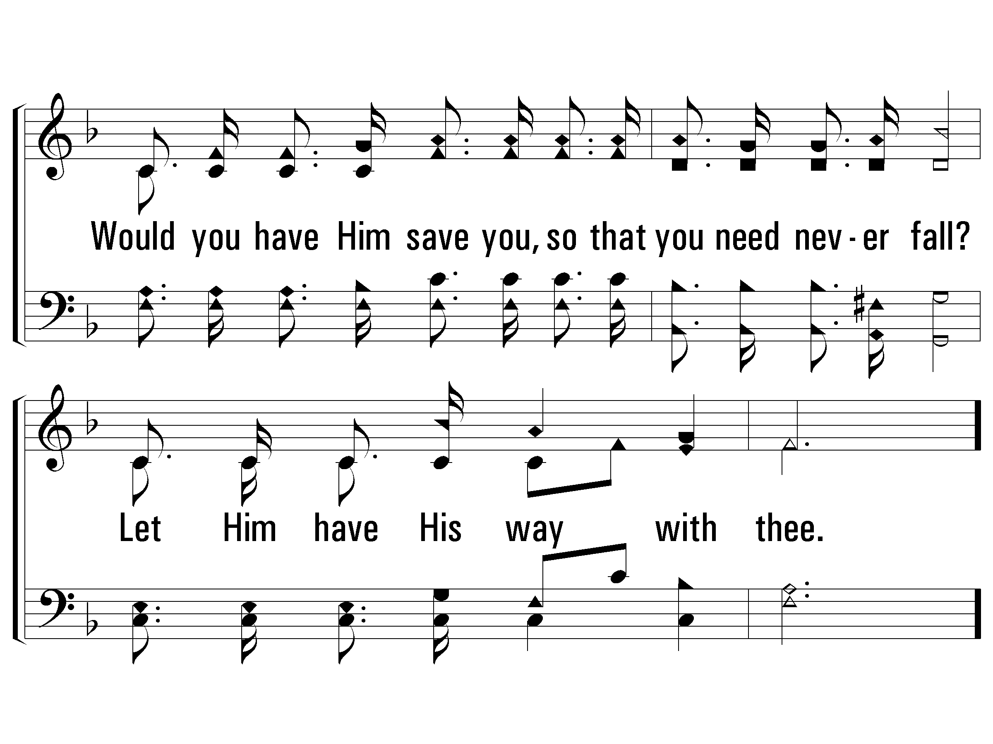
2 - Let Him Have His Way with Thee
© 2008 The Paperless Hymnal®

Slide 47
c - Let Him Have His Way with Thee
His power can make you what you ought to be;
His blood can cleanse your heart and make you free;
His love can fill your soul, and you will see
'Twas best for Him to have His way with thee.
© 2008 The Paperless Hymnal®

Slide 48
c - Let Him Have His Way with Thee
© 2008 The Paperless Hymnal®

Slide 49
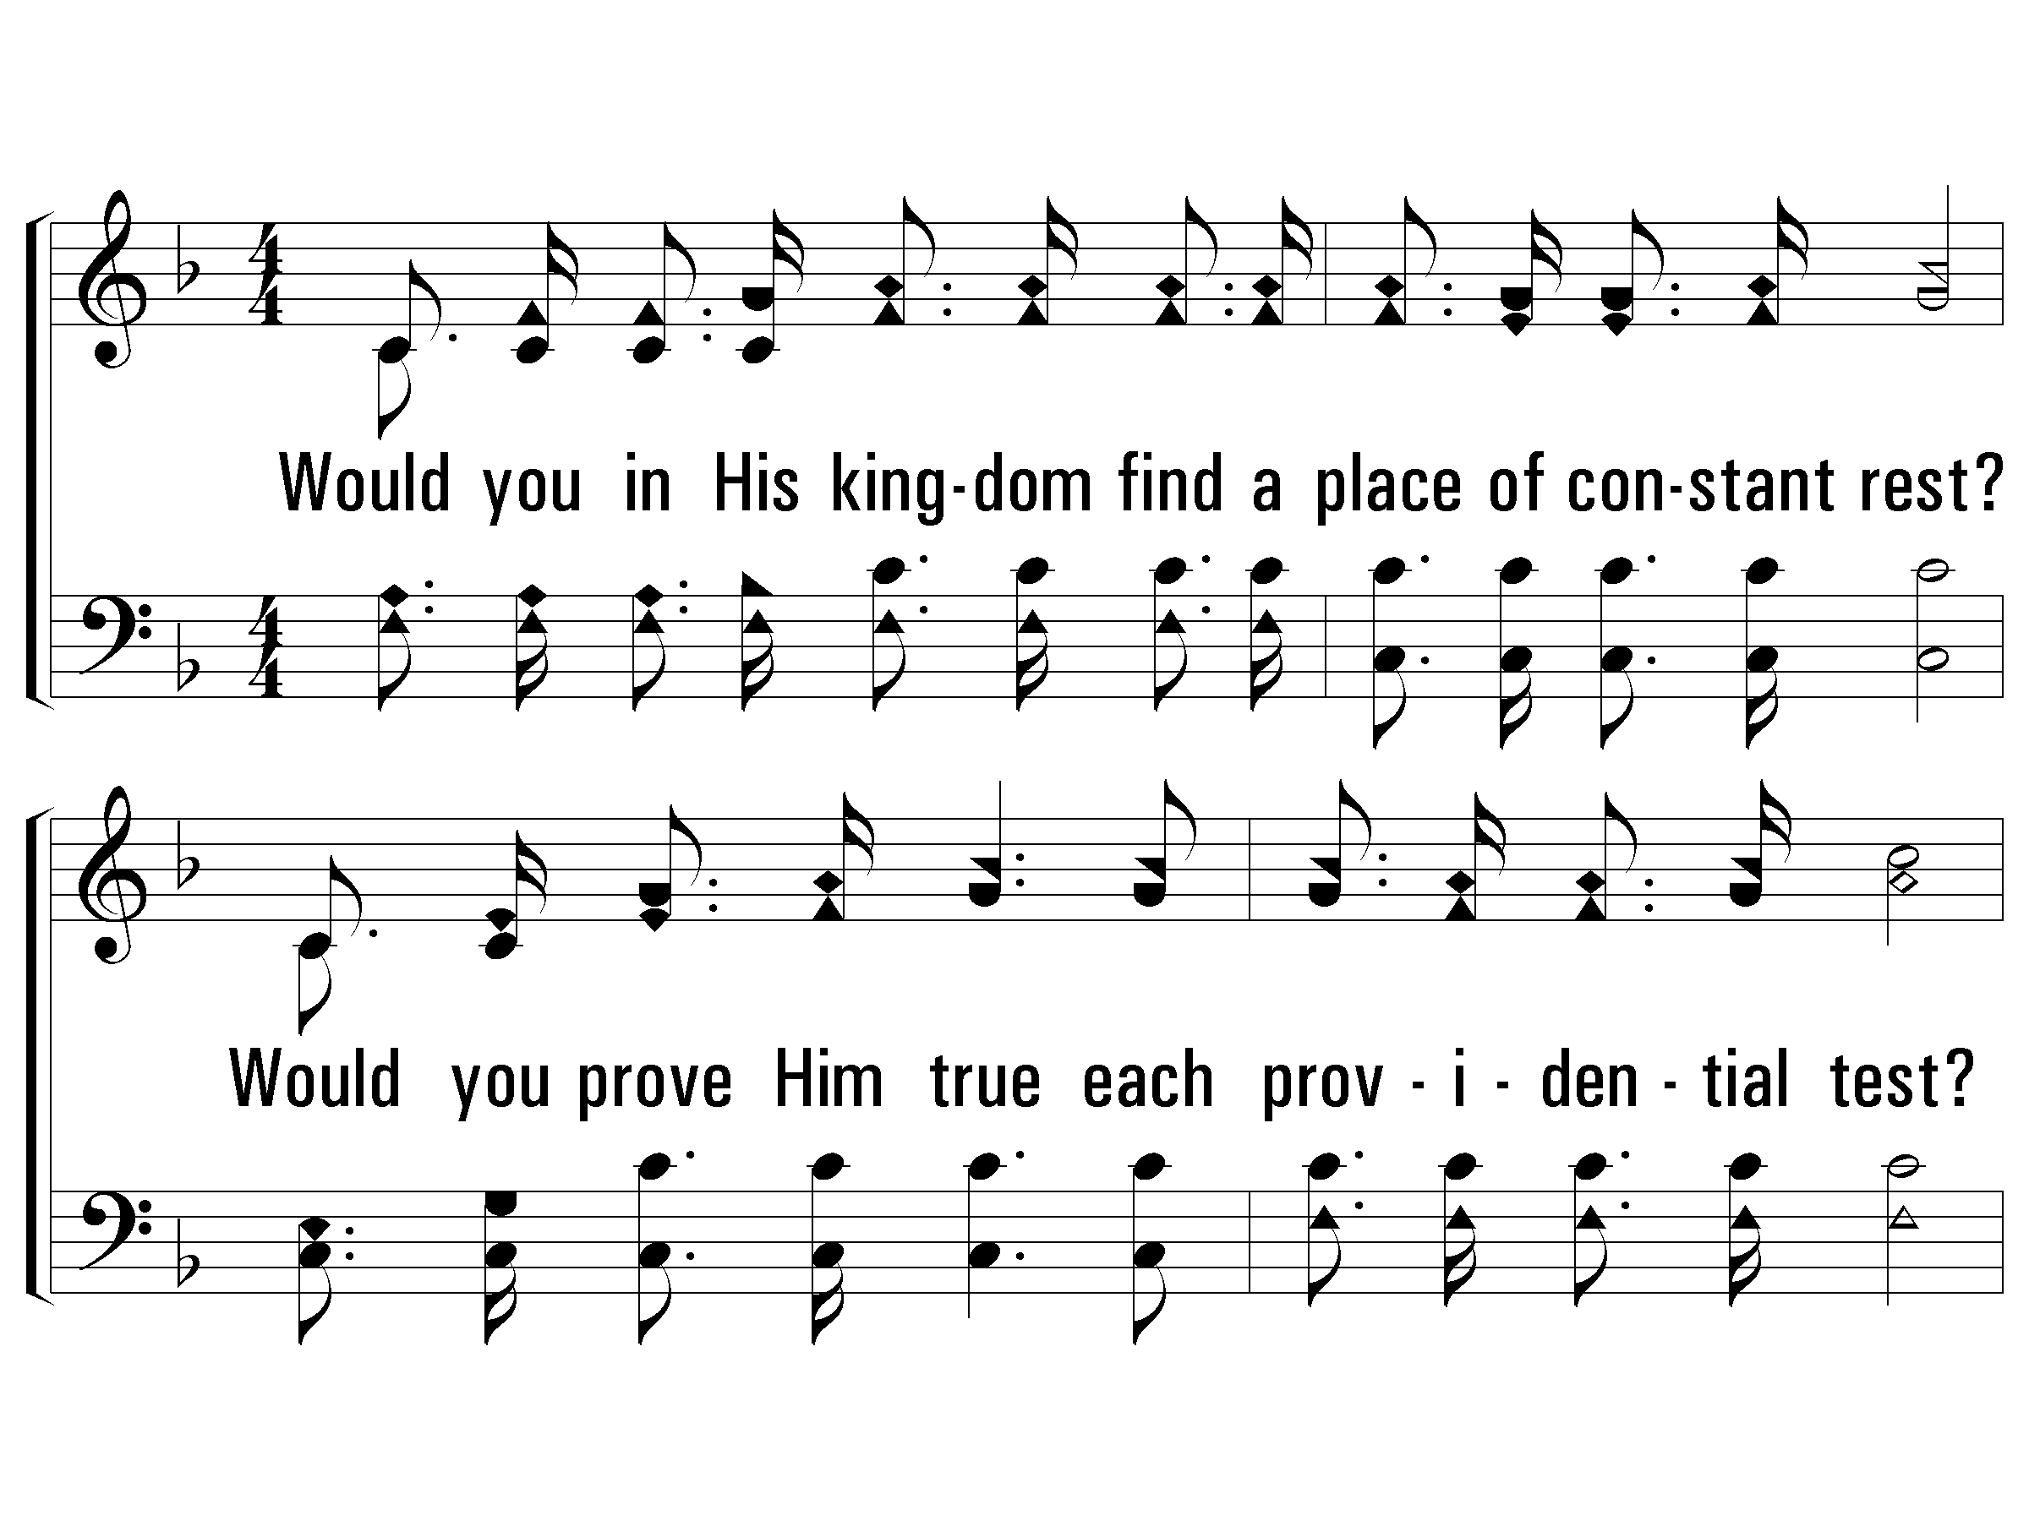
3 - Let Him Have His Way with Thee
3.
Would you in His kingdom find a place of constant rest?
Would you prove Him true each providential test?
Would you in His service labor always at your best?
Let Him have His way with thee.
Words & Music: Cyrus S. Nusbarm
© 2008 The Paperless Hymnal®

Slide 50
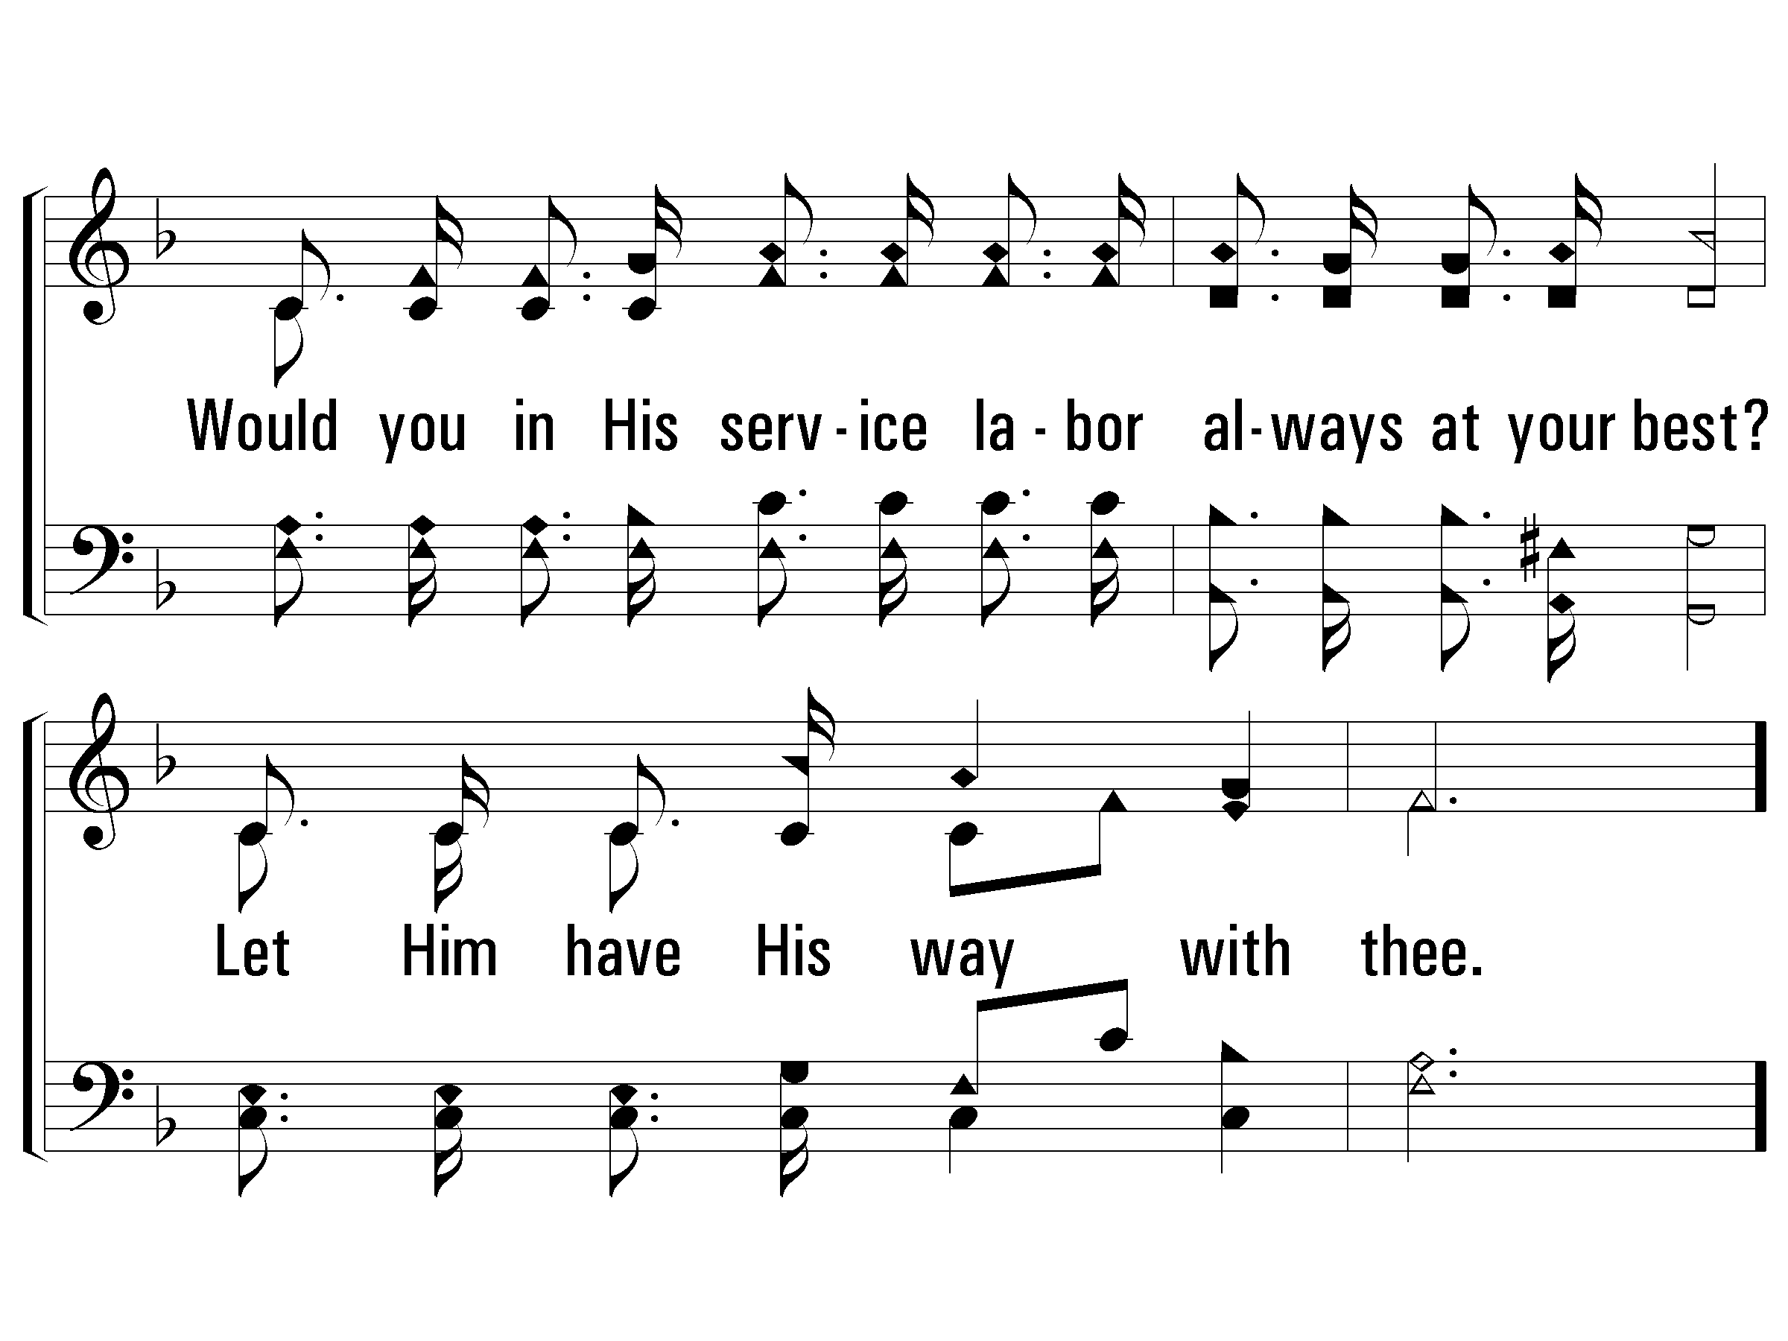
3 - Let Him Have His Way with Thee
© 2008 The Paperless Hymnal®

Slide 51
c - Let Him Have His Way with Thee
His power can make you what you ought to be;
His blood can cleanse your heart and make you free;
His love can fill your soul, and you will see
'Twas best for Him to have His way with thee.
© 2008 The Paperless Hymnal®

Slide 52
c - Let Him Have His Way with Thee
© 2008 The Paperless Hymnal®

Slide 53

Night, With Ebon Pinion

Slide 54
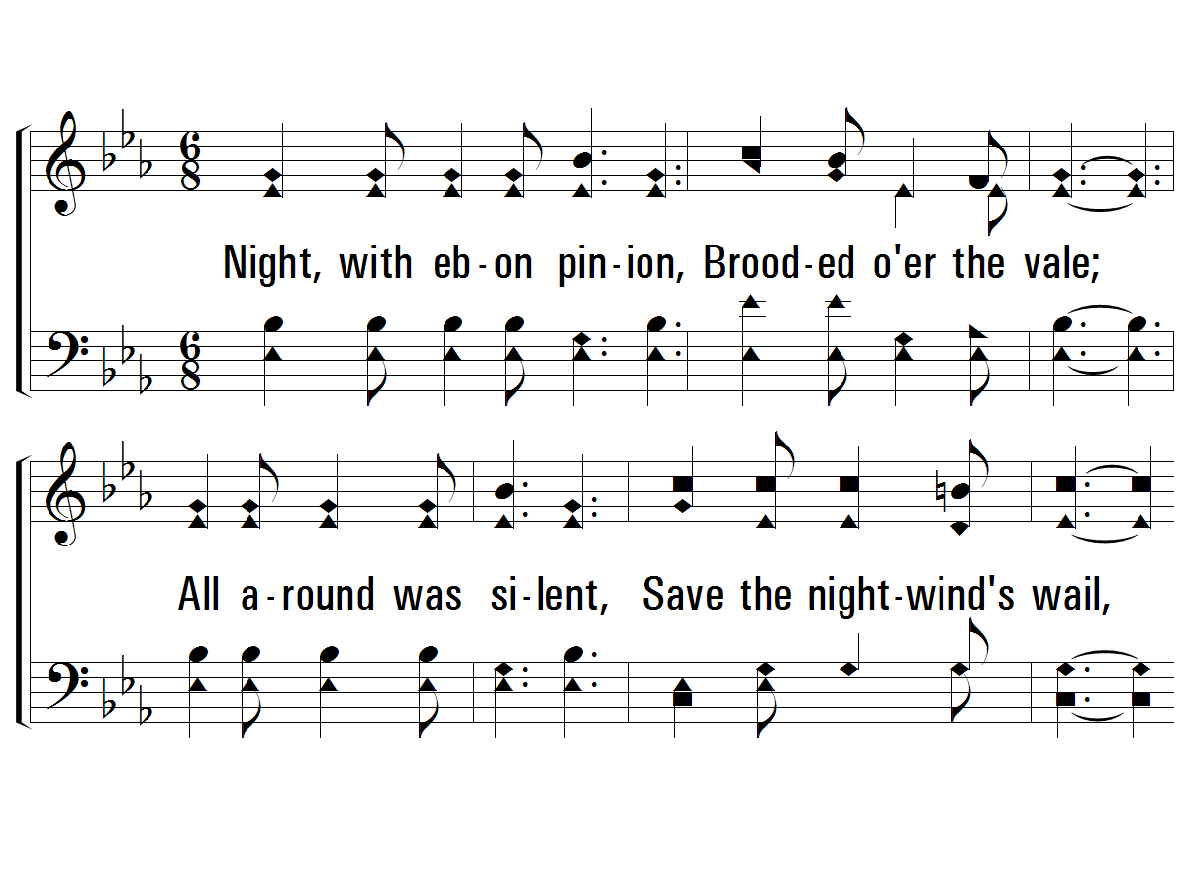
1 - Night, With Ebon Pinion
1.
Night, with ebon pinion,
Brooded over the vale;
All around was silent,
Save the night-wind's wail,
When Christ, the Man of Sorrows,
In tears and sweat and blood,
Prostrate in the garden,
Raised His voice to God.
Words: Love H. Jameson
Music: Joseph P. Powell
© 2007 The Paperless Hymnal®

Slide 55
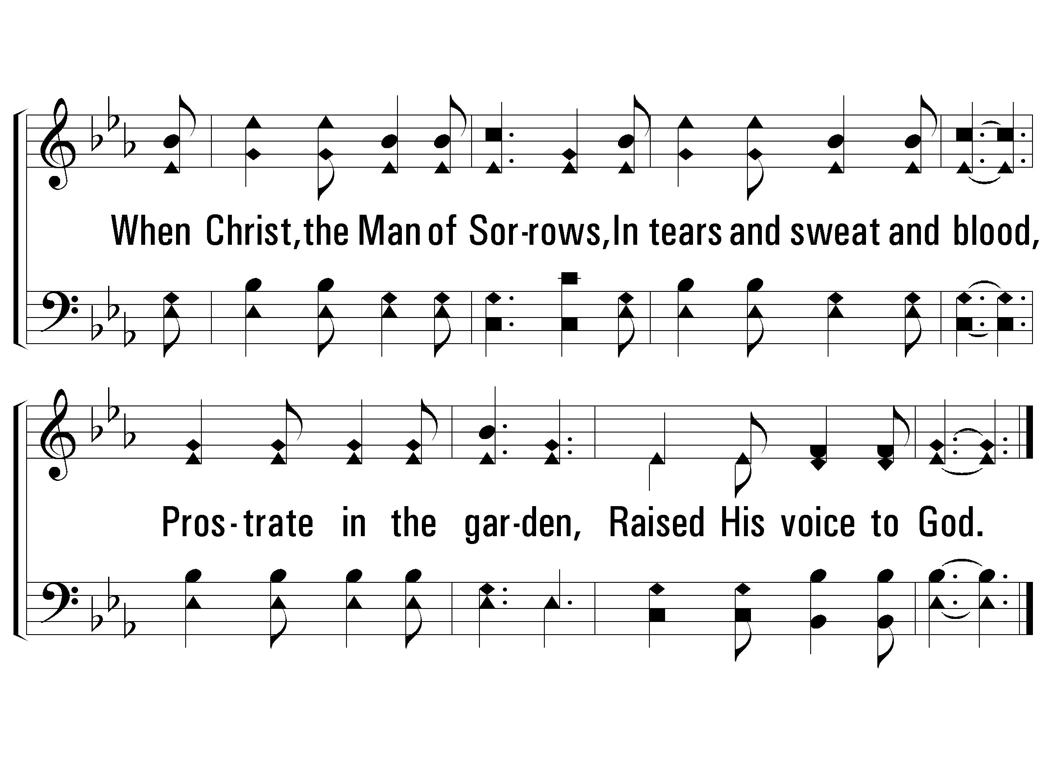
1 - Night, With Ebon Pinion
© 2007 The Paperless Hymnal®

Slide 56
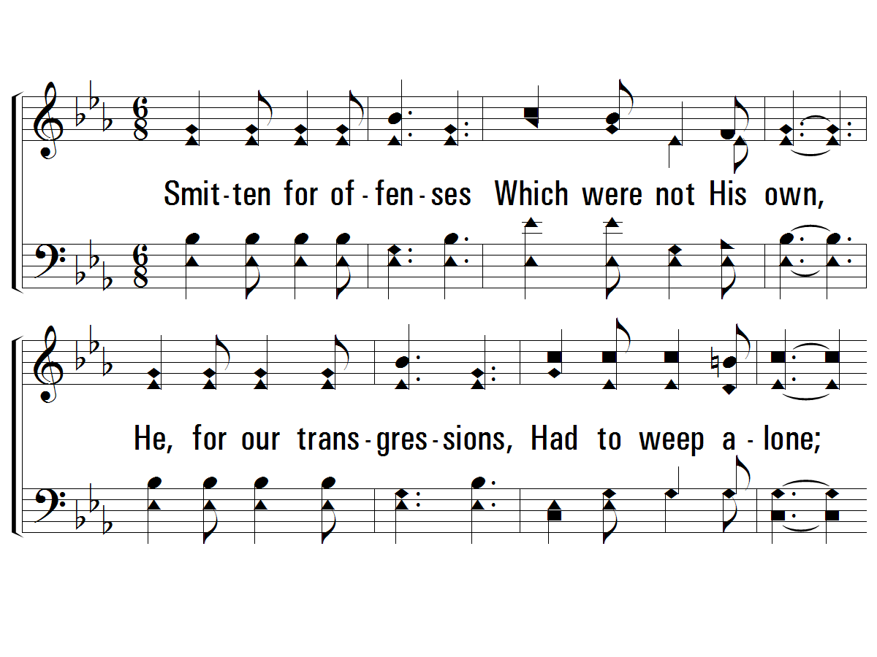
2 - Night, With Ebon Pinion
2.
Smitten for offenses
Which were not His own,
He, for our transgressions,
Had to weep alone;
No friend with words to comfort,
Nor hand to help was there,
When the Meek and Lowly
Humbly bowed in prayer.
Words: Love H. Jameson
Music: Joseph P. Powell
© 2007 The Paperless Hymnal®

Slide 57
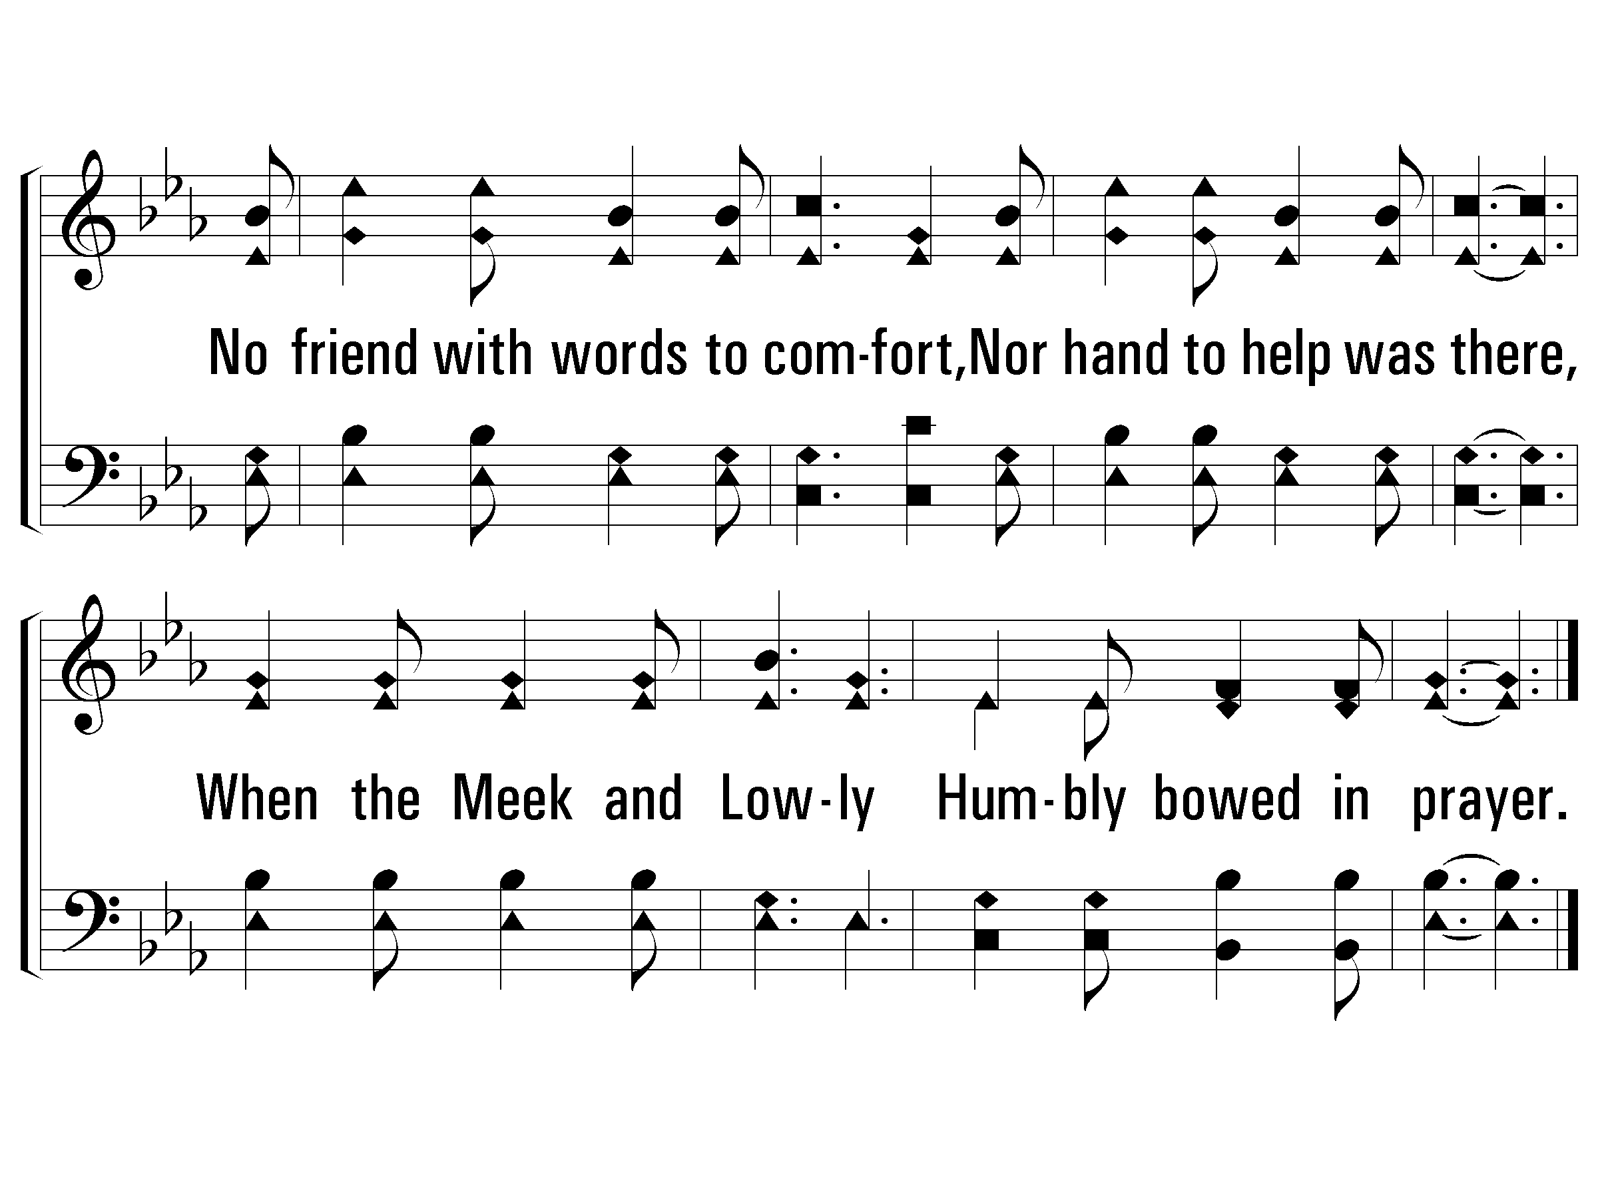
2 - Night, With Ebon Pinion
© 2007 The Paperless Hymnal®

Slide 58
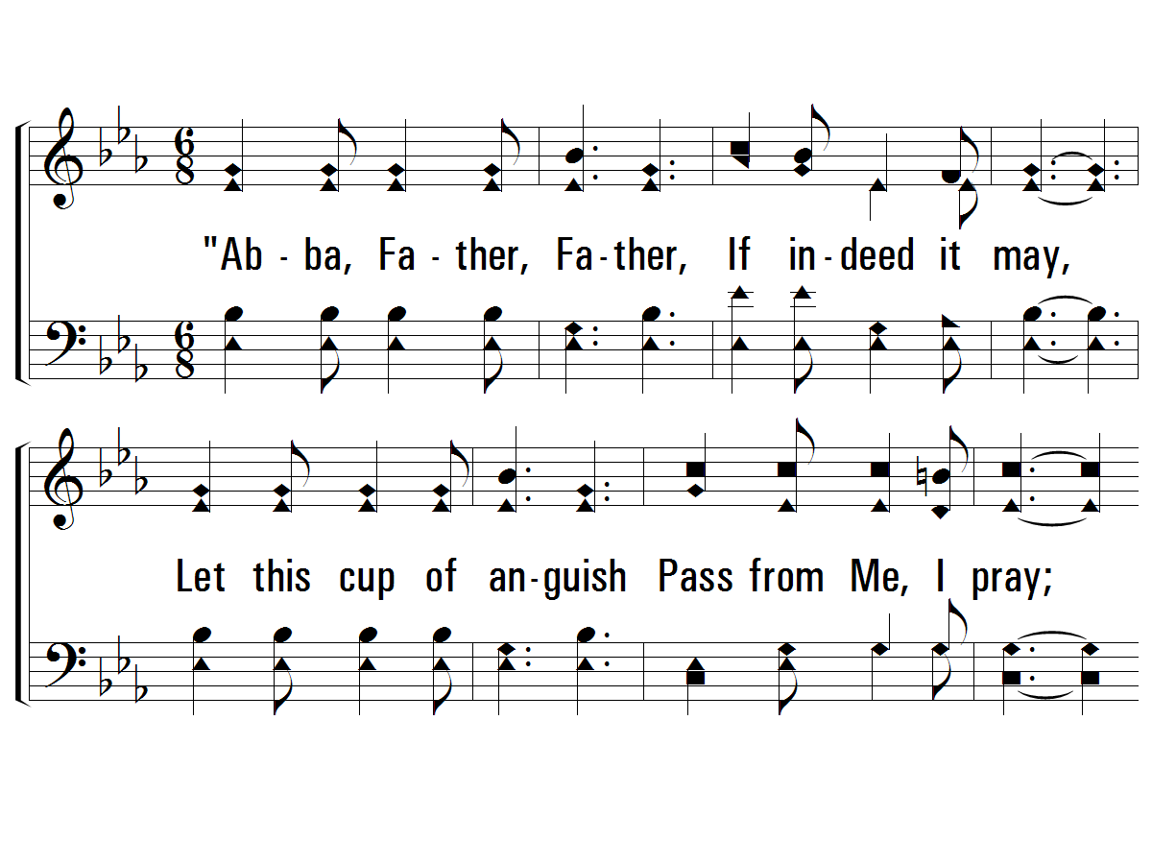
3 - Night, With Ebon Pinion
3.
"Abba, Father, Father,
If indeed it may,
Let this cup of anguish
Pass from Me, I pray;
Yet, if it must be suffered,
By Me, Thine only Son,
Abba, Father, Father,
Let Thy will be done."
Communion leader come forward
Words: Love H. Jameson
Music: Joseph P. Powell
© 2007 The Paperless Hymnal®

Slide 59
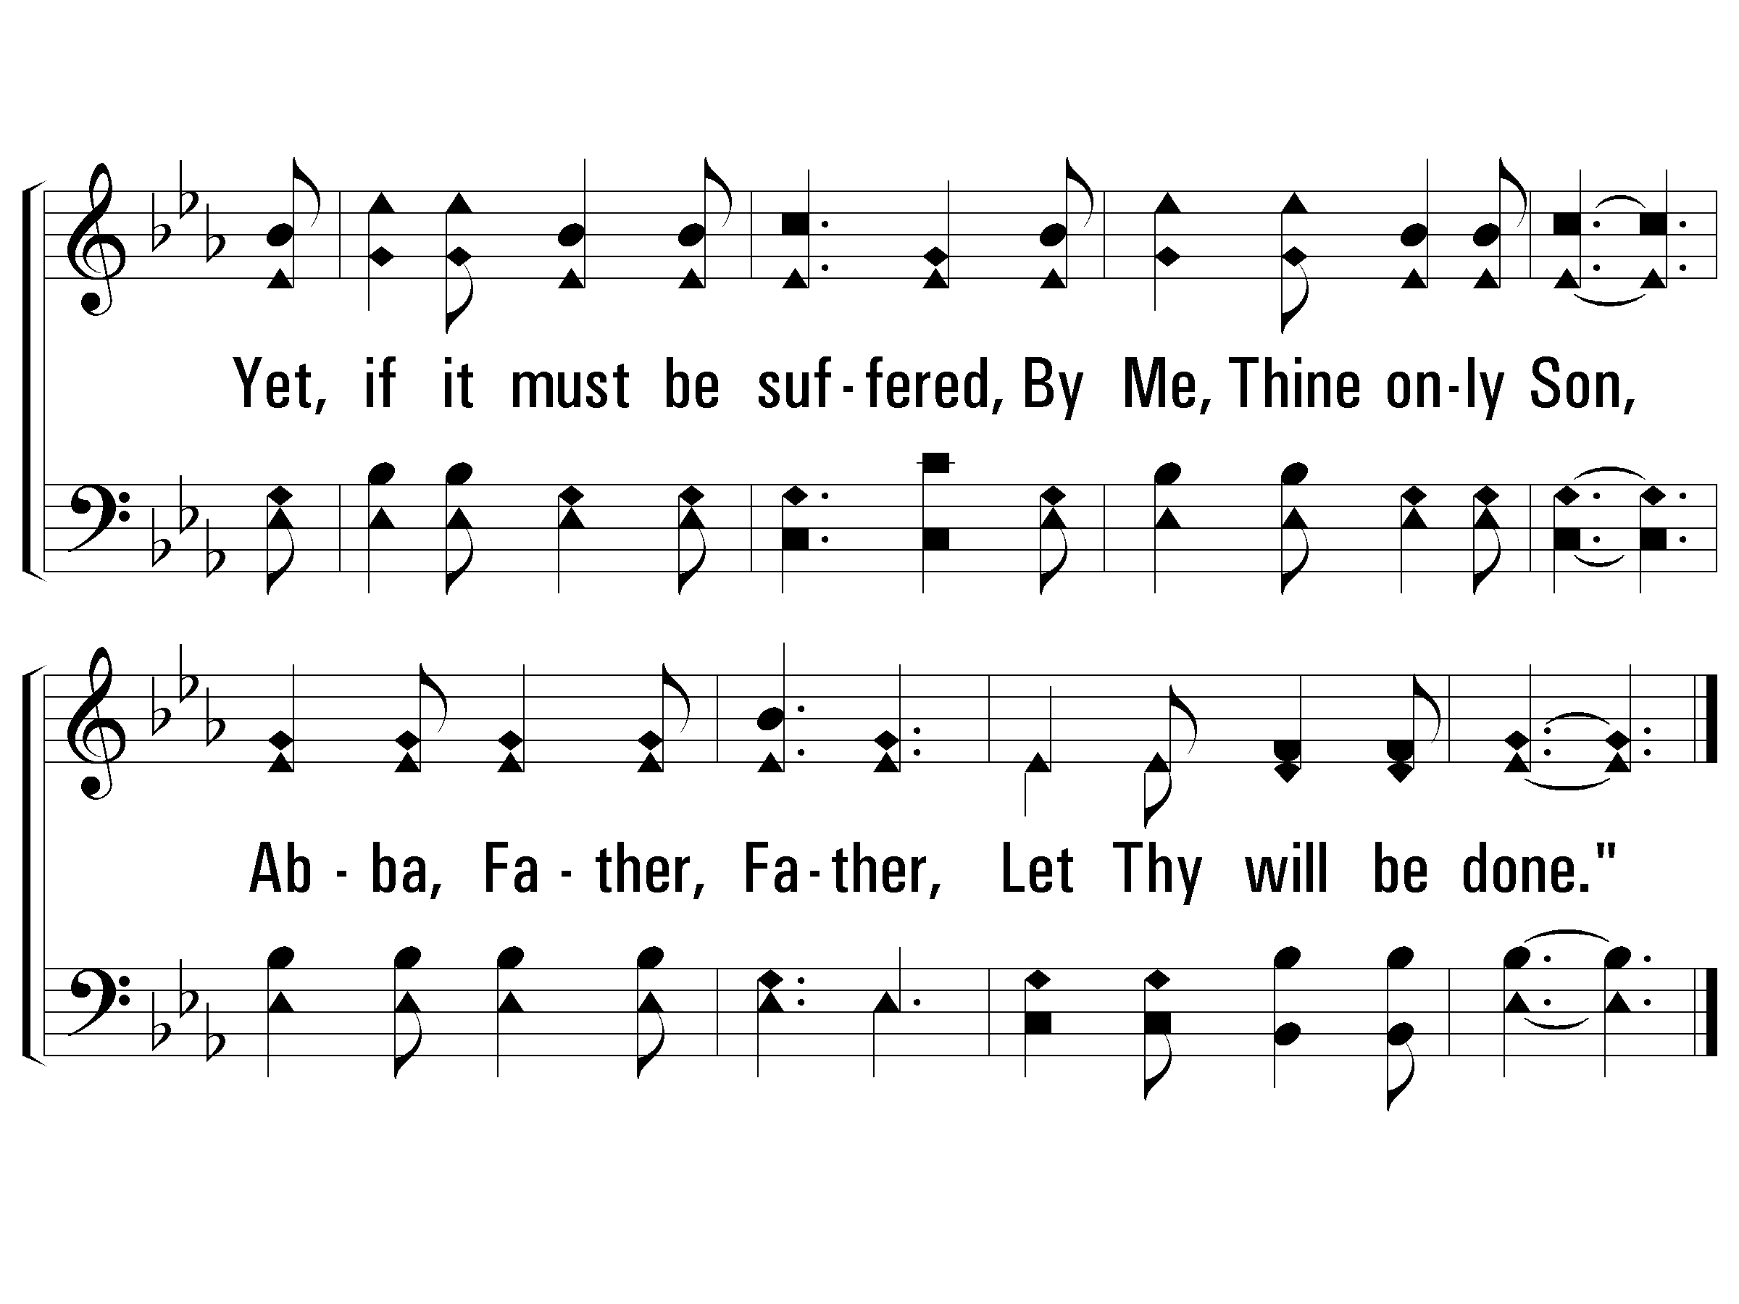
3 - Night, With Ebon Pinion
© 2007 The Paperless Hymnal®

Slide 60
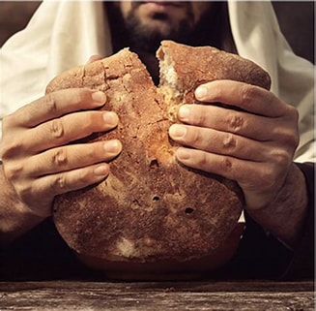


The Lords Supper

Slide 61

OFFERING
WORSHIP THROUGH GIVING

Slide 62

CHILDRENS WORSHIP
ALL CHILDREN ARE INVITED TO COME UP AND PARTICIPATE
-
BIBLE HOUR IMMEDIATELY AFTER WITH NURSURY AVAILIBLE
Our Offerings Support
The Southern Christian Children's Home
In Morrilton, Arkansas

Slide 63

Romans 6:3-4

Slide 64
Romans 6:3-4
3 Or do you not know that all of us who have been baptized into Christ Jesus have been baptized into His death? 4 Therefore we have been buried with Him through baptism into death, so that, just as Christ was raised from the dead through the glory of the Father, so we too may walk in newness of life.

Slide 65

What…died?

Slide 66
Romans 6:3-4
3 Or do you not know that all of us who have been baptized into Christ Jesus have been baptized into His death? 4 Therefore we have been buried with Him through baptism into death, so that, just as Christ was raised from the dead through the glory of the Father, so we too may walk in newness of life.

Slide 67
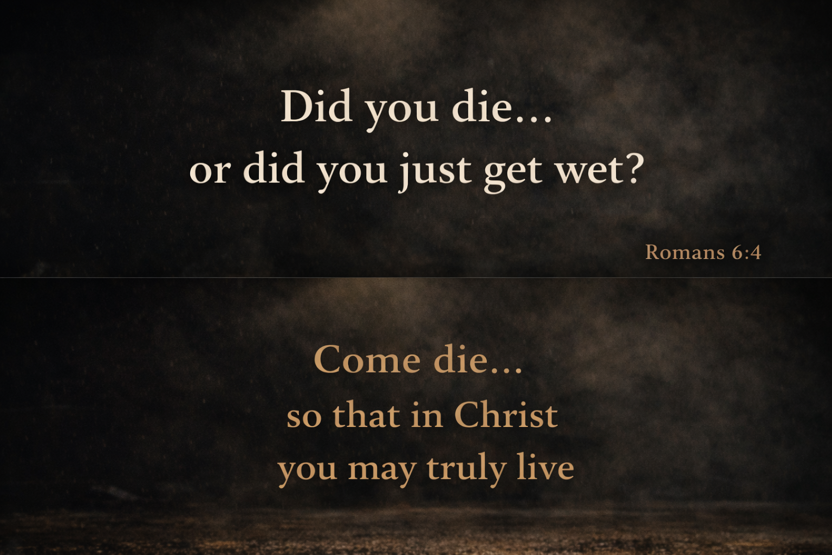

Slide 69

Invitation
There’s A Great Day Coming
If you are interested in Bible study, prayer, or being baptized, please contact us at the Poteau Church of Christ @ (918) 647-4873. If you call and no answer, please leave a message and someone will get back to you asap.

Slide 70
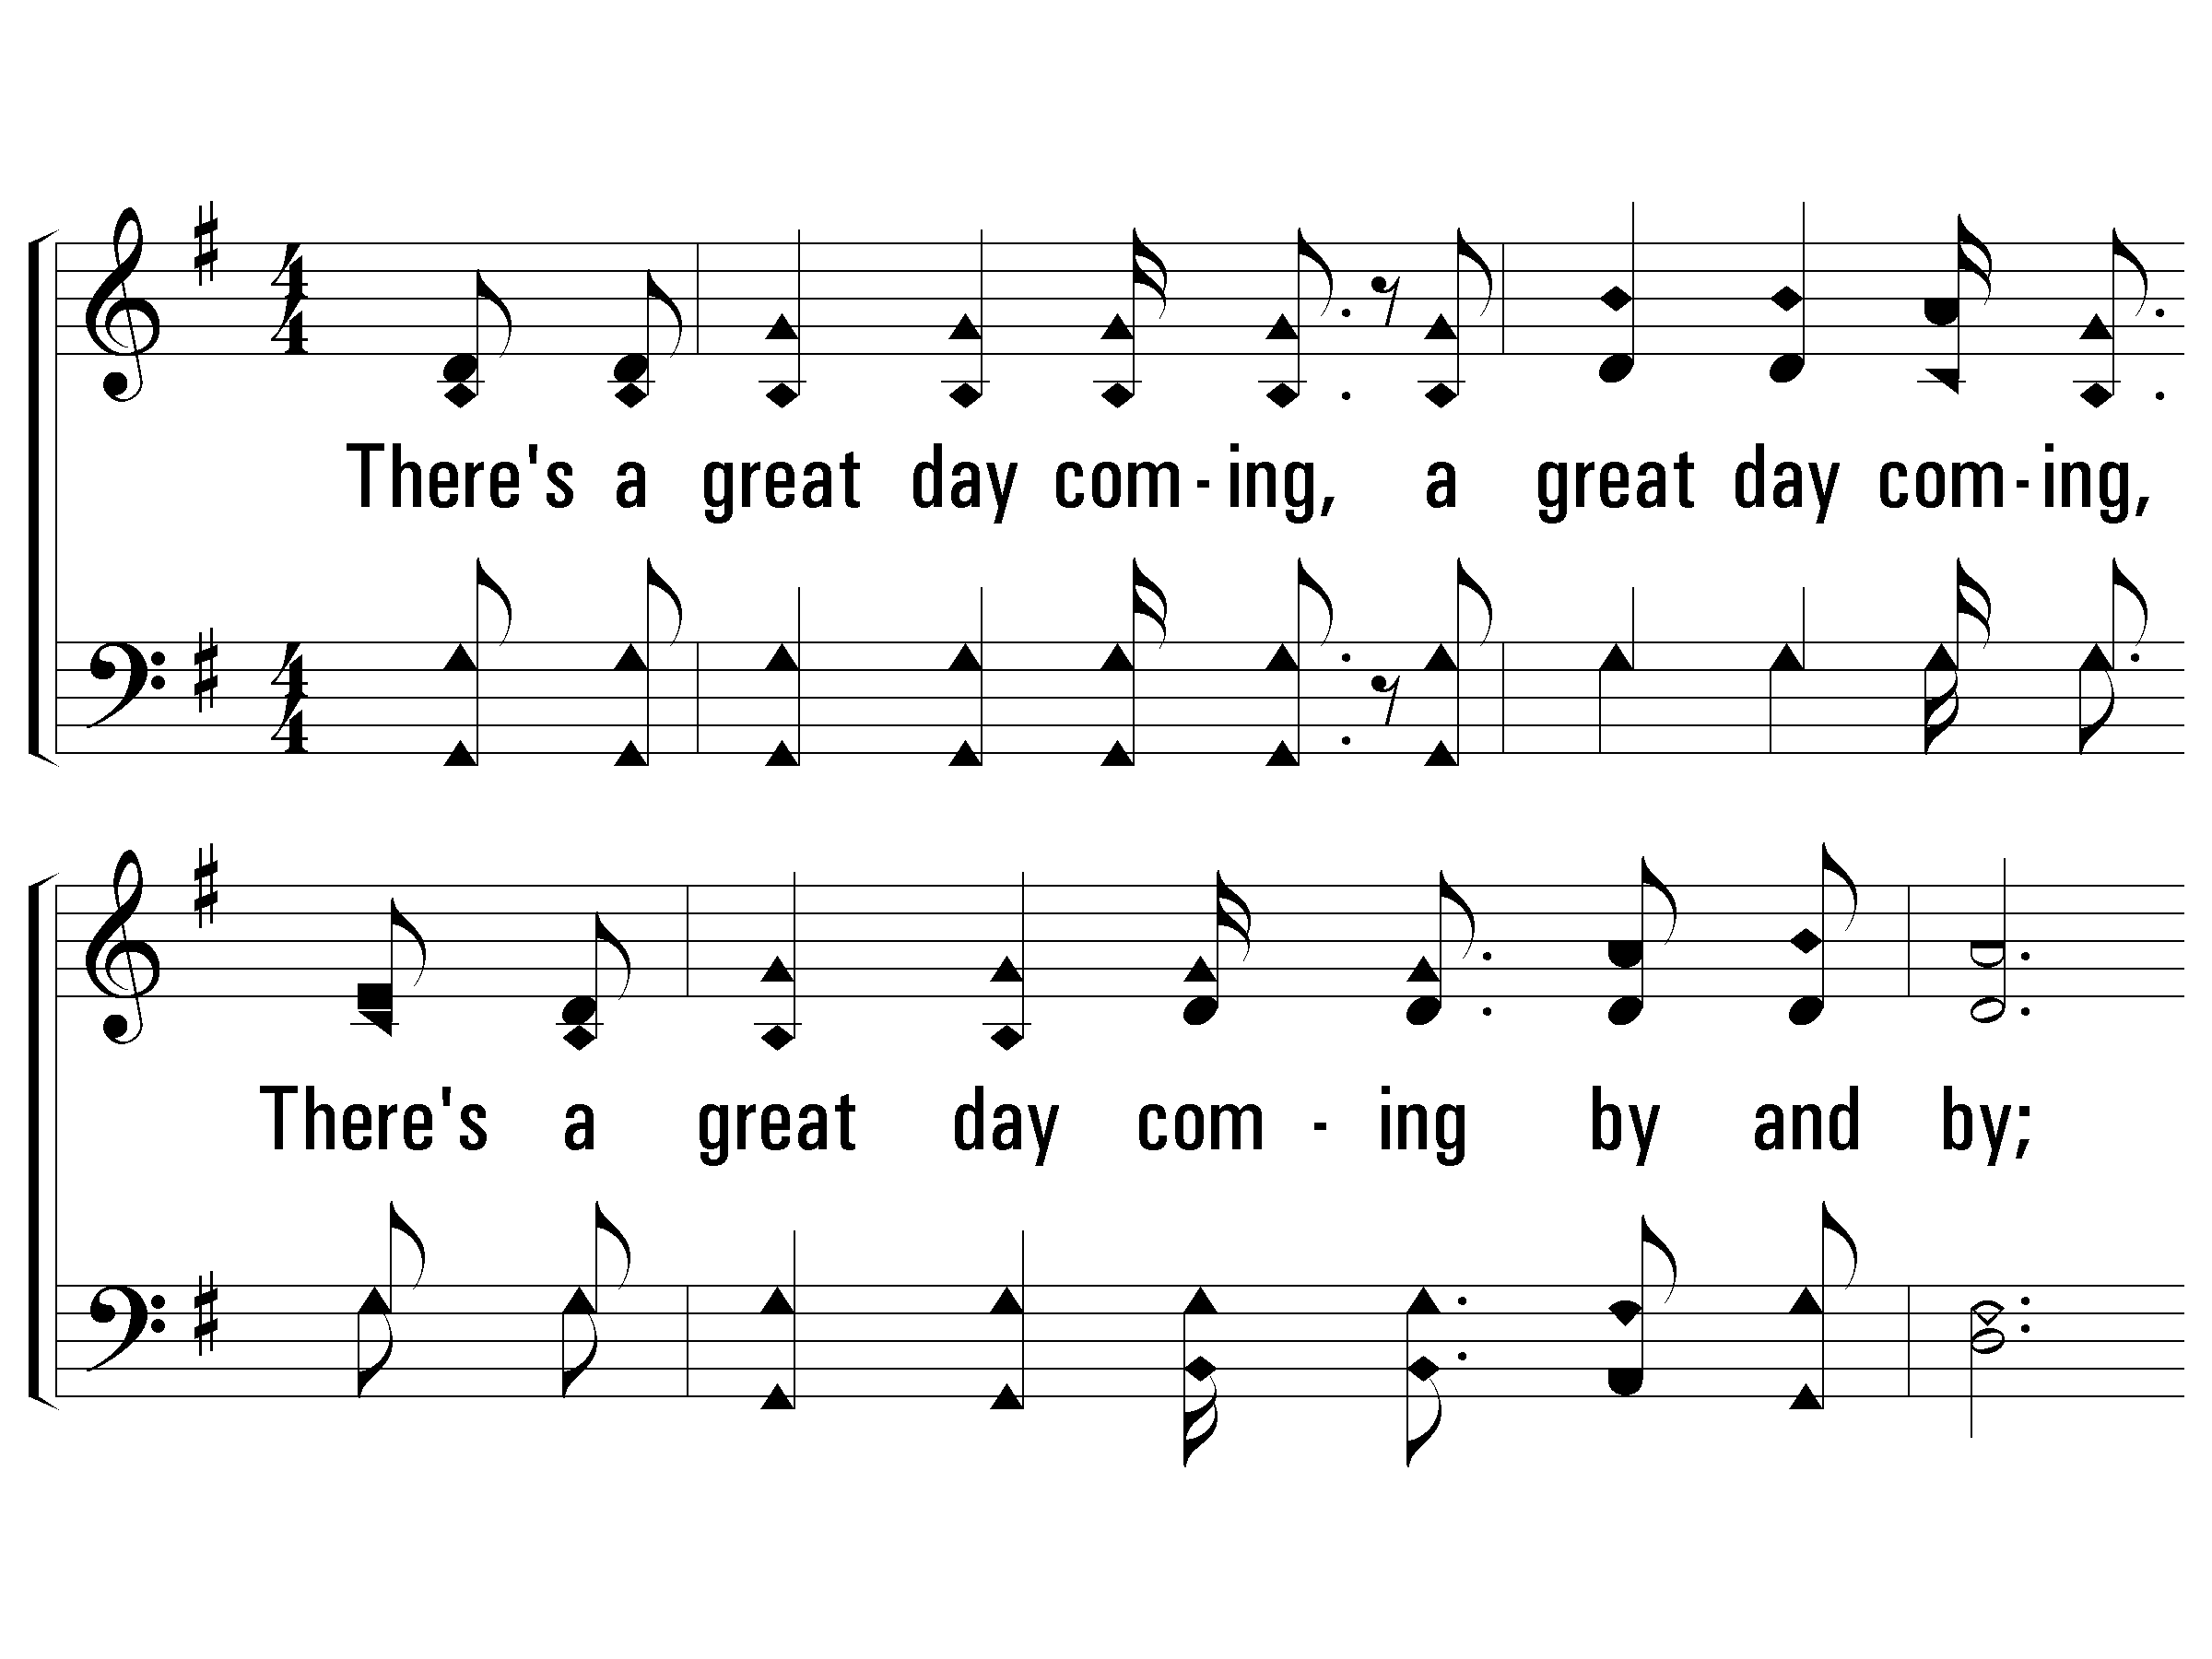
1 - There’s a Great Day Coming
1.
There's a great day coming, a great day coming,
There's a great day coming by and by;
When the saints and the sinners shall be parted right and left,
Are you ready for that day to come?
Words & Music: Will L. Thompson
© 2007 The Paperless Hymnal®

Slide 71
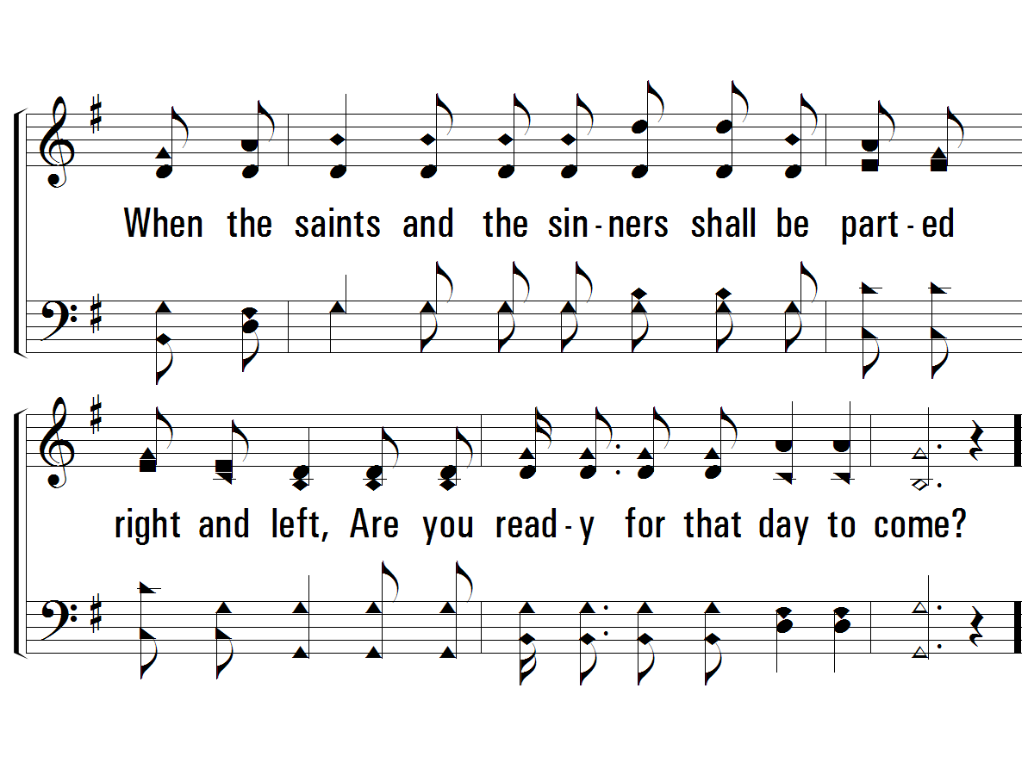
1 - There’s a Great Day Coming
© 2007 The Paperless Hymnal®

Slide 72
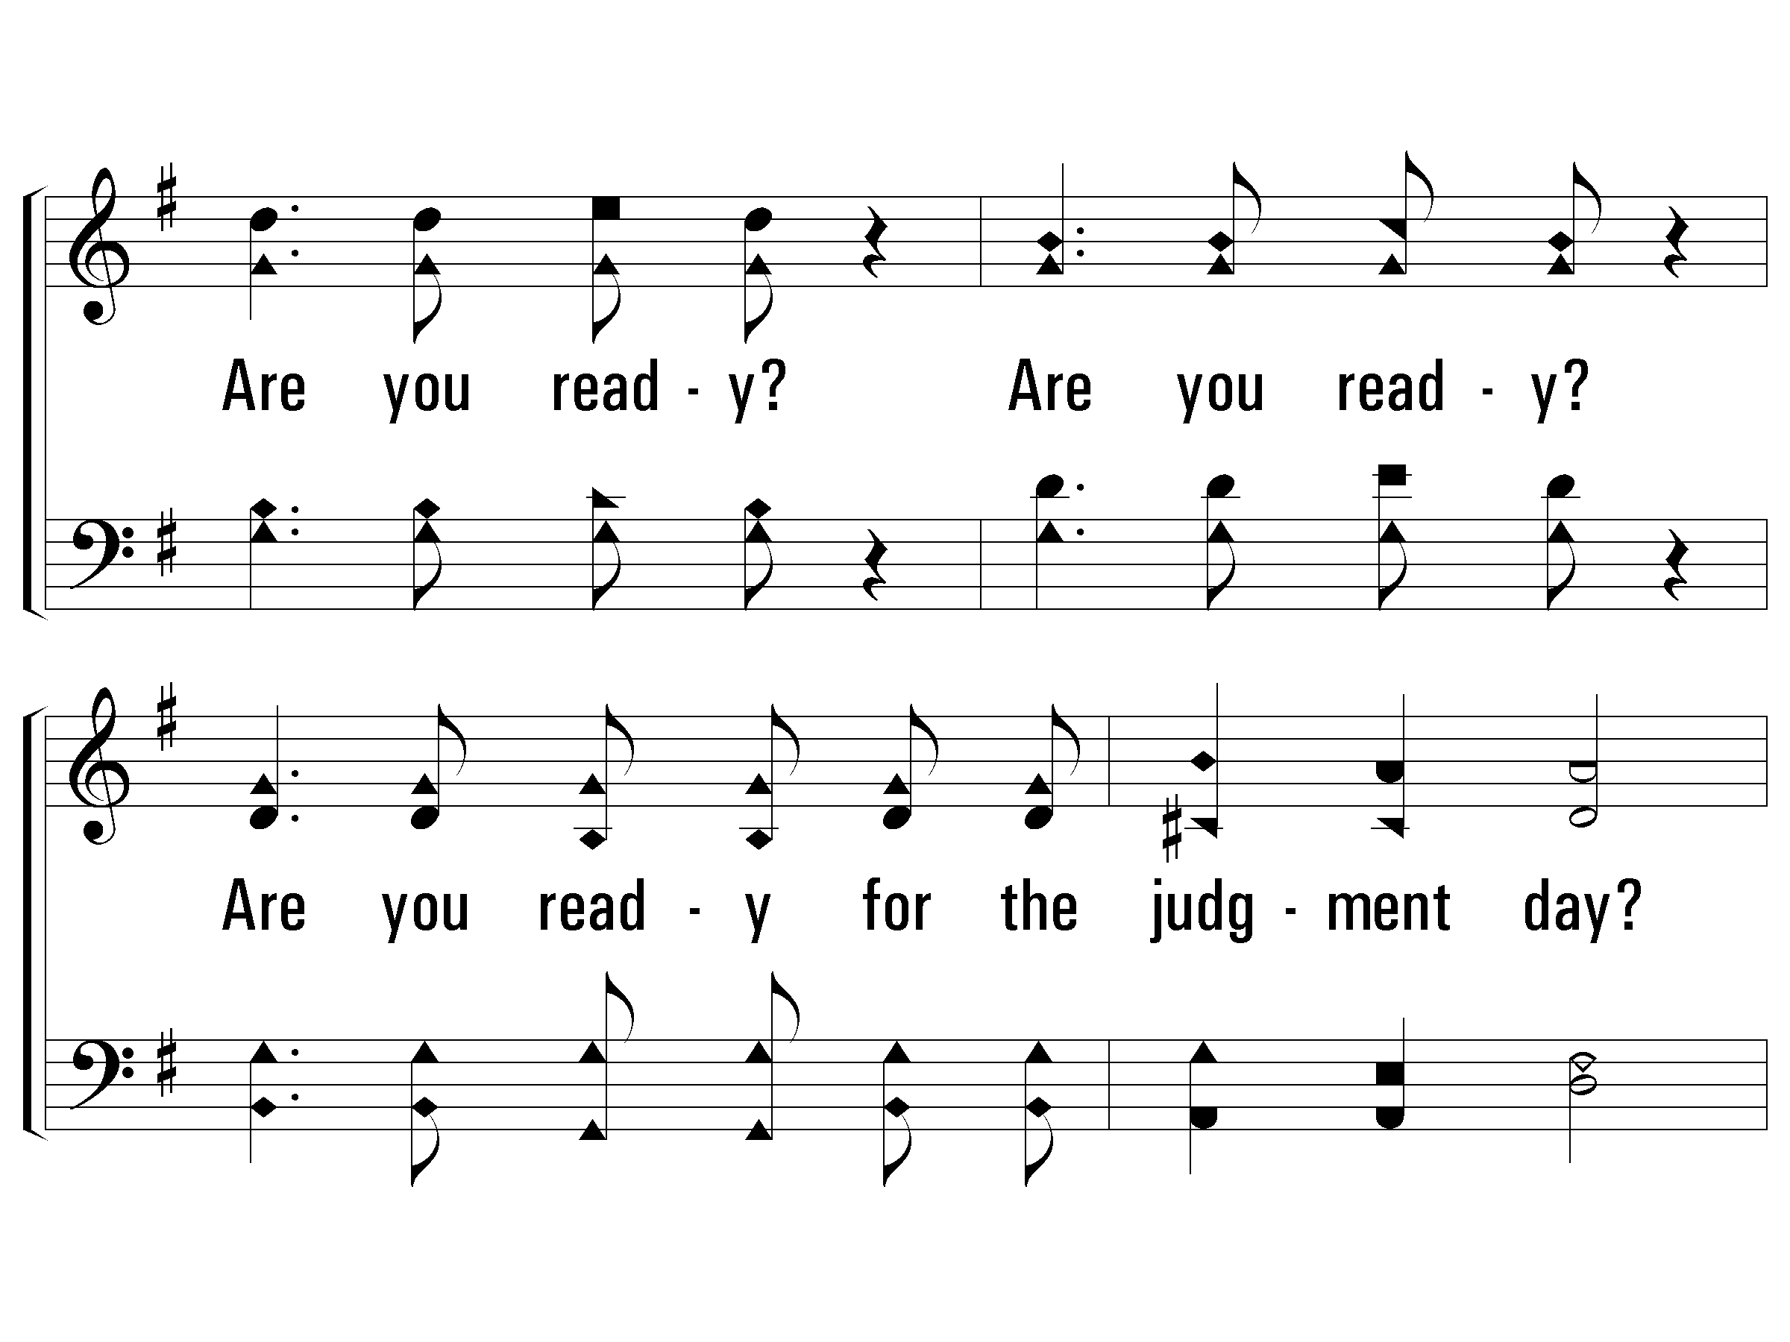
c - There’s a Great Day Coming
Are you ready? Are you ready?
Are you ready for the judgment day?
Are you ready? Are you ready for the judgment day?
© 2007 The Paperless Hymnal®

Slide 73
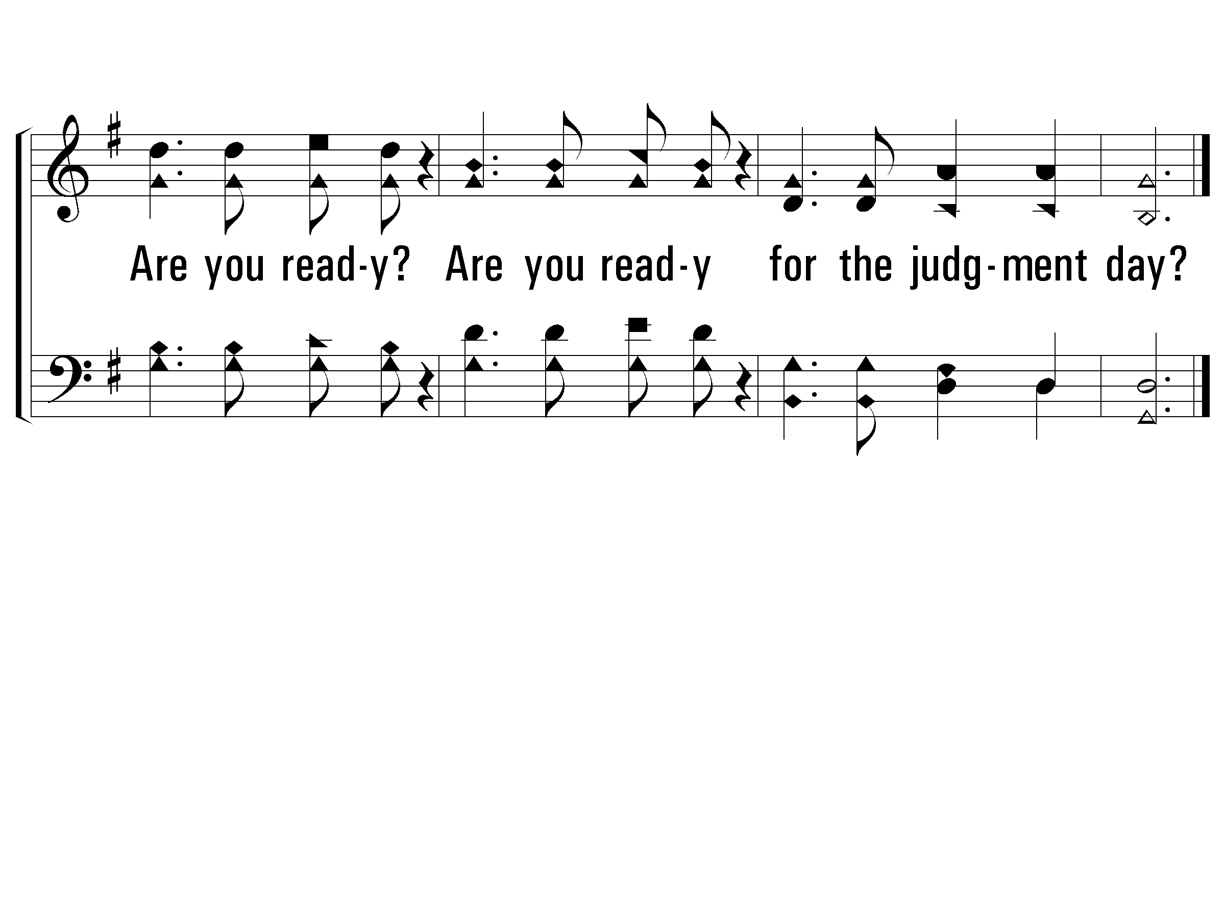
c - There’s a Great Day Coming
© 2007 The Paperless Hymnal®

Slide 74
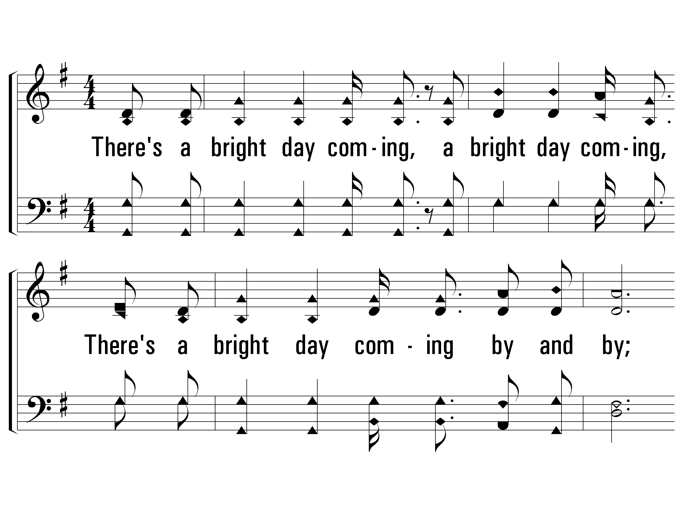
2 - There’s a Great Day Coming
2.
There's a bright day coming, a bright day coming,
There's a bright day coming by and by;
But its brightness shall only come to them that love the Lord,
Are you ready for that day to come?
Words & Music: Will L. Thompson
© 2007 The Paperless Hymnal®

Slide 75
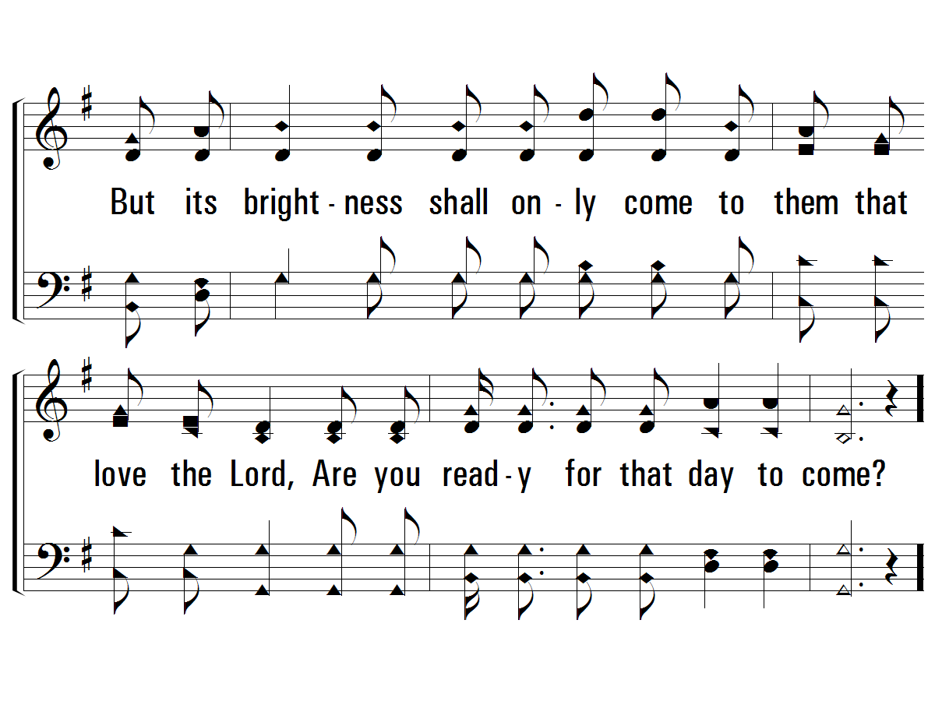
2 - There’s a Great Day Coming
© 2007 The Paperless Hymnal®

Slide 76
c - There’s a Great Day Coming
Are you ready? Are you ready?
Are you ready for the judgment day?
Are you ready? Are you ready for the judgment day?
© 2007 The Paperless Hymnal®

Slide 77
c - There’s a Great Day Coming
© 2007 The Paperless Hymnal®

Slide 78
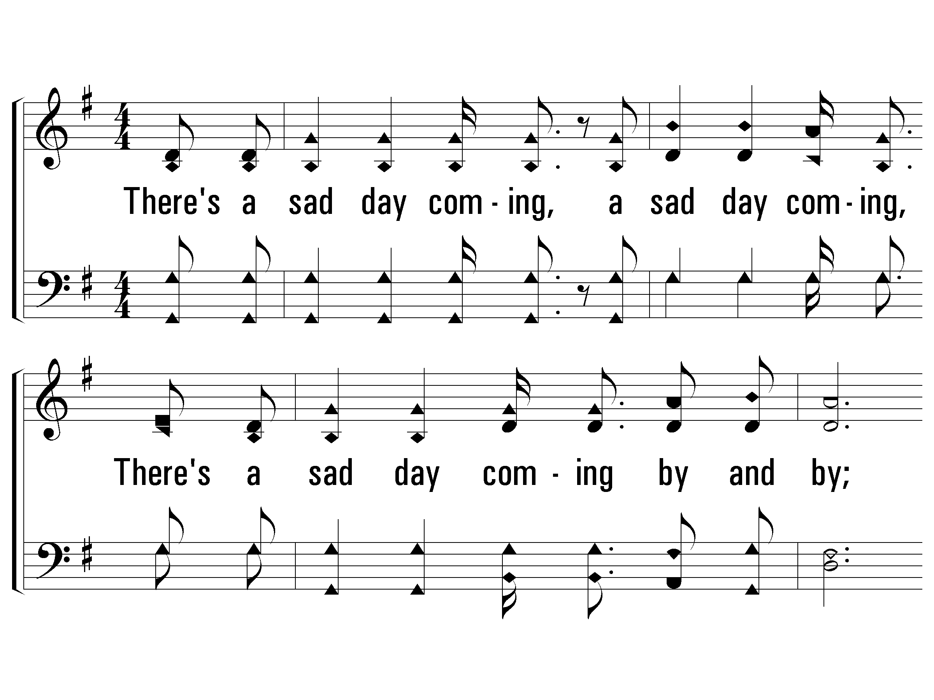
3 - There’s a Great Day Coming
3.
There's a sad day coming, a sad day coming,
There's a sad day coming by and by;
When the sinner shall hear his doom,
"Depart, I know ye not,"
Are you ready for that day to come?
Words & Music: Will L. Thompson
© 2007 The Paperless Hymnal®

Slide 79
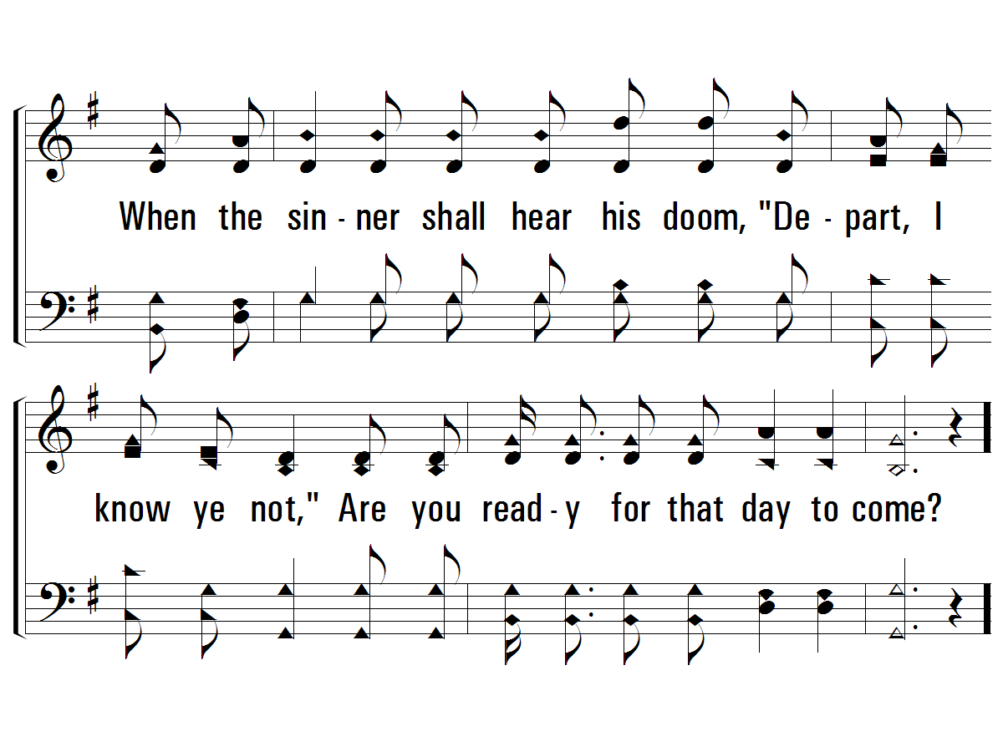
3 - There’s a Great Day Coming
© 2007 The Paperless Hymnal®

Slide 80
c - There’s a Great Day Coming
Are you ready? Are you ready?
Are you ready for the judgment day?
Are you ready? Are you ready for the judgment day?
© 2007 The Paperless Hymnal®

Slide 81
c - There’s a Great Day Coming
© 2007 The Paperless Hymnal®

Slide 82
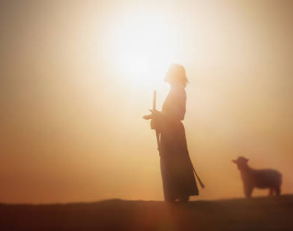
Under-Shepherds’ Prayer
1 Peter 5:1-4
1 Therefore, I urge elders among you, as your fellow elder and a witness of the sufferings of Christ, and one who is also a fellow partaker of the glory that is to be revealed: 2 shepherd the flock of God among you, exercising oversight, not under compulsion but voluntarily, according to the will of God; and not with greed but with eagerness; 3 nor yet as domineering over those assigned to your care, but by proving to be examples to the flock. 4 And when the Chief Shepherd appears, you will receive the unfading crown of glory.

Slide 83

1 - We Shall See the King Some Day
1.
Though the way we journey may be often drear,
We shall see the King some day,
On that blessed morning clouds will disappear:
We shall see the King some day.
Words & Music: Lewis E. Jones
© 2006 The Paperless Hymnal®

Slide 84

1 - We Shall See the King Some Day
© 2006 The Paperless Hymnal®

Slide 85

c - We Shall See the King Some Day
We shall see the King some day,
We will shout and sing some day;
Gathered round the throne, when He shall call His own,
We shall see the King some day.
© 2006 The Paperless Hymnal®

Slide 86

c - We Shall See the King Some Day
© 2006 The Paperless Hymnal®

Slide 87

2 - We Shall See the King Some Day
2.
After pain and anguish, after toil and care,
We shall see the King some day,
Through the endless ages joy and blessing share:
We shall see the King some day.
Words & Music: Lewis E. Jones
© 2006 The Paperless Hymnal®

Slide 88

2 - We Shall See the King Some Day
© 2006 The Paperless Hymnal®

Slide 89
c - We Shall See the King Some Day
We shall see the King some day,
We will shout and sing some day;
Gathered round the throne, when He shall call His own,
We shall see the King some day.
© 2006 The Paperless Hymnal®

Slide 90
c - We Shall See the King Some Day
© 2006 The Paperless Hymnal®

Slide 91

3 - We Shall See the King Some Day
3.
After foes are conquered, after battles won,
We shall see the King some day,
After strife is over, after set of sun,
We shall see the King some day.
Words & Music: Lewis E. Jones
© 2006 The Paperless Hymnal®

Slide 92

3 - We Shall See the King Some Day
© 2006 The Paperless Hymnal®

Slide 93
c - We Shall See the King Some Day
We shall see the King some day,
We will shout and sing some day;
Gathered round the throne, when He shall call His own,
We shall see the King some day.
© 2006 The Paperless Hymnal®

Slide 94
c - We Shall See the King Some Day
© 2006 The Paperless Hymnal®

Slide 95

4 - We Shall See the King Some Day
4.
There with all the loved ones who have gone before,
We shall see the King some day,
Sorrow past for ever, on that peaceful shore,
We shall see the King some day.
Words & Music: Lewis E. Jones
© 2006 The Paperless Hymnal®

Slide 96

4 - We Shall See the King Some Day
© 2006 The Paperless Hymnal®

Slide 97
c - We Shall See the King Some Day
We shall see the King some day,
We will shout and sing some day;
Gathered round the throne, when He shall call His own,
We shall see the King some day.
© 2006 The Paperless Hymnal®

Slide 98
c - We Shall See the King Some Day
© 2006 The Paperless Hymnal®

Slide 99


LET
US
PRAY

Slide 100

BAPTISM

Slide 101

1-1 Mansion Over the Hilltop
Mansion Over the Hilltop
881

Slide 102

1-2 Mansion Over the Hilltop
Mansion Over the Hilltop
881

Slide 103

C-1 Mansion Over the Hilltop
Mansion Over the Hilltop
881

Slide 104

C-2 Mansion Over the Hilltop
Mansion Over the Hilltop
881

Slide 105

2-1 Mansion Over the Hilltop
Mansion Over the Hilltop
881

Slide 106

2-2 Mansion Over the Hilltop
Mansion Over the Hilltop
881

Slide 107
C-1 Mansion Over the Hilltop
Mansion Over the Hilltop
881

Slide 108
C-2 Mansion Over the Hilltop
Mansion Over the Hilltop
881

Slide 109

1-1 Walking in Sunlight
Walking In Sunlight
611

Slide 110

1-2 Walking in Sunlight
Walking In Sunlight
611

Slide 111

C-1 Walking in Sunlight
Walking In Sunlight
611

Slide 112

C-2 Walking in Sunlight
Walking In Sunlight
611

Slide 113

2-1 Walking in Sunlight
Walking In Sunlight
611

Slide 114

2-2 Walking in Sunlight
Walking In Sunlight
611

Slide 115
C-1 Walking in Sunlight
Walking In Sunlight
611

Slide 116
C-2 Walking in Sunlight
Walking In Sunlight
611

Slide 117

3-1 Walking in Sunlight
Walking In Sunlight
611

Slide 118

3-2 Walking in Sunlight
Walking In Sunlight
611

Slide 119
C-1 Walking in Sunlight
Walking In Sunlight
611

Slide 120
C-2 Walking in Sunlight
Walking In Sunlight
611

Slide 121

1-1 Sweet Are the Promises
Where He Leads I’ll Follow
417

Slide 122

1-2 Sweet Are the Promises
Where He Leads I’ll Follow
417

Slide 123

C-1 Sweet Are the Promises
Where He Leads I’ll Follow
417

Slide 124

C-2 Sweet Are the Promises
Where He Leads I’ll Follow
417

Slide 125

2-1 Sweet Are the Promises
Where He Leads I’ll Follow
417

Slide 126

2-2 Sweet Are the Promises
Where He Leads I’ll Follow
417

Slide 127
C-1 Sweet Are the Promises
Where He Leads I’ll Follow
417

Slide 128
C-2 Sweet Are the Promises
Where He Leads I’ll Follow
417

Slide 129

3-1 Sweet Are the Promises
Where He Leads I’ll Follow
417

Slide 130

3-2 Sweet Are the Promises
Where He Leads I’ll Follow
417

Slide 131
C-1 Sweet Are the Promises
Where He Leads I’ll Follow
417

Slide 132
C-2 Sweet Are the Promises
Where He Leads I’ll Follow
417

