Slide 1
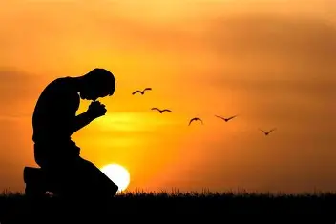
When Prayers are Not Heard
“When the Answer is No”

Slide 2
Psalm 22:27-28
²⁷ All the ends of the earth will remember and turn to the Lord, And all the families of the nations will worship before You. ²⁸ For the kingdom is the Lord’s And He rules over the nations.

Slide 3
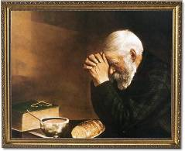
When Prayers are Not Heard

Slide 4
Remember to Praise God
Matthew 6:9 (NASB)
The Lord’s Prayer
⁹ “Pray, then, in this way: ‘Our Father, who is in heaven, Hallowed be Your name.

Slide 5
Remember God is Faithful
1 Corinthians 1:9 (NASB)
⁹ God is faithful, through whom you were called into fellowship with His Son, Jesus Christ our Lord.

Slide 6
Remember God is Faithful
God has always been and will always be loyal to His people.
It would be contrary to His nature to fail to keep His word.
God will always be with us and never betray His promises to us.

Slide 7
God is Holy
Joshua 24:19 (NASB)
¹⁹ Then Joshua said to the people, “You will not be able to serve the Lord, for He is a holy God. He is a jealous God; He will not forgive your wrongdoing or your sins.

Slide 8
God is Holy
God is pure and free from evil.
He will never mistreat anyone especially His own children.
If saying “Yes” goes against His righteous nature or His holy will, He will say “No”.

Slide 9
Put Your Trust in God
Proverbs 3:5-6 (NASB)
⁵ Trust in the Lord with all your heart And do not lean on your own understanding. ⁶ In all your ways acknowledge Him, And He will make your paths straight.

Slide 10
Put Your Trust in God
When we are in the time of trial, let us trust God to work out our situation according to His will.
His plan is far greater than ours and He sees the results of His actions.
When God says “No” to us, let us recognize that He is working through us to accomplish His plan.

Slide 11
Why “No”?
You may need to work on yourself.
You ask a-miss.
God has other plans for you.
God may need you elsewhere.

Slide 12

Remember:
God Said, “No” to His Son

