Slide 1

Qualities Identifying Us as a New Creation

Slide 2
2 Corinthians 5:17
¹⁷ Therefore if anyone is in Christ, this person is a new creation; the old things passed away; behold, new things have come.

Slide 3
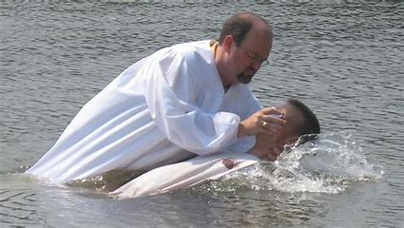
Qualities of a
New Creation

Slide 4
We Are “NEW”
Romans 6:4 (NASB)
⁴ Therefore we have been buried with Him through baptism into death, so that, just as Christ was raised from the dead through the glory of the Father, so we too may walk in newness of life.

Slide 5
Qualities of a New Creation
Ephesians 4:22-23 (NASB)
²² that, in reference to your former way of life, you are to rid yourselves of the old self, which is being corrupted in accordance with the lusts of deceit, ²³ and that you are to be renewed in the spirit of your minds,
Become Christ-Centered

Slide 6
Qualities of a New Creation
Ephesians 4:21 (NASB)
²¹ if indeed you have heard Him and have been taught in Him, just as truth is in Jesus,
Stand Firm in the Truth

Slide 7
Qualities of a New Creation
Revelation 2:2 (NASB)
² ‘I know your deeds and your labor and perseverance, and that you cannot tolerate evil people, and you have put those who call themselves apostles to the test, and they are not, and you found them to be false;
Reject False Teaching

Slide 8
Qualities of a New Creation
1 Corinthians 10:13 (NASB)
¹³ No temptation has overtaken you except something common to mankind; and God is faithful, so He will not allow you to be tempted beyond what you are able, but with the temptation will provide the way of escape also, so that you will be able to endure it.
Reject Temptation

Slide 9
Qualities of a New Creation
Romans 12:2 (NASB)
² And do not be conformed to this world, but be transformed by the renewing of your mind, so that you may prove what the will of God is, that which is good and acceptable and perfect.
Focus on Good

Slide 10
Qualities of a New Creation
1 John 1:7 (NASB)
⁷ but if we walk in the Light as He Himself is in the Light, we have fellowship with one another, and the blood of Jesus His Son cleanses us from all sin.
Walk in Fellowship with God

Slide 11
Qualities of a New Creation
1 Corinthians 6:11 (NASB)
¹¹ Such were some of you; but you were washed, but you were sanctified, but you were justified in the name of the Lord Jesus Christ and in the Spirit of our God.
You Have Changed

Slide 12
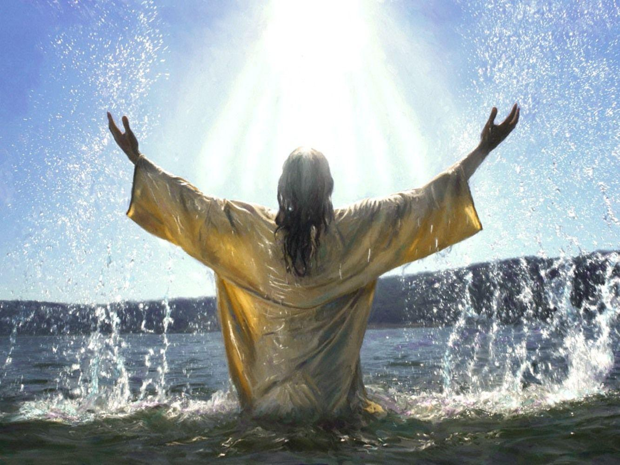
Matthew 3:15
¹⁵ But Jesus, answering, said to him, “Allow it at this time; for in this way it is fitting for us to fulfill all righteousness.” Then he *allowed Him.

