Slide 1
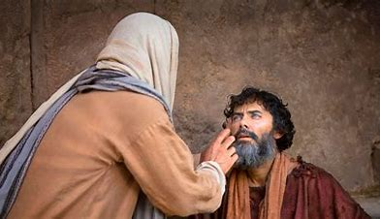
Miraculous Gifts
And the Church Today

Slide 2
1 Corinthians 13:8-10
⁸ Love never fails; but if there are gifts of prophecy, they will be done away with; if there are tongues, they will cease; if there is knowledge, it will be done away with. ⁹ For we know in part and prophesy in part; ¹⁰ but when the perfect comes, the partial will be done away with.

Slide 3
Purpose
For Miraculous
Gifts

Slide 4
Purpose for the Gifts
John 3:2 (NASB)
² this man came to Jesus at night and said to Him, “Rabbi, we know that You have come from God as a teacher; for no one can do these signs that You do unless God is with him.”

Slide 5
Purpose for the Gifts
2 Corinthians 12:12 (NASB)
¹² The distinguishing marks of a true apostle were performed among you with all perseverance, by signs, wonders, and miracles.

Slide 6
Miraculous Sings
Acts 3:8 (NASB)
⁸ And leaping up, he stood and began to walk; and he entered the temple with them, walking and leaping and praising God.

Slide 7
Those Signs Are Gone
1 Corinthians 13:8 (NASB)
⁸ Love never fails; but if there are gifts of prophecy, they will be done away with; if there are tongues, they will cease; if there is knowledge, it will be done away with.

Slide 8
When the Perfect Has Come
1 Corinthians 13:9-10 (NASB)
⁹ For we know in part and prophesy in part; ¹⁰ but when the perfect comes, the partial will be done away with.

Slide 9

What Do We Have Today?

Slide 10
God Answers Prayer
John 14:13-14 (NASB)
¹³ And whatever you ask in My name, this I will do, so that the Father may be glorified in the Son. ¹⁴ If you ask Me anything in My name, I will do it.

Slide 11
Righteous Prayer
James 5:16 (NASB)
¹⁶ Therefore, confess your sins to one another, and pray for one another so that you may be healed. A prayer of a righteous person, when it is brought about, can accomplish much.

Slide 12
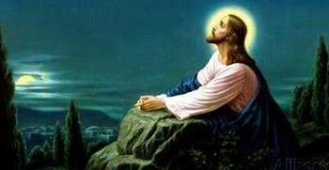
Open Your Eyes
Then You Will See

