Slide 1
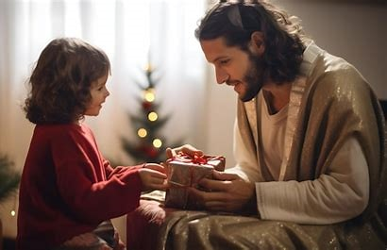
What
Now

Slide 2
John 3:16-17
¹⁶ “For God so loved the world, that He gave His only Son, so that everyone who believes in Him will not perish but have eternal life. ¹⁷ For God did not send the Son into the world to judge the world, but so that the world might be saved through Him.

Slide 3
Using the Gifts
We Have
Received

Slide 4
Gifts We Have Received
Ephesians 4:11 (NASB)
¹¹ And He gave some as apostles, some as prophets, some as evangelists, some as pastors and teachers,
We Have Each Other

Slide 5
Gifts We Have Received
Romans 5:8 (NASB)
⁸ But God demonstrates His own love toward us, in that while we were still sinners, Christ died for us.

Slide 6
Gifts We Have Received
John 17:3 (NASB)
³ And this is eternal life, that they may know You, the only true God, and Jesus Christ whom You have sent.

Slide 7
Using Our Gifts
Matthew 22:37-39 (NASB)
³⁷ And He said to him, “‘You shall love the Lord your God with all your heart, and with all your soul, and with all your mind.’ ³⁸ This is the great and foremost commandment. ³⁹ The second is like it, ‘You shall love your neighbor as yourself.’

Slide 8
How We Love God
John 14:15 (NASB) - ¹⁵ “If you love Me, you will keep My commandments.
Acts 22:16 (NKJV) - ¹⁶ And now why are you waiting? Arise and be baptized, and wash away your sins, calling on the name of the Lord.’

Slide 9
Love Each Other
Matthew 25:35 (NASB)
³⁵ For I was hungry, and you gave Me something to eat; I was thirsty, and you gave Me something to drink; I was a stranger, and you invited Me in;

Slide 10
Love Each Other
Mark 16:15-16 (NASB)
¹⁵ And He said to them, “Go into all the world and preach the gospel to all creation. ¹⁶ The one who has believed and has been baptized will be saved; but the one who has not believed will be condemned.

Slide 11
Love Each Other
John 15:13 (NASB)
¹³ Greater love has no one than this, that a person will lay down his life for his friends.

Slide 12

Romans 13:14
¹⁴ But put on the Lord Jesus Christ,…

