Slide 1

Walk Worthy of Your Calling

Slide 2
Matthew 5:14-16
¹⁴ “You are the light of the world. A city set on a hill cannot be hidden; ¹⁵ nor do people light a lamp and put it under a basket, but on the lampstand, and it gives light to all who are in the house.

Slide 3
Matthew 5:14-16
¹⁶ Your light must shine before people in such a way that they may see your good works and glorify your Father who is in heaven.

Slide 4
Five Qualities of the Worthy Walk
Ephesians 4:2, 3

Slide 5
Humility
Ephesians 4:2-3 (NASB)
² with all humility and gentleness, with patience, bearing with one another in love, ³ being diligent to keep the unity of the Spirit in the bond of peace.

Slide 6
Gentleness
Ephesians 4:2-3 (NASB)
² with all humility and gentleness, with patience, bearing with one another in love, ³ being diligent to keep the unity of the Spirit in the bond of peace.

Slide 7
Patience
Ephesians 4:2-3 (NASB)
² with all humility and gentleness, with patience, bearing with one another in love, ³ being diligent to keep the unity of the Spirit in the bond of peace.

Slide 8
Tolerance
Ephesians 4:2-3 (NASB)
² with all humility and gentleness, with patience, bearing with one another in love, ³ being diligent to keep the unity of the Spirit in the bond of peace.

Slide 9
Unity of the Spirit
Ephesians 4:2-3 (NASB)
² with all humility and gentleness, with patience, bearing with one another in love, ³ being diligent to keep the unity of the Spirit in the bond of peace.

Slide 10
Be Attitudes
Matthew 5:3-12 (NASB)
³ “Blessed are the poor in spirit, for theirs is the kingdom of heaven. ⁴ “Blessed are those who mourn, for they will be comforted. ⁵ “Blessed are the gentle, for they will inherit the earth.

Slide 11
Be Attitudes
⁶ “Blessed are those who hunger and thirst for righteousness, for they will be satisfied. ⁷ “Blessed are the merciful, for they will receive mercy. ⁸ “Blessed are the pure in heart, for they will see God. ⁹ “Blessed are the peacemakers, for they will be called sons of God. ¹⁰ “Blessed are those who have been persecuted for the sake of righteousness, for theirs is the kingdom of heaven.

Slide 12
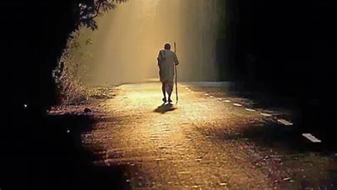
¹¹ “Blessed are you when people insult you and persecute you and falsely say all kinds of evil against you because of Me.
¹² Rejoice and be glad, for your reward in heaven is great; for in this same way they persecuted the prophets who were before you.

