Slide 1

The Compassion of God
Ephesians 2:4-10

Slide 2
Ephesians 2:4-5
⁴ But God, being rich in mercy, because of His great love with which He loved us, ⁵ even when we were dead in our wrongdoings, made us alive together with Christ (by grace you have been saved),

Slide 3
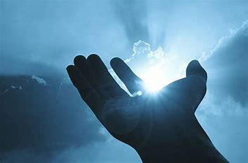
John 3:16 (NASB)
¹⁶ “For God so loved the world, that He gave His only Son, so that everyone who believes in Him will not perish but have eternal life.

Slide 4
Not God’s Will
2 Peter 3:9 (NASB)
⁹ The Lord is not slow about His promise, as some count slowness, but is patient toward you, not willing for any to perish, but for all to come to repentance.

Slide 5
All Have Sinned
Romans 3:23 (NASB)
²³ for all have sinned and fall short of the glory of God,

Slide 6
Wages of Sin
Romans 6:23 (NASB)
²³ For the wages of sin is death, but the gracious gift of God is eternal life in Christ Jesus our Lord.

Slide 7
God – Rich in Mercy
Ephesians 2:4 (NASB)
⁴ But God, being rich in mercy, because of His great love with which He loved us,

Slide 8
God – Loves Us
Ephesians 2:4 (NASB)
⁴ But God, being rich in mercy, because of His great love with which He loved us,

Slide 9
God – Made Us Alive
Ephesians 2:5 (NASB)
⁵ even when we were dead in our wrongdoings, made us alive together with Christ (by grace you have been saved),

Slide 10
God – Saved Us
Ephesians 2:8 (NASB)
⁸ For by grace you have been saved through faith; and this is not of yourselves it is the gift of God;

Slide 11
Not Us – But God
Ephesians 2:9-10 (NASB)
⁹ not a result of works, so that no one may boast. ¹⁰ For we are His workmanship, created in Christ Jesus for good works, which God prepared beforehand so that we would walk in them.

Slide 12
Romans 6:23
²³ . . . gift of God is eternal life in Christ Jesus our Lord.

