Slide 1
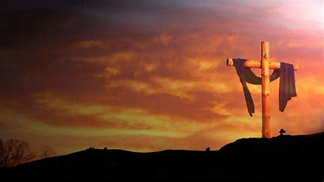
The
Cross

Slide 2
Ephesians 2:1-3
2 And you were dead in your offenses and sins, ² in which you previously walked according to the course of this world, according to the prince of the power of the air, of the spirit that is now working in the sons of disobedience.

Slide 3
Ephesians 2:1-3
³ Among them we too all previously lived in the lusts of our flesh, indulging the desires of the flesh and of the mind, and were by nature children of wrath, just as the rest.

Slide 4
Victory
Of the Cross

Slide 5
Greatest Event in History
From Human standpoint, the cross was a complete failure.
From God’s standpoint, the cross is the greatest victory.
The cross opened the door for a lost world to be forgiven of sin and enter the gates of heaven.

Slide 6
It Was From the Beginning
Ephesians 3:10-11 (NASB)
¹⁰ so that the multifaceted wisdom of God might now be made known through the church to the rulers and the authorities in the heavenly places. ¹¹ This was in accordance with the eternal purpose which He carried out in Christ Jesus our Lord,

Slide 7
Only Hope
1 Corinthians 15:3-4 (NASB)
³ For I handed down to you as of first importance what I also received, that Christ died for our sins according to the Scriptures, ⁴ and that He was buried, and that He was raised on the third day according to the Scriptures,

Slide 8
We Were Dead
Ephesians 2:1 (NASB)
2 And you were dead in your offenses and sins,

Slide 9
We Were Separated
Isaiah 59:2 (NASB)
² But your wrongdoings have caused a separation between you and your God, And your sins have hidden His face from you so that He does not hear.

Slide 10
No Spiritual Life
Romans 6:23 (NASB)
²³ For the wages of sin is death, but the gracious gift of God is eternal life in Christ Jesus our Lord.

Slide 11
Events of that Day
Matthew 27:45-54
⁴⁵ Now from the sixth hour darkness fell upon all the land until the ninth hour. ⁴⁶ And about the ninth hour Jesus cried out with a loud voice, saying, “Eli, Eli, lema sabaktanei?” that is, “My God, My God, why have You forsaken Me?”

Slide 12
Events of that Day
⁴⁷ And some of those who were standing there, when they heard it, said, “This man is calling for Elijah.” ⁴⁸ And immediately one of them ran, and taking a sponge, he filled it with sour wine and put it on a reed, and gave Him a drink.

Slide 13
Events of that Day
⁴⁹ But the rest of them said, “Let us see if Elijah comes to save Him.” ⁵⁰ And Jesus cried out again with a loud voice and gave up His spirit.

Slide 14
Events of that Day
⁵¹ And behold, the veil of the temple was torn in two from top to bottom; and the earth shook, and the rocks were split. ⁵² Also the tombs were opened, and many bodies of the saints who had fallen asleep were raised; ⁵³ and coming out of the tombs after His resurrection, they entered the holy city and appeared to many.

Slide 15
Events of that Day
⁵⁴ Now as for the centurion and those who were with him keeping guard over Jesus, when they saw the earthquake and the other things that were happening, they became extremely frightened and said, “Truly this was the Son of God!”

Slide 16
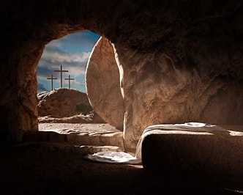
Our Greatest Victory

