Slide 1
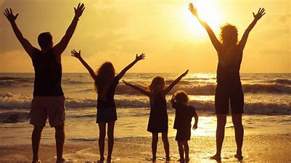
Knowing We Have Received God’s Promises

Slide 2
Ephesians 1:13
¹³ In Him, you also, after listening to the message of truth, the gospel of your salvation—having also believed, you were sealed in Him with the Holy Spirit of the promise,

Slide 3
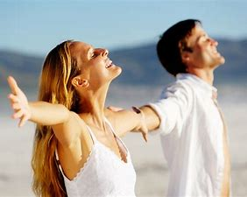
How We Know

Slide 4
We Have the Holy Spirit
2 Corinthians 1:21-22 (NASB)
²¹ Now He who establishes us with you in Christ and anointed us is God, ²² who also sealed us and gave us the Spirit in our hearts as a pledge.

Slide 5
Spirit Dwells in Us
Romans 8:9 (NASB)
⁹ However, you are not in the flesh but in the Spirit, if indeed the Spirit of God dwells in you. But if anyone does not have the Spirit of Christ, he does not belong to Him.

Slide 6
We Are Sealed
Ephesians 4:30 (NASB)
³⁰ Do not grieve the Holy Spirit of God, by whom you were sealed for the day of redemption.

Slide 7
We Are God’s
Jeremiah 32:9-10 (NASB)
⁹ “So, I bought the field which was in Anathoth from Hanamel my uncle’s son, and I weighed out the silver for him, seventeen shekels of silver. ¹⁰ And I signed and sealed the deed, and called in witnesses, and weighed out the silver on the scales.

Slide 8
Cannot Be Taken Away
Romans 8:38-39 (NASB)
³⁸ For I am convinced that neither death, nor life, nor angels, nor principalities, nor things present, nor things to come, nor powers, ³⁹ nor height, nor depth, nor any other created thing will be able to separate us from the love of God that is in Christ Jesus our Lord.

Slide 9
Looking Toward the Promises
Romans 8:23 (NASB)
²³ And not only that, but also, we ourselves, having the first fruits of the Spirit, even we ourselves groan within ourselves, waiting eagerly for our adoption as sons and daughters, the redemption of our body.

Slide 10
God is Not Slow
2 Peter 3:9 (NASB)
⁹ The Lord is not slow about His promise, as some count slowness, but is patient toward you, not willing for any to perish, but for all to come to repentance.

Slide 11
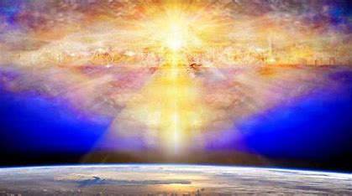
1 Corinthians 15:52
⁵² in a moment, in the twinkling of an eye, at the last trumpet; for the trumpet will sound, and the dead will be raised imperishable, and we will be changed.

