Slide 1
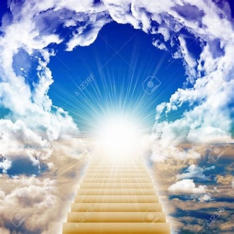
The Grounds of Our Inheritance

Slide 2
Ephesians 1:10-13
¹⁰ regarding His plan of the fullness of the times, to bring all things together in Christ, things in the heavens and things on the earth. ¹¹ In Him we also have obtained an inheritance, having been predestined according to the purpose of Him who works all things in accordance with the plan of His will,

Slide 3
Ephesians 1:10-13
¹² to the end that we who were the first to hope in the Christ would be to the praise of His glory. ¹³ In Him, you also, after listening to the message of truth, the gospel of your salvation—having also believed, you were sealed in Him with the Holy Spirit of the promise,

Slide 4
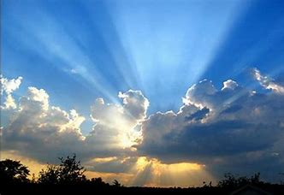
How Do We Obtain the Promises of God?

Slide 5
When We Are Chosen
Ephesians 1:11 (NASB)
¹¹ In Him we also have obtained an inheritance, having been predestined according to the purpose of Him who works all things in accordance with the plan of His will,

Slide 6
When Are We Chosen
Ephesians 1:3 (NASB)
³ Blessed be the God and Father of our Lord Jesus Christ, who has blessed us with every spiritual blessing in the heavenly places in Christ,

Slide 7
When Are We “In Christ”
Romans 6:3 (NASB)
³ Or do you not know that all of us who have been baptized into Christ Jesus have been baptized into His death?

Slide 8
When Are We “In Christ”
Galatians 3:26-27 (NASB)
²⁶ For you are all sons and daughters of God through faith in Christ Jesus. ²⁷ For all of you who were baptized into Christ have clothed yourselves with Christ.

Slide 9
We Are Children of God
1 John 3:1 (NASB)
3 See how great a love the Father has given us, that we would be called children of God; and in fact, we are. For this reason, the world does not know us: because it did not know Him.

Slide 10
Heirs With Christ
Romans 8:17 (NASB)
¹⁷ and if children, heirs also, heirs of God and fellow heirs with Christ, if indeed we suffer with Him so that we may also be glorified with Him.

Slide 11
Who Are Welcome
Genesis 26:4 (NASB)
⁴ I will multiply your descendants as the stars of heaven, and will give your descendants all these lands; and by your descendants all the nations of the earth shall be blessed,

Slide 12
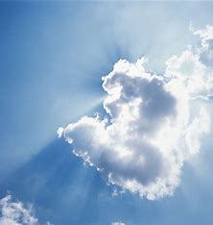
Romans 4:20-21
²¹ and being fully assured that what God had promised, He was able also to perform.

