Slide 1
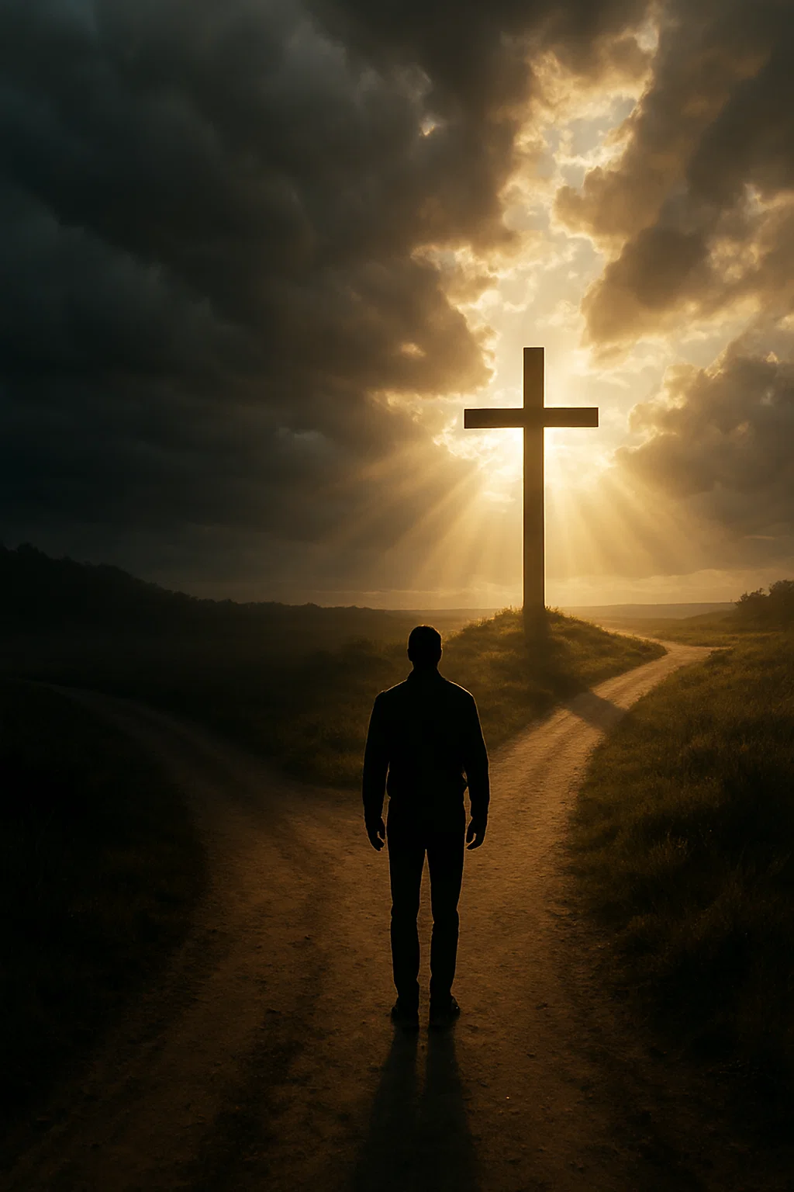
-HERE I AM OR THERE I GO-
Responding to a Present Savior

Slide 2
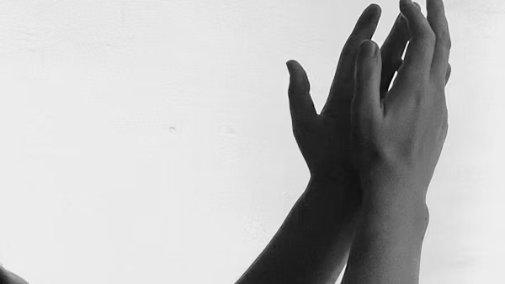
WORSHIP IS WHAT WE WERE CREATE FOR.
Romans 11:36
For from Him and through Him and to Him are all things. To Him be the glory forever. Amen

Slide 3

IF WORSHIP ISN’T AT THE CENTER OF YOUR LIFE, YOU'RE MISSING THE REASON GOD PUT BREATH IN YOUR LUNGS

Slide 4
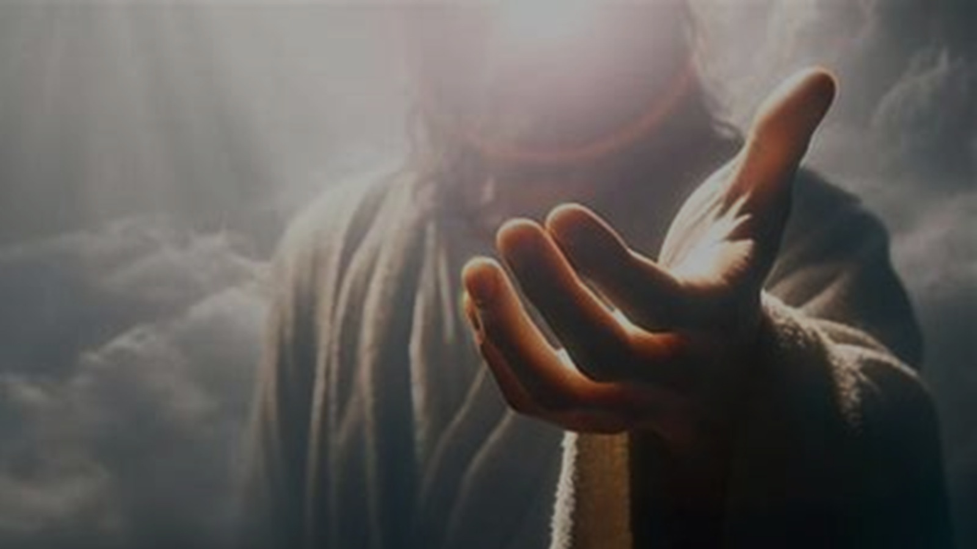
WORSHIP DIDN’T BEGIN WITH US
Philippians 2:7-11
For this reason also God highly exalted Him, and bestowed on Him the name which is above every name

Slide 5

Have you ever been lost in the dark?

Slide 6
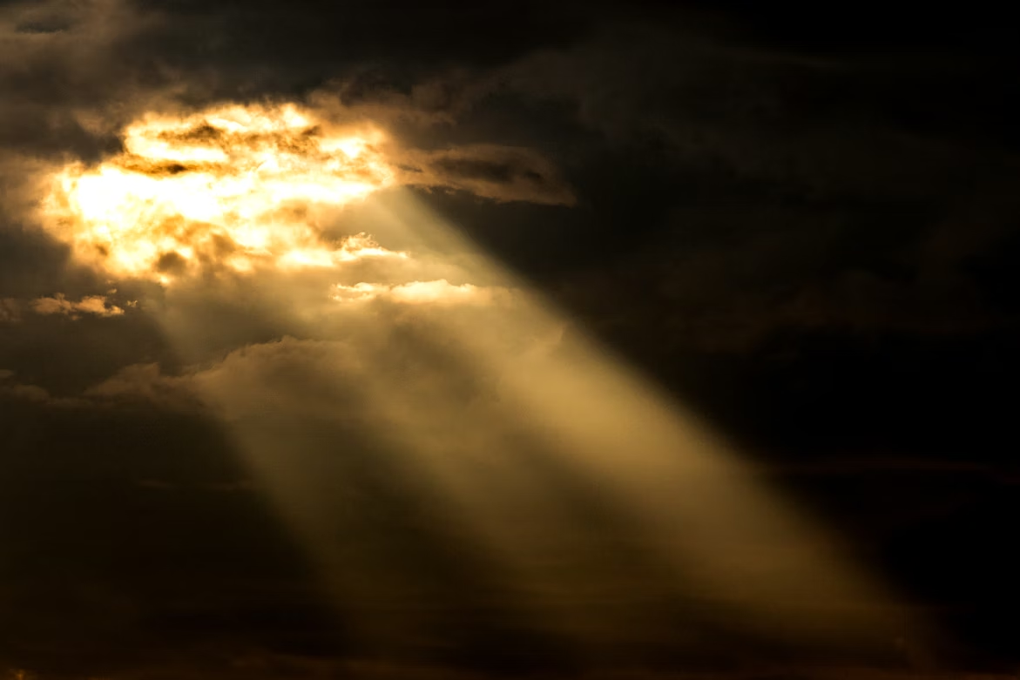

Isaiah 9:2
“The people who walk in darkness will see a great light; those who live in a dark land, the light will shine on them.”
HIS LIGHT REVEALS WHO WE ARE

Slide 7
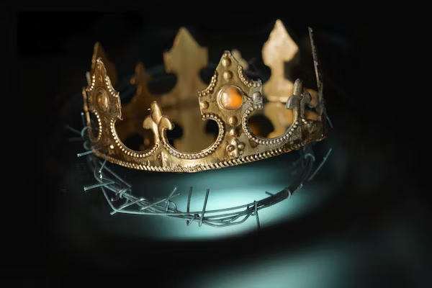
WOSHIP IS A RESPONSE TO THE GLORY HE SET ASIDE.
Philippians 2:6–7
“6 as He already existed in the form of God, did not consider equality with God something to be grasped, 7 but emptied Himself by taking the form of a bond-servant and being born in the likeness of men.

Slide 8
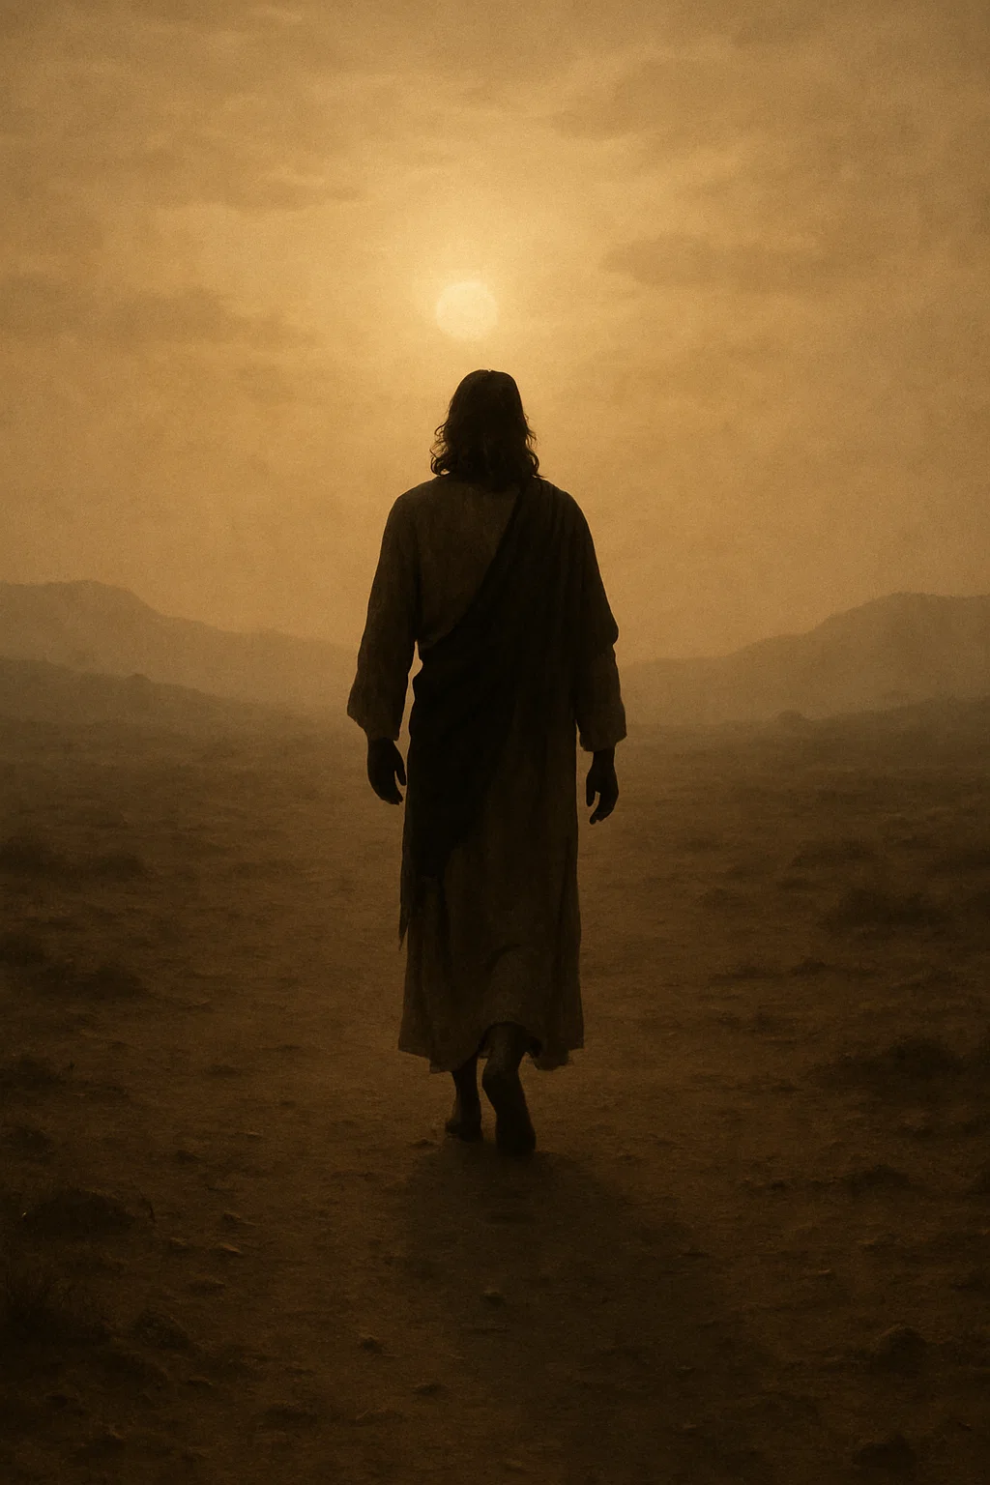
Isaiah 53:3
“He was despised and abandoned by men, A man of great pain and familiar with sickness; And like one from whom people hide their faces, He was despised, and we had no regard for Him.”

Slide 9
TRUE WORSHIP BEGINS WHEN WE GRASP THE REALITY OF HIS HUMILITY AND SACRIFICE

Slide 10

WORSHIP DECLARES THE TRUTH OF WHO GOD ALREADY IS
Philippians 2:10-11
10 so that at the name of Jesus every knee will bow, of those who are in heaven and on earth and under the earth, 11 and that every tongue will confess that Jesus Christ is Lord, to the glory of God the Father.

Slide 11
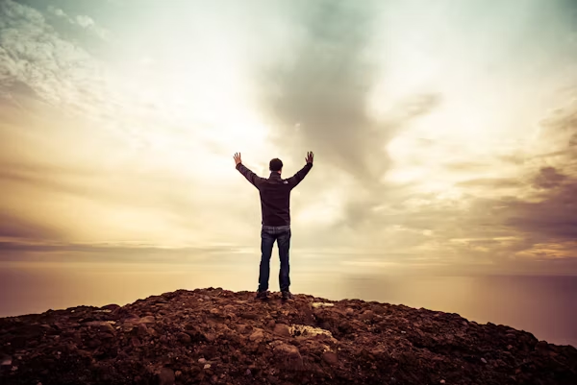
Hebrews 13:15
Through Jesus then, let us continually offer up a sacrifice of praise to God, that is, the fruit of lips praising His name

Slide 12
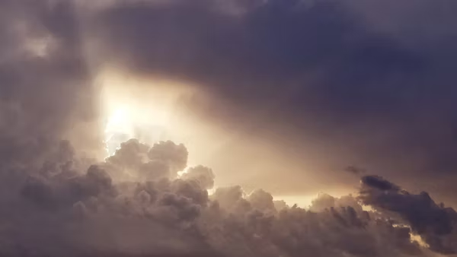
WORSHIP LIFTS OUR EYES FROM WHAT’S WRONG AROUND US TO THE ONE WHO IS STILL RIGHT ABOVE US.
Psalm 34:18
The Lord is near to the brokenhearted and
saves the crushed in spirit

Slide 13
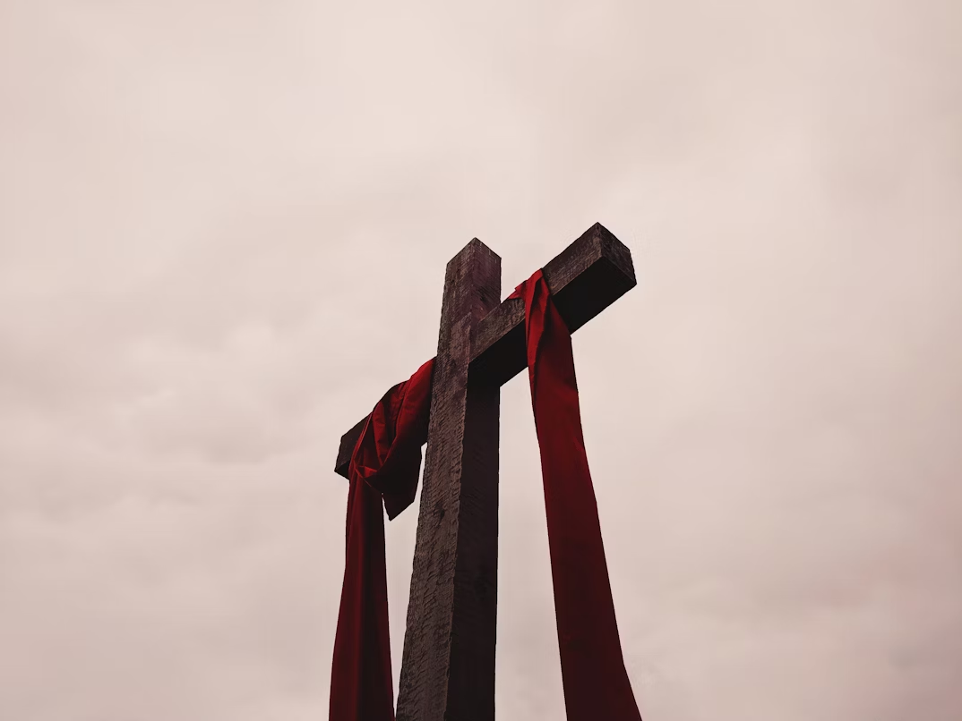
WORSHIP DRAWS US TO REMEMBER
Philippians 2:7-
8 And being found in appearance as a man, He humbled Himself by becoming obedient to the point of death: death on a cross.

Slide 14
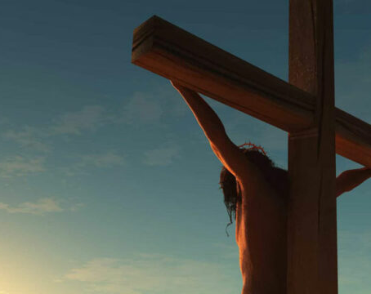
HIS LOVE STRETCHED WIDE WHERE WE FELL SHORT
2 Corinthians 5:21
“God made Him who knew no sin to be sin for us, so that in Him we might become the righteousness of God.”

Slide 15

WORSHIP POINTS TO THE PROMISE
Revelation 21:4
and He will wipe away every tear from their eyes; and there will no longer be any death; there will no longer be any mourning, or crying, or pain; the first things have passed away.”

Slide 16
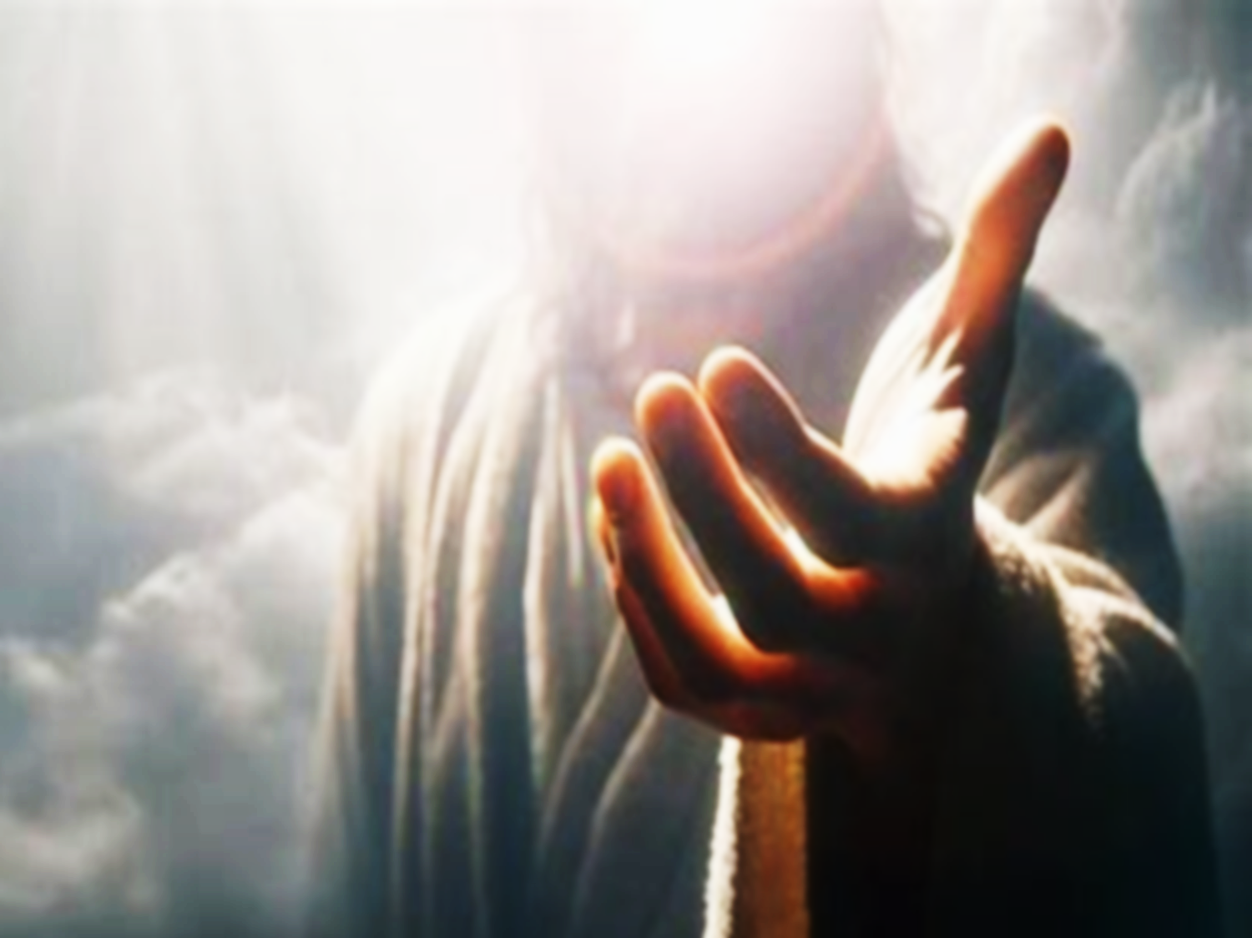
THE ONE WHO PAID THE PRICE, NOW PREPARES THE PLACE

Slide 17
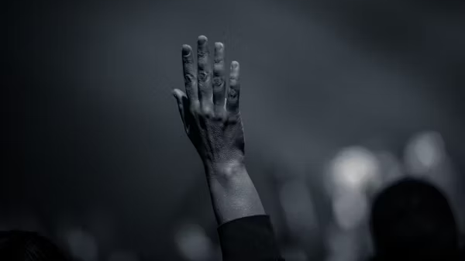
Here I Am or There I Go?

Slide 18

Philippians 2:5
Have this attitude in yourselves which was also in Christ Jesus,
Romans 12:1
“Offer your bodies as a living sacrifice, holy and pleasing to God—this is your true and proper worship.”

Slide 19
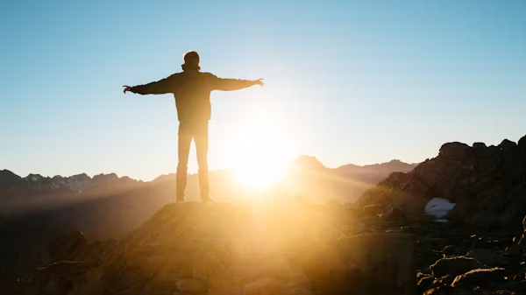

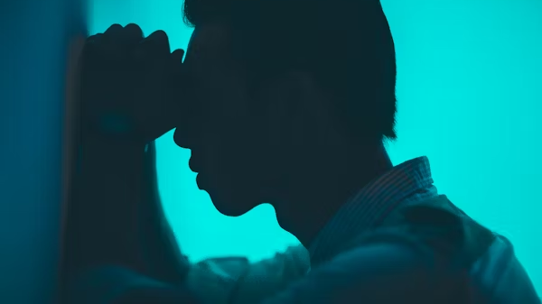
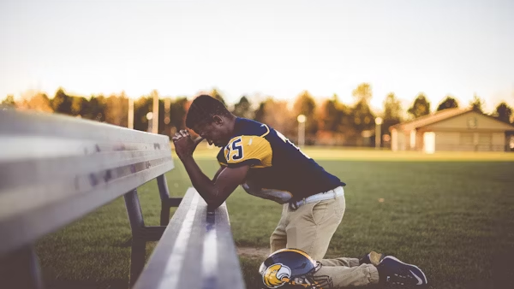
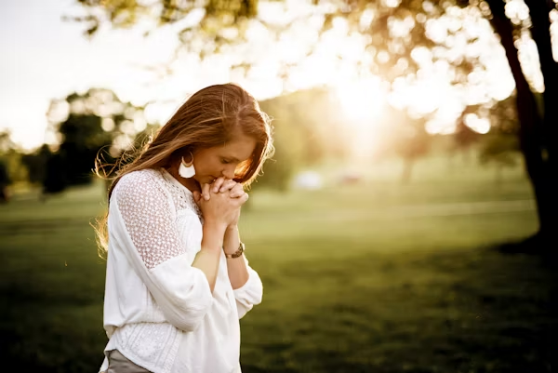
OUR WORSHIP SHOULD POINT OTHERS TO JESUS

Slide 20
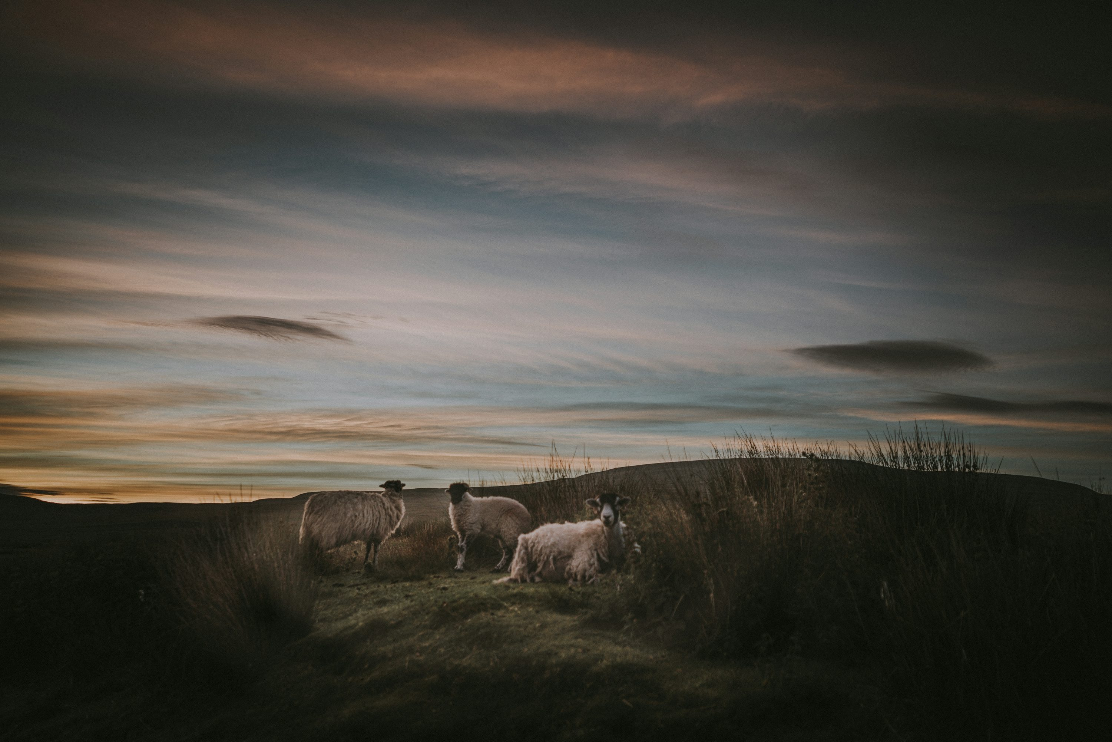
~Psalms 95:6-7~
6 Come, let us worship and bow down, Let us kneel before the Lord our Maker. 7 For He is our God, And we are the people of His pasture and the sheep of His hand.
IF MAN DOESN’T WORSHIP GOD,
HE WILL WORSHIP SOMETHING ELSE.

Slide 21
THE SAVIOR IS PRESENT, ARE YOU?
Romans 14:12
Each of us will give an account of himself to God

