Slide 1

Our Perfect Redeemer

Slide 2
Galatians 3:13
¹³ Christ redeemed us from the curse of the Law, having become a curse for us—for it is written: “Cursed is everyone who hangs on a tree”—

Slide 3
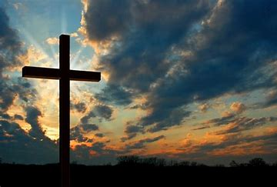
Why Christ is Our Perfect Redeemer

Slide 4
Redeemer Defined
One who frees or delivers another from difficulty, danger, or bondage, usually by the payment of a ransom price.
Galatians 3:13 (NASB) - ¹³ Christ redeemed us from the curse of the Law, having become a curse for us—for it is written: “Cursed is everyone who hangs on a tree”—

Slide 5
Redemption Defined
Deliverance by payment of a price.
In the New Testament, redemption refers to salvation from sin, death, and the wrath of God by Christ’s sacrifice.
1 Peter 1:18-19 (NASB) - ¹⁸ knowing that you were not redeemed with perishable things like silver or gold from your futile way of life inherited from your forefathers, ¹⁹ but with precious blood, as of a lamb unblemished and spotless, the blood of Christ.

Slide 6
Christ Became Flesh
Hebrews 2:17 (NASB)
¹⁷ Therefore, in all things He had to be made like His brothers so that He might become a merciful and faithful high priest in things pertaining to God, to make propitiation for the sins of the people.

Slide 7
Christ Was Tempted
Hebrews 4:15 (NASB)
¹⁵ For we do not have a high priest who cannot sympathize with our weaknesses, but One who has been tempted in all things just as we are, yet without sin.

Slide 8
Christ Overcame Sin
Hebrews 4:15 (NASB)
¹⁵ For we do not have a high priest who cannot sympathize with our weaknesses, but One who has been tempted in all things just as we are, yet without sin.

Slide 9
Christ Was Able
2 Corinthians 5:21 (NASB)
²¹ He made Him who knew no sin to be sin in our behalf, so that we might become the righteousness of God in Him.

Slide 10
Christ Was Willing
John 10:17-18 (NASB)
¹⁷ For this reason the Father loves Me, because I lay down My life so that I may take it back. ¹⁸ No one has taken it away from Me, but I lay it down on My own. I have authority to lay it down, and I have authority to take it back. This commandment I received from My Father.”

Slide 11
John 8:36
³⁶ So if the Son sets you free, you really will be free.

