Slide 1
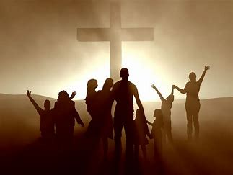
I Am Blessed

Slide 2
Ephesians 1:3
³ Blessed be the God and Father of our Lord Jesus Christ, who has blessed us with every spiritual blessing in the heavenly places in Christ,

Slide 3
Blessings We Receive
New Creature
Forgiveness of Sins
2 Cor. 5:17 - ¹⁷ Therefore if anyone is in Christ, this person is a new creation; the old things passed away; behold, new things have come.
Col. 1:14 - ¹⁴ in whom we have redemption, the forgiveness of sins.

Slide 4
Blessings We Receive
Salvation
Eternal Life
2 Tim. 2:10 - ¹⁰ For this reason I endure all things for the sake of those who are chosen, so that they also may obtain the salvation which is in Christ Jesus and with it eternal glory.
1 John 5:11 - ¹¹ And the testimony is this, that God has given us eternal life, and this life is in His Son.

Slide 5
Blessings We Receive
Every Spiritual Blessing
Ephesians 1:3 (NASB)
³ Blessed be the God and Father of our Lord Jesus Christ, who has blessed us with every spiritual blessing in the heavenly places in Christ,

Slide 6
Two Truths Noted
Ephesians 1:3 (NASB)
³ Blessed be the God and Father of our Lord Jesus Christ, who has blessed us with every spiritual blessing in the heavenly places in Christ,
Blessings Come From God

Slide 7
Two Truths Noted
Ephesians 1:3 (NASB)
³ Blessed be the God and Father of our Lord Jesus Christ, who has blessed us with every spiritual blessing in the heavenly places in Christ,
Only for Those In Christ

Slide 8
How Do We Enter Into Christ?

Slide 9
We Must Believe
Acts 16:30-31 (NASB)
³⁰ and after he brought them out, he said, “Sirs, what must I do to be saved?” ³¹ They said, “Believe in the Lord Jesus, and you will be saved, you and your household.”

Slide 10
We Must Repent
Luke 13:3 (NASB)
³ No, I tell you, but unless you repent, you will all likewise perish.

Slide 11
Must Be Baptized
1 Peter 3:21(NASB)
²¹ Corresponding to that, baptism now saves you—not the removal of dirt from the flesh, but an appeal to God for a good conscience—through the resurrection of Jesus Christ,

Slide 12
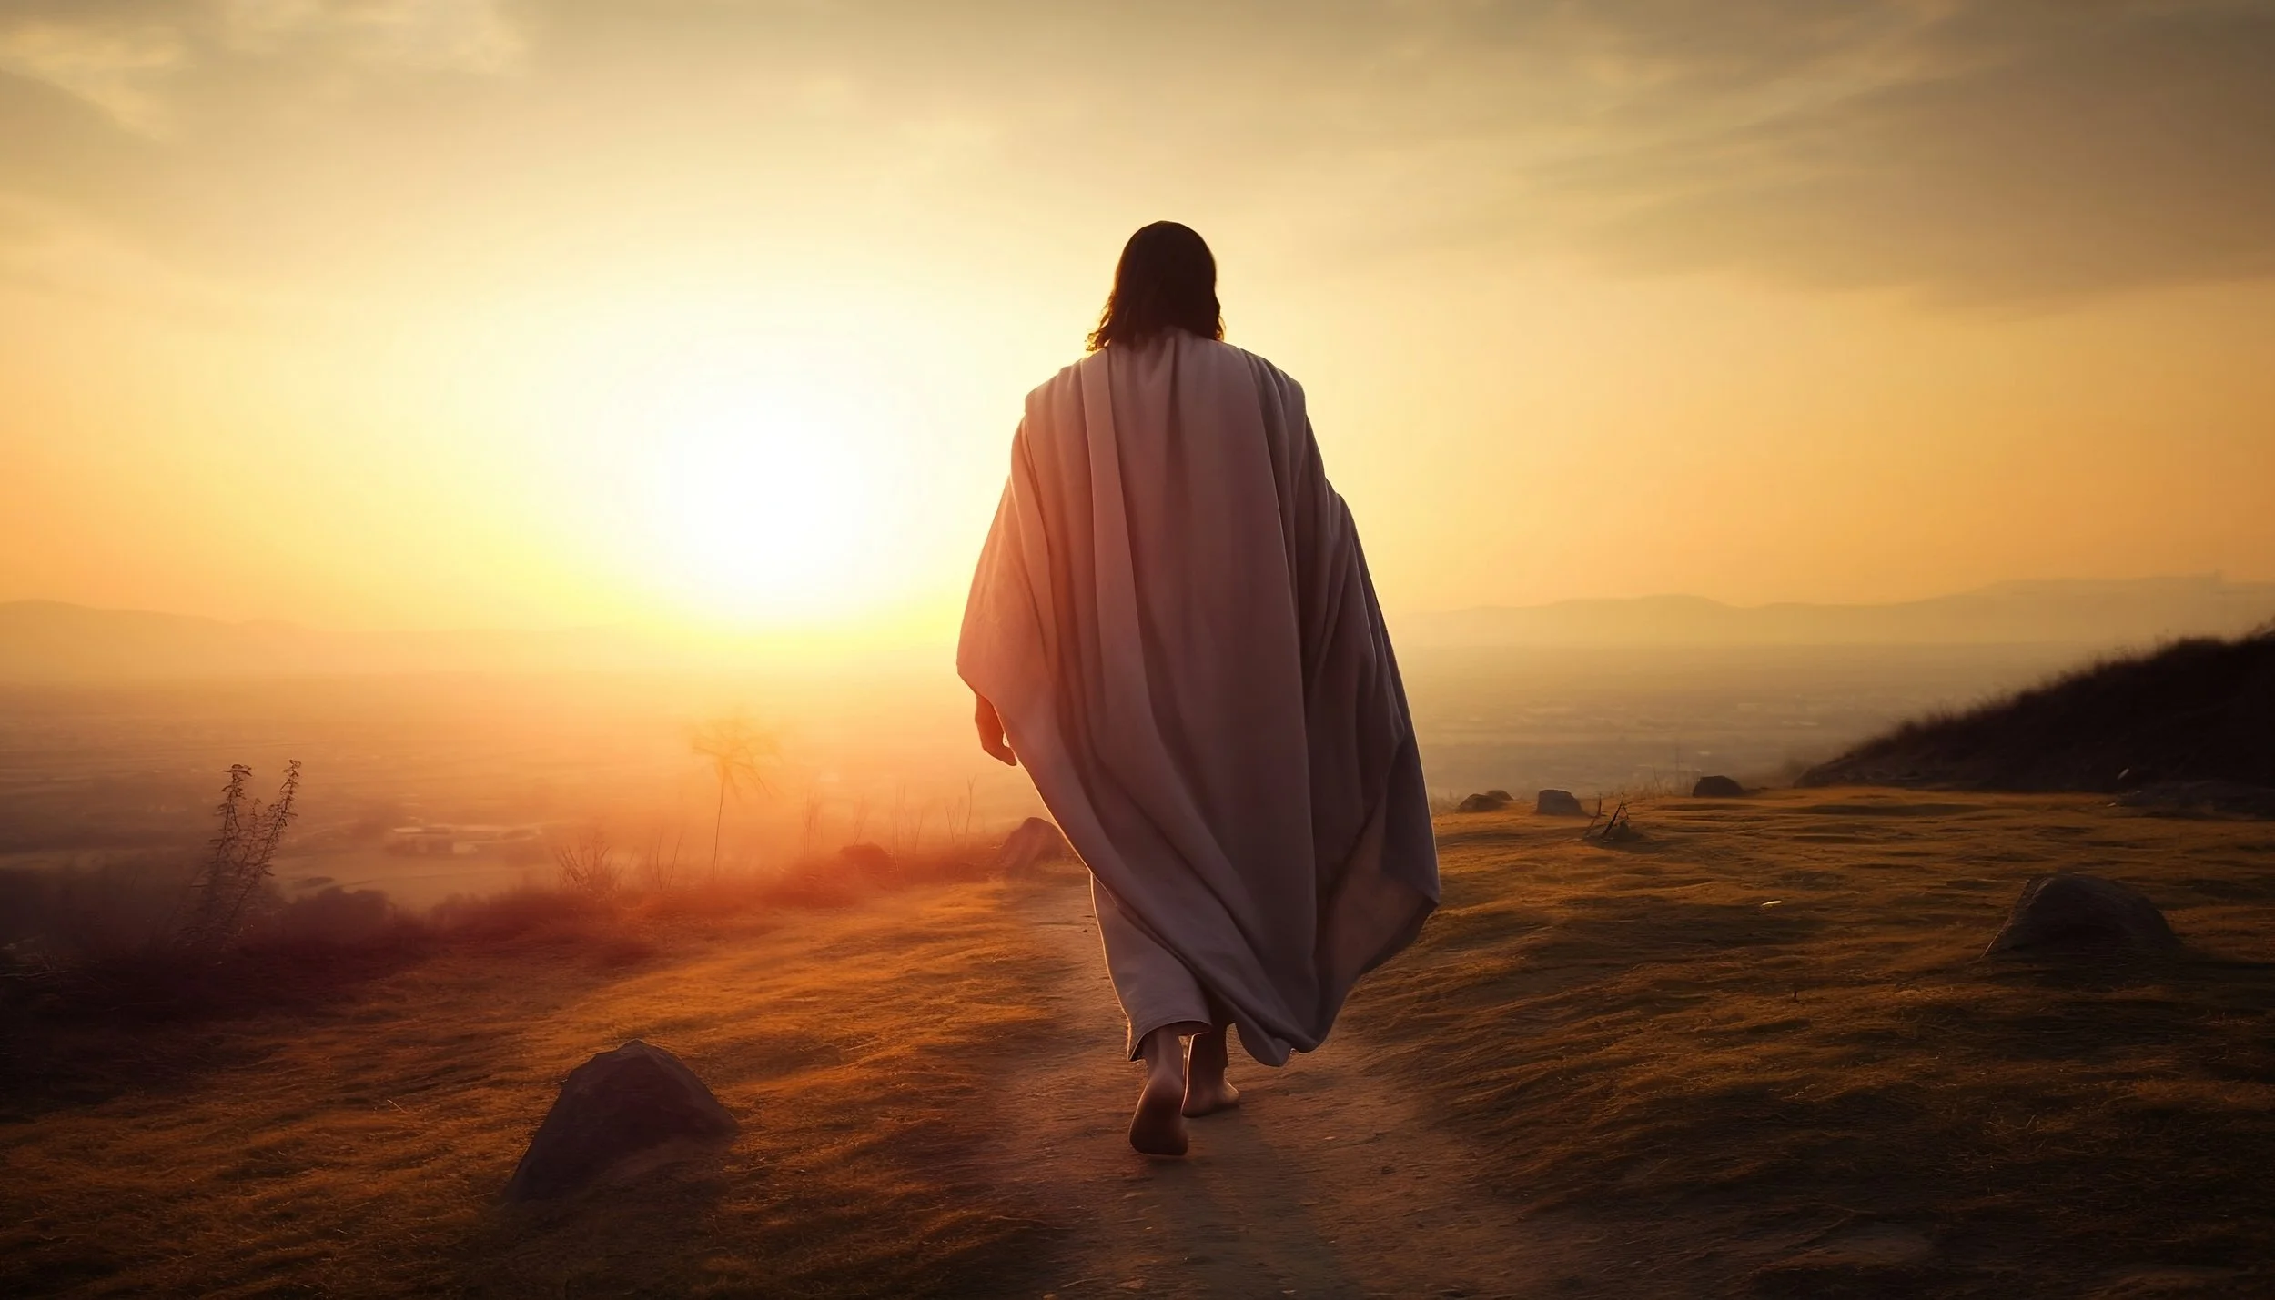
I Am In Christ
And Christ In Me

