Slide 1

Increase Our Faith

Slide 2
Luke 17:5-6
⁵ The apostles said to the Lord, “Increase our faith!” ⁶ But the Lord said, “If you had faith the size of a mustard seed, you could say to this mulberry tree, ‘Be uprooted and be planted in the sea’; and it would obey you.

Slide 3
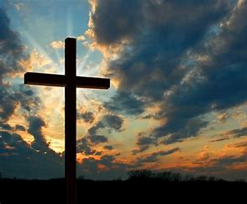

How Can We Increase Our Faith

Slide 4
Faith Defined
Hebrews 11:1 (NASB)
11 Now faith is the certainty of things hoped for, a proof of things not seen.

Slide 5
Requirement for Faith
Hebrews 11:6 (NASB)
⁶ And without faith it is impossible to please Him, for the one who comes to God must believe that He exists, and that He proves to be One who rewards those who seek Him.

Slide 6
Requirement for Action
Matthew 7:21 (NASB)
²¹ “Not everyone who says to Me, ‘Lord, Lord,’ will enter the kingdom of heaven, but the one who does the will of My Father who is in heaven will enter.

Slide 7
Hear God’s Word
Romans 10:17 (NASB)
¹⁷ So faith comes from hearing and hearing by the word of Christ.

Slide 8
Come to Worship
Hebrews 10:25 (NASB)
²⁵ not abandoning our own meeting together, as is the habit of some people, but encouraging one another; and all the more as you see the day drawing near.

Slide 9
Fellowship With Believers
2 Corinthians 6:14 (NASB)
¹⁴ Do not be mismatched with unbelievers; for what do righteousness and lawlessness share together, or what does light have in common with darkness?

Slide 10
Open Your Eyes
Mark 8:18 (NASB)
¹⁸ Having eyes, do you not see? And having ears, do you not hear? And do you not remember,

Slide 11
Focus on Good
Romans 8:28 (NASB)
²⁸ And we know that God causes all things to work together for good to those who love God, to those who are called according to His purpose.

Slide 12

Help My Unbelief

