Slide 1
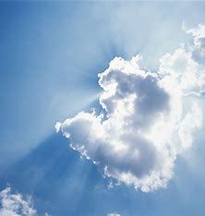
Mysteries of God

Slide 2
Romans 16:25-27
²⁵ Now to Him who is able to establish you according to my gospel and the preaching of Jesus Christ, according to the revelation of the mystery which has been kept secret for long ages past,

Slide 3
Romans 16:25-27
²⁶ but now has been disclosed, and through the Scriptures of the prophets, in accordance with the commandment of the eternal God, has been made known to all the nations, leading to obedience of faith; ²⁷ to the only wise God, through Jesus Christ, be the glory forever. Amen.

Slide 4
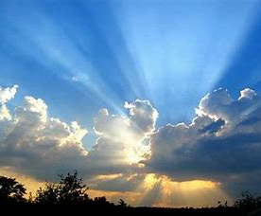

What Are the Mysteries of God?

Slide 5
Man’s Fall
Genesis 3:11 (NASB)
¹¹ And He said, “Who told you that you were naked? Have you eaten from the tree from which I commanded you not to eat?”

Slide 6
Plan of Redemption
Genesis 3:15 (NASB)
¹⁵ And I will make enemies Of you and the woman, And of your offspring and her Descendant; He shall bruise you on the head, And you shall bruise Him on the heel.”

Slide 7
Christ Coming
Colossians 2:2 (NASB)
² that their hearts may be encouraged, having been knit together in love, and that they would attain to all the wealth that comes from the full assurance of understanding, resulting in a true knowledge of God’s mystery, that is, Christ Himself,

Slide 8
Israel’s Unbelief
Romans 11:25 (NASB)
²⁵ For I do not want you, brothers and sisters, to be uninformed of this mystery—so that you will not be wise in your own estimation—that a partial hardening has happened to Israel until the fullness of the Gentiles has come in;

Slide 9
Indwelling Spirit
Colossians 1:26-27 (NASB)
²⁶ that is, the mystery which had been hidden from the past ages and generations, but now has been revealed to His saints, ²⁷ to whom God willed to make known what the wealth of the glory of this mystery among the Gentiles is, the mystery that is Christ in you, the hope of glory.

Slide 10
The Church
Ephesians 5:29-32 (NASB)
²⁹ for no one ever hated his own flesh, but nourishes and cherishes it, just as Christ also does the church,… ³² This mystery is great; but I am speaking with reference to Christ and the church.

Slide 11
Eternal Life
1 Corinthians 15:51-52 (NASB)
⁵¹ Behold, I am telling you a mystery; we will not all sleep, but we will all be changed, ⁵² in a moment, in the twinkling of an eye, at the last trumpet; for the trumpet will sound, and the dead will be raised imperishable, and we will be changed.

Slide 12
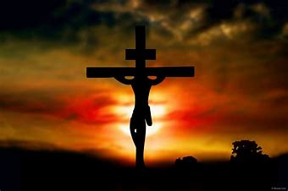
Romans 16:25-26
²⁵ …according to the revelation of the mystery which has been kept secret for long ages past, ²⁶ but now has been disclosed, and through the Scriptures of the prophets, in accordance with the commandment of the eternal God,…

