Slide 1
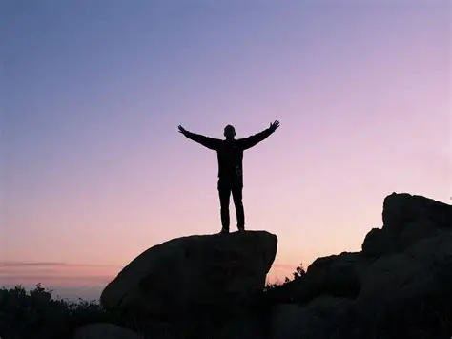
Standing Firm on the Rock

Slide 2
Matthew 16:15-18
¹⁵ He *said to them, “But who do you yourselves say that I am?” ¹⁶ Simon Peter answered, “You are the Christ, the Son of the living God.” ¹⁷ And Jesus said to him, “Blessed are you, Simon Barjona, because flesh and blood did not reveal this to you, but My Father who is in heaven.

Slide 3
Matthew 16:15-18
¹⁸ And I also say to you that you are Peter, and upon this rock I will build My church; and the gates of Hades will not overpower it.

Slide 4
Ways to Stand Firm

Slide 5
Paul’s Exhortation
1 Corinthians 16:13 (NASB)
¹³ Be on the alert, stand firm in the faith, act like men, be strong.

Slide 6
Be On Alert
2 Peter 2:1-2 (NASB)
2 But false prophets also appeared among the people, just as there will also be false teachers among you, who will secretly introduce destructive heresies, even denying the Master who bought them, bringing swift destruction upon themselves. ² Many will follow their indecent behavior, and because of them the way of the truth will be maligned;

Slide 7
Be On Alert
Hebrews 2:1(NASB)
2 For this reason we must pay much closer attention to what we have heard, so that we do not drift away from it.

Slide 8
Stand Firm
2 Thessalonians 2:15 (NASB)
¹⁵ So then, brothers and sisters, stand firm and hold on to the traditions which you were taught, whether by word of mouth or by letter from us.

Slide 9
Act Like Men
Ephesians 6:13 (NASB)
¹³ Therefore, take up the full armor of God, so that you will be able to resist on the evil day, and having done everything, to stand firm.

Slide 10
Be Strong
Joshua 1:9 (NASB)
⁹ Have I not commanded you? Be strong and courageous! Do not be terrified nor dismayed, for the Lord your God is with you wherever you go.”

Slide 11
The One Who Overcomes
Revelation 2:7 (NASB)
⁷ The one who has an ear, let him hear what the Spirit says to the churches. To the one who overcomes, I will grant to eat from the tree of life, which is in the Paradise of God.’

Slide 12
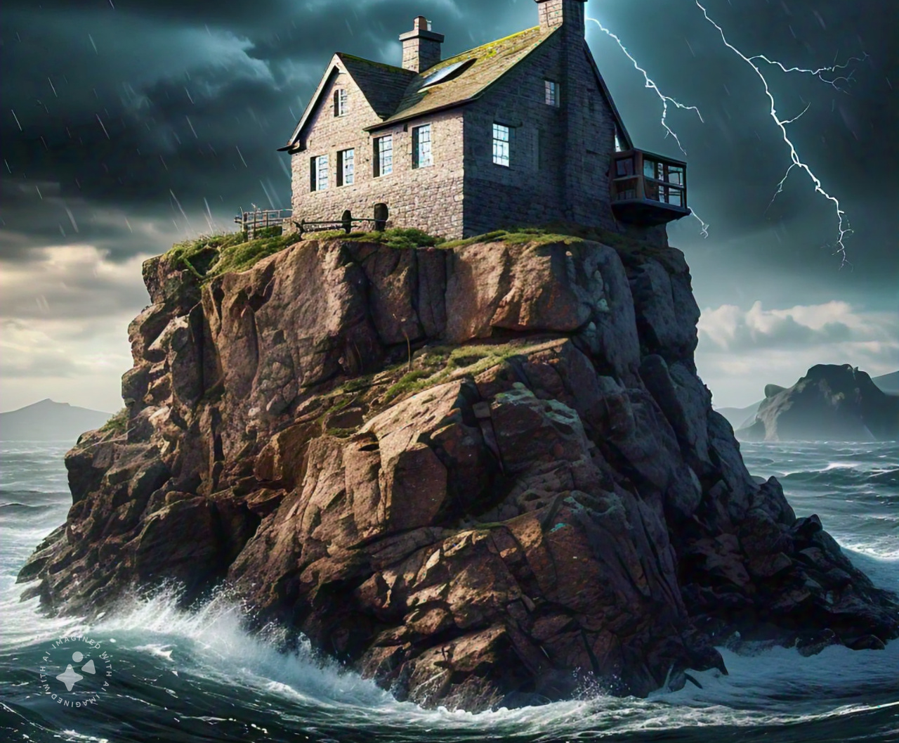

²⁴ “Therefore, everyone who hears these words of Mine, and acts on them, will be like a wise man who built his house on the rock.

