Slide 1
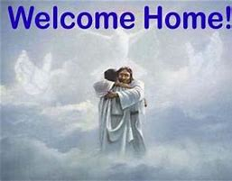
Our Heavenly Body

Slide 2
1 Corinthians 15:35
³⁵ But someone will say, “How are the dead raised? And with what kind of body do they come?”

Slide 3
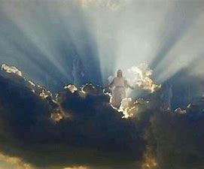
Our Heavenly Body

Slide 4
Order of Resurrection
1 Thessalonians 4:16-17 (NASB)
¹⁶ For the Lord Himself will descend from heaven with a shout, with the voice of the archangel and with the trumpet of God, and the dead in Christ will rise first. ¹⁷ Then we who are alive, who remain, will be caught up together with them in the clouds to meet the Lord in the air, and so we will always be with the Lord.

Slide 5
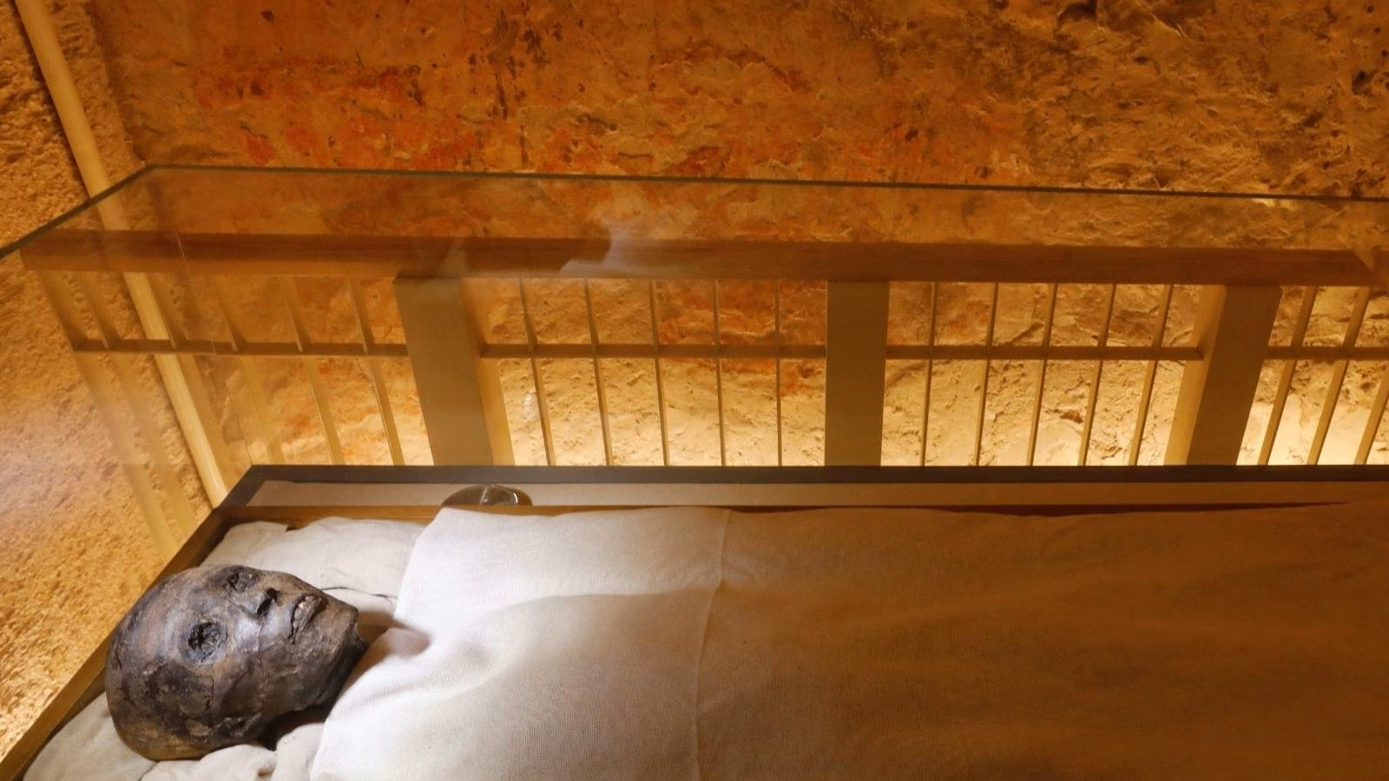
Misconceptions

Slide 6
Will Not Be Physical
Matthew 22:29 (NASB)
²⁹ But Jesus answered and said to them, “You are mistaken, since you do not understand the Scriptures nor the power of God.

Slide 7
Will Not Be Physical
Revelation 21:4 (NASB)
⁴ and He will wipe away every tear from their eyes; and there will no longer be any death; there will no longer be any mourning, or crying, or pain; the first things have passed away.”

Slide 8
We Will Be Changed
1 Corinthians 15:51-52 (NASB)
⁵¹ Behold, I am telling you a mystery; we will not all sleep, but we will all be changed, ⁵² in a moment, in the twinkling of an eye, at the last trumpet; for the trumpet will sound, and the dead will be raised imperishable, and we will be changed.

Slide 9
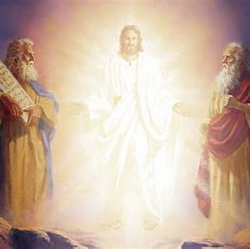
We Will Know Each Other
Matthew 17:2-3 (NASB)
² And He was transfigured before them; and His face shone like the sun, and His garments became as white as light. ³ And behold, Moses and Elijah appeared to them, talking with Him.

Slide 10
We Will Remember
Only Good
Matthew 25:40 (NASB)
⁴⁰ And the King will answer and say to them, ‘Truly I say to you, to the extent that you did it for one of the least of these brothers or sisters of Mine, you did it for Me.’

Slide 11
We Will Remember
Only Good
Matthew 22:29 (NASB)
²⁹ But Jesus answered and said to them, “You are mistaken, since you do not understand the Scriptures nor the power of God.

Slide 12
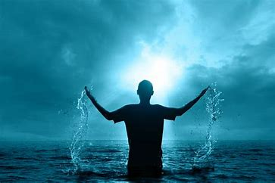
We Are Changed
Today
To Walk in the
Newness of Life

