Slide 1
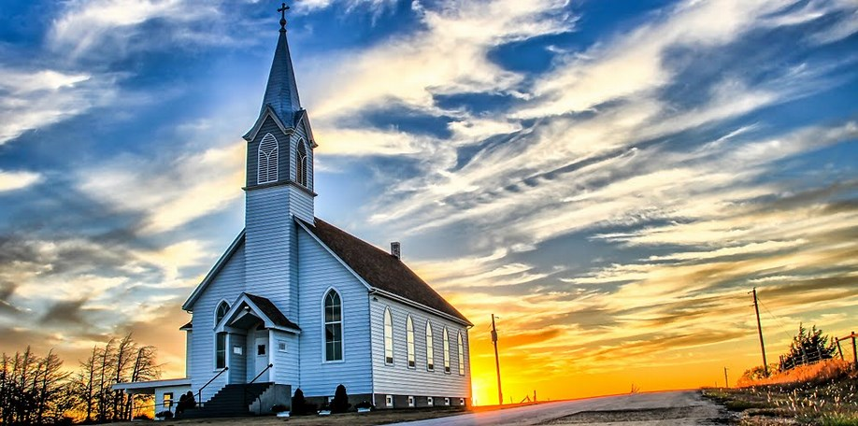
That Which is Perfect

Slide 2
1 Corinthians 13:8-10
⁸ Love never fails; but if there are gifts of prophecy, they will be done away with; if there are tongues, they will cease; if there is knowledge, it will be done away with. ⁹ For we know in part and prophesy in part; ¹⁰ but when the perfect comes, the partial will be done away with.

Slide 3
What is Perfect?

Slide 4
Jesus Christ
John 6:38 (NASB)
³⁸ For I have come down from heaven, not to do My own will, but the will of Him who sent Me.

Slide 5
Jesus Christ
2 Corinthians 5:21(NASB)
²¹ He made Him who knew no sin to be sin in our behalf, so that we might become the righteousness of God in Him.

Slide 6
The Word
2 Timothy 3:16 (NASB)
¹⁶ All Scripture is inspired by God and beneficial for teaching, for rebuke, for correction, for training in righteousness;

Slide 7
The Church
Ephesians 5:25-27 (NASB)
²⁷ that He might present to Himself the church in all her glory, having no spot or wrinkle or any such thing; but that she would be holy and blameless.

Slide 8
Kingdom of Heaven
Revelation 21:1-4 (NASB)
21 Then I saw a new heaven and a new earth; for the first heaven and the first earth passed away, and there is no longer any sea. ² And I saw the holy city, new Jerusalem, coming down out of heaven from God, prepared as a bride adorned for her husband.

Slide 9
Kingdom of Heaven
³ And I heard a loud voice from the throne, saying, “Behold, the tabernacle of God is among the people, and He will dwell among them, and they shall be His people, and God Himself will be among them, ⁴ and He will wipe away every tear from their eyes; and there will no longer be any death; there will no longer be any mourning, or crying, or pain; the first things have passed away.”

Slide 10
We Can Be
Romans 3:23 (NASB)
²³ for all have sinned and fall short of the glory of God,

Slide 11
We Can Be
1 Corinthians 6:11(NASB)
¹¹ Such were some of you; but you were washed, but you were sanctified, but you were justified in the name of the Lord Jesus Christ and in the Spirit of our God.

Slide 12
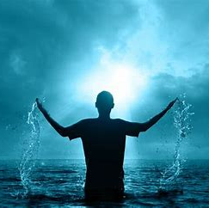
Revelation 21:7
⁷ The one who overcomes will inherit these things, and I will be his God, and he will be My son.

